Slide 1
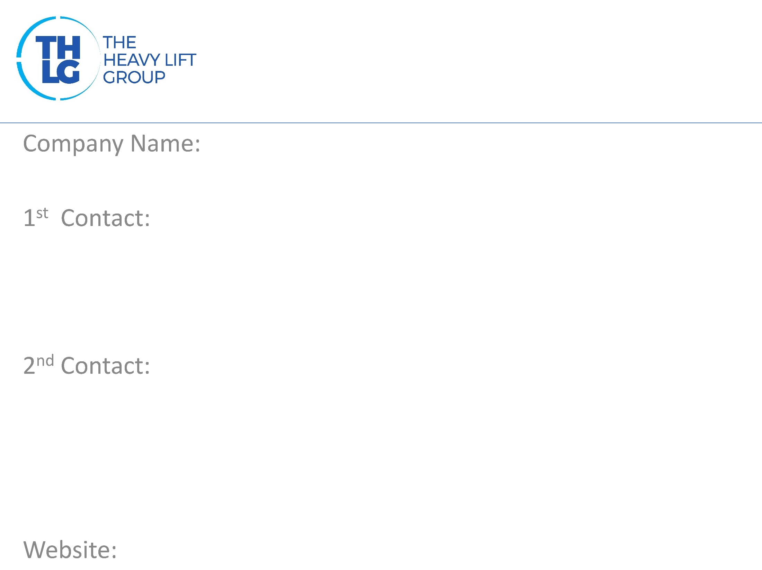
ALGERIA/MOROCCO THLG member since 2011
IPSEN LOGISTICS
Mr. Eduard Dubbers-Albrecht / Managing Director T: +49 421 3034 341 M:+49 172 421 76 80 e.dubbers-albrecht@ipsenlogistics.com
Mr. Mourad Meghdas / ALGERIA T: +213 21 54 36 20 m.meghdas@ipsenlogistics.com Mr. Fouad Rahmani / MOROCCO T: + 212 522 66 67 70 f.rahmani@ipsenlogistics.com
www.ipsenlogistics.com

Slide 2
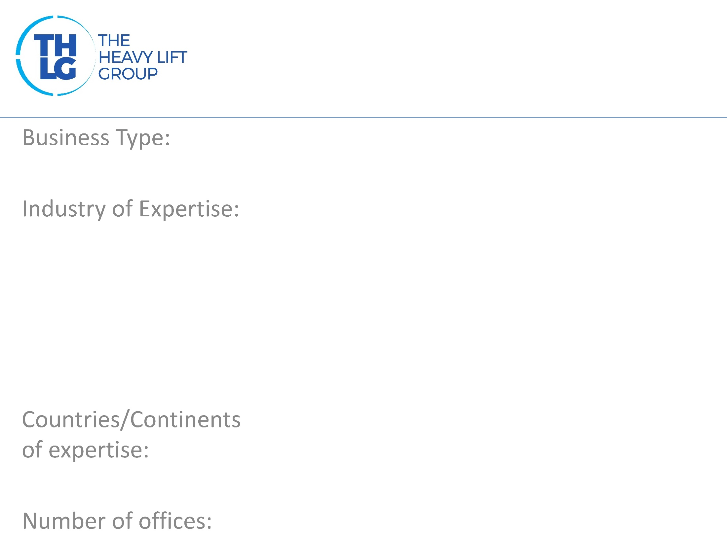
ALGERIA/MOROCCO THLG member since 2011
Freight Forwarders
Hydro, Thermo, Wind Mining Machinery Oil & Gas Chemical & Petrochemical Industrial Projects Cement Plants High & Heavy Utility Vehicles
Maghreb, Latin-America, Europe, Asia
4 – Algeria, 2 – Morocco

Slide 3
ALGERIA/MOROCCO THLG member since 2011

Slide 4
ALGERIA/MOROCCO THLG member since 2011
Transports via land, sea and/or air ex factory to the project destination
Heavy-Lift shipments, special cargoes,
OOG, Ro/Ro and building site equipment
Domestic transport of unpacked machines,
with seaworthy packing and stowage
Consulting and Planning
Development of individual logistics concepts
Documentation and customs clearance with comprehensive prior advice
Road Survey
Information Management
Liner Service or Charter Vessel
Interim Storage

Slide 5
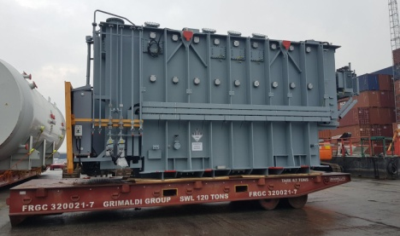
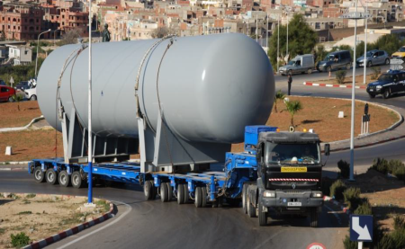
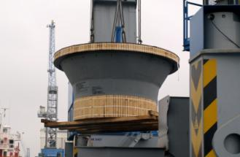
ALGERIA/MOROCCO THLG member since 2011
Transformer Morocco
Transformer Algeria
Cement Plant Indonesia
Join us on social media
Participation in other Groups:

