Slide 1
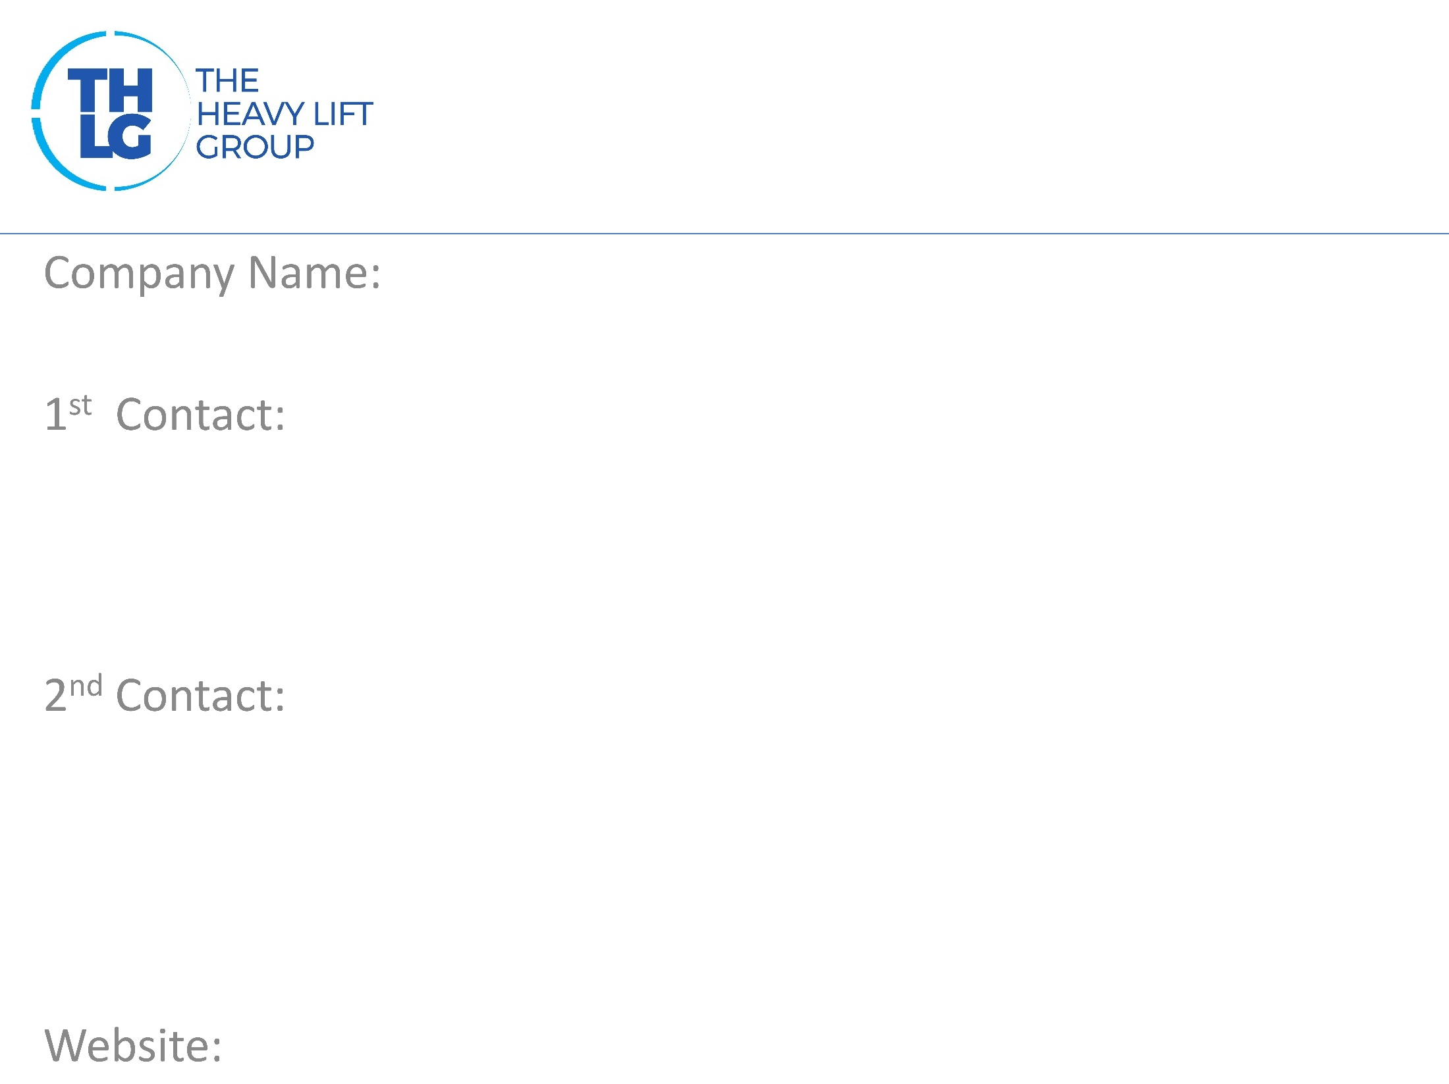
BELGIUM THLG member since 2002
ADM Team Heavy Weight BVBA
Mr. Eric Hufkens / CEO T: +32 14 / 85 20 00 M:+32 492 / 27 36 99 eric.hufkens@thw-adm.be
Mr. Kris Hufkens / Project Coordinator T: +32 14 / 85 20 00 M:+32 492 / 27 36 40 kris.hufkens@thw-adm.com
www.thw-adm.com

Slide 2
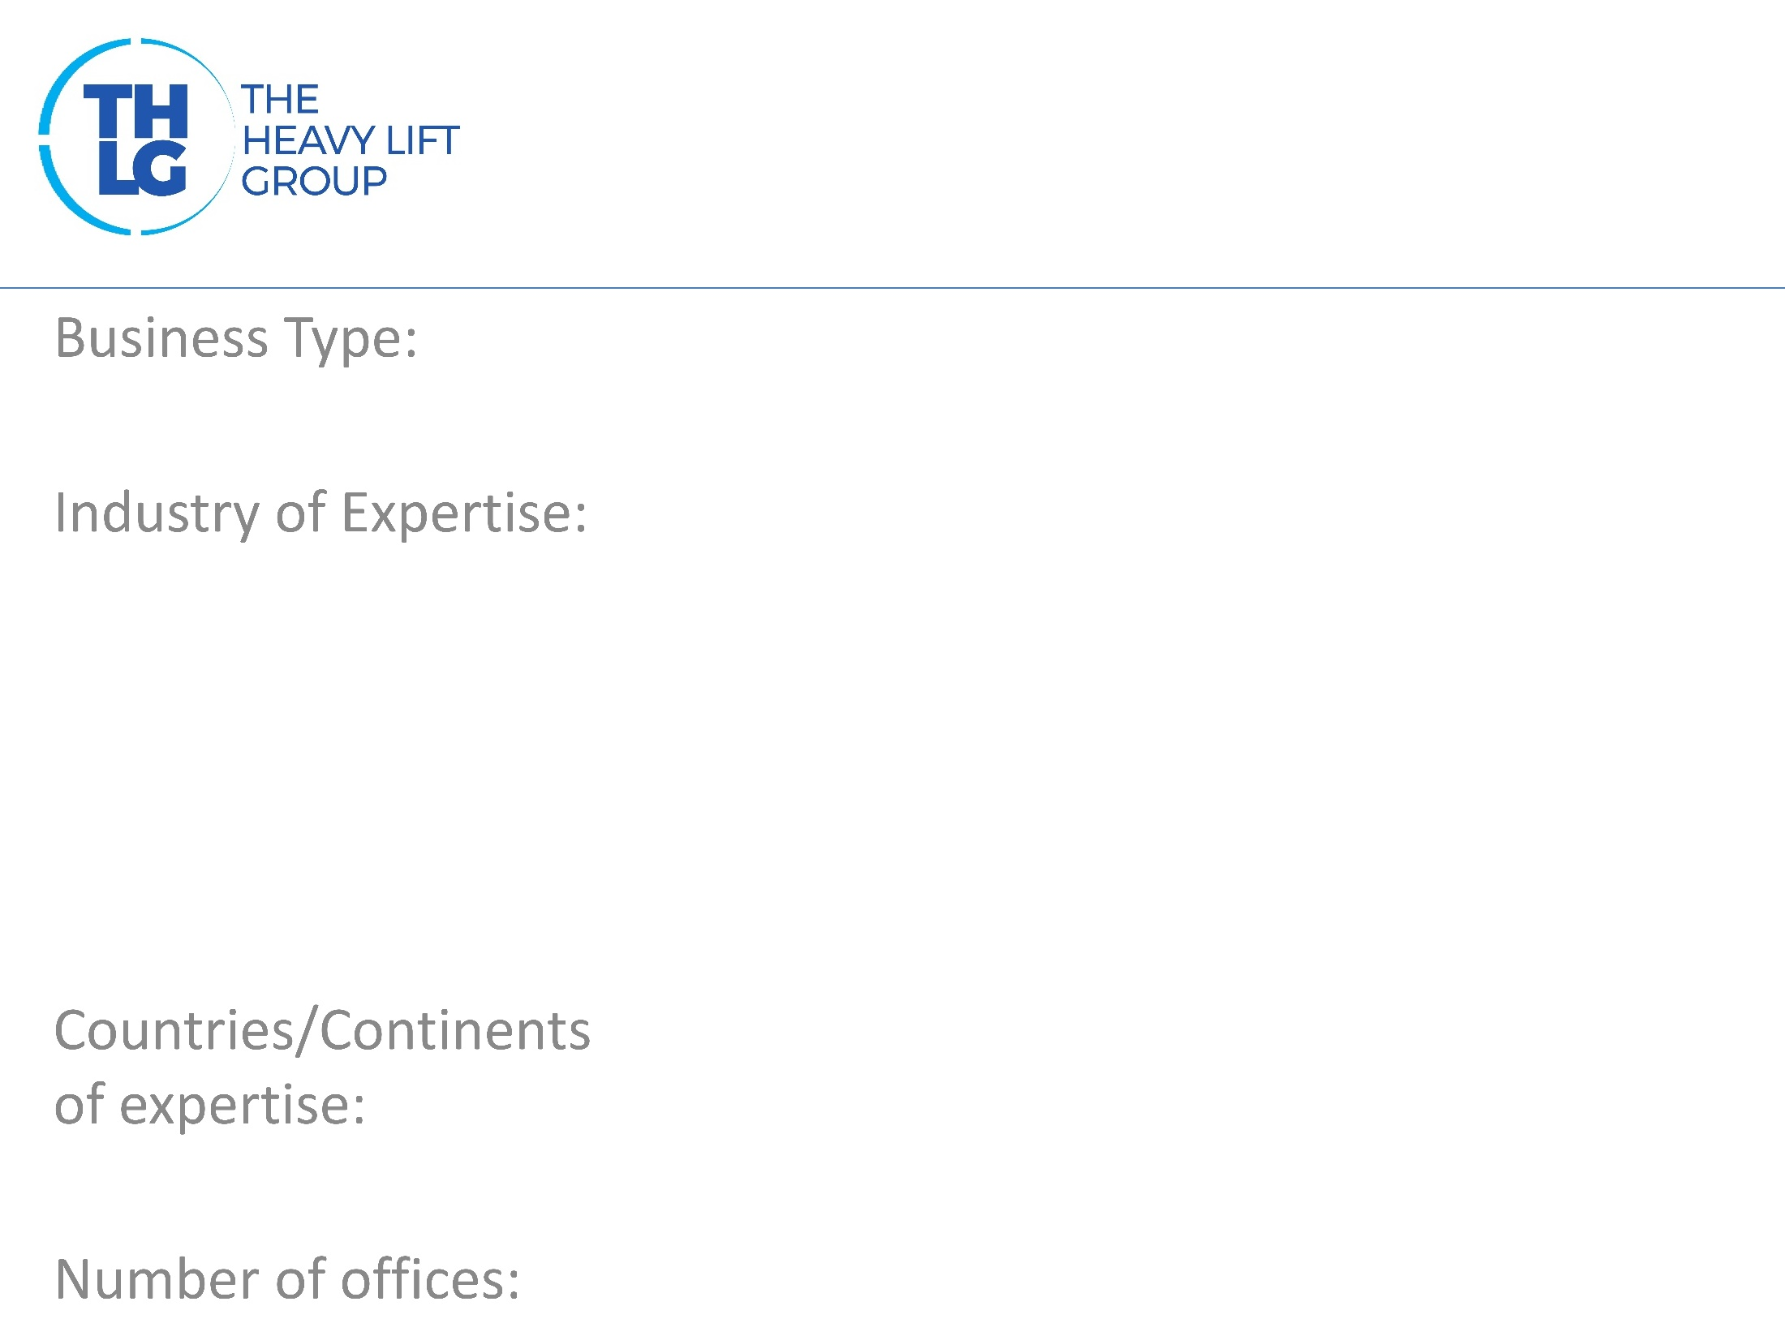
BELGIUM THLG member since 2002
Transport company / storage facility
Power (Transformers, Wind-energy, …) Mining Military Equipment Machinery Petrochemical
Belgium, Netherlands, France, Germany, UK, Spain, Portugal, Swiss, Austria, Denmark, Poland, Norway, Sweden, Slovenia,…
2 (BE-Westerlo & DE-Nürnberg)

Slide 3
BELGIUM THLG member since 2002

Slide 4
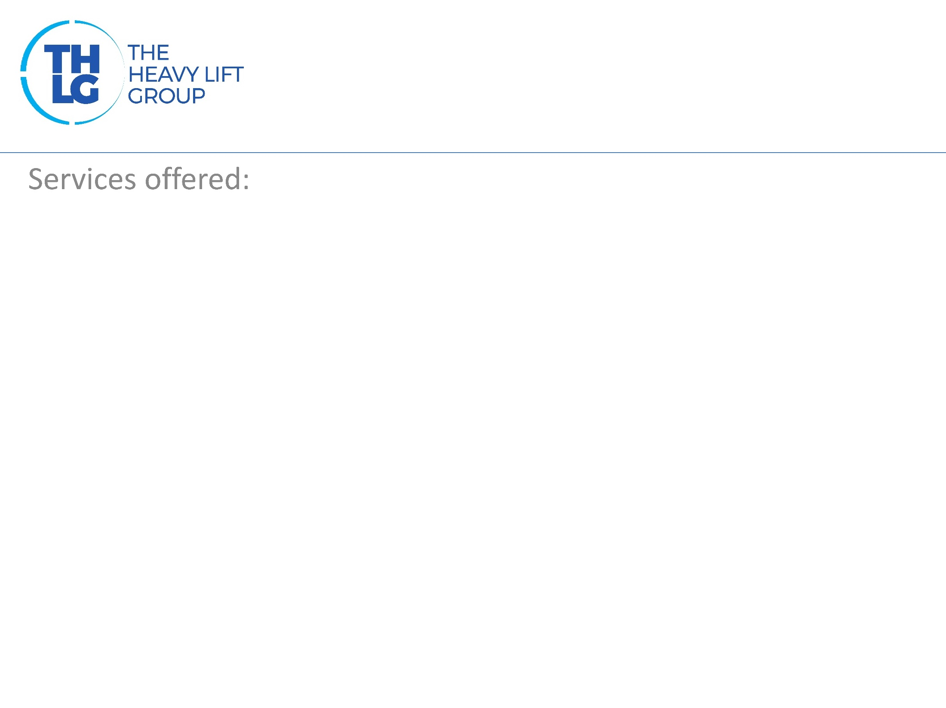
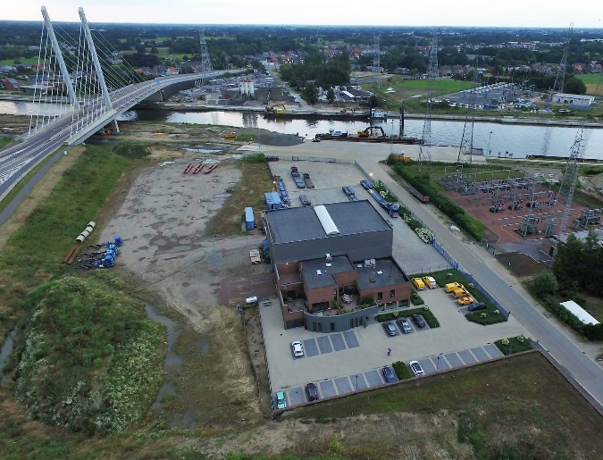
BELGIUM THLG member since 2002
National road transport International road transport Combined transports (road/water/rail) Permits for heavy transports Pilot cars International project logistics Custom-formalities Storing & transloading heavy cargo’s

Slide 5
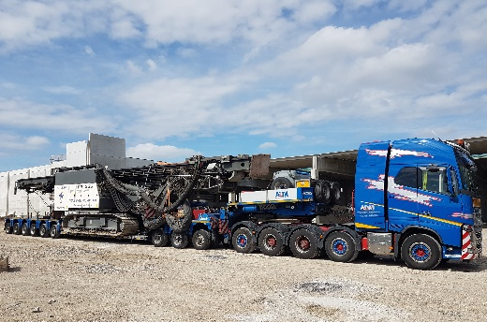
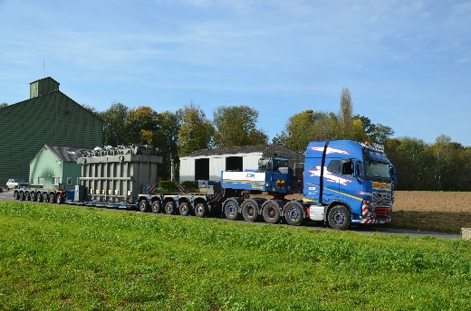
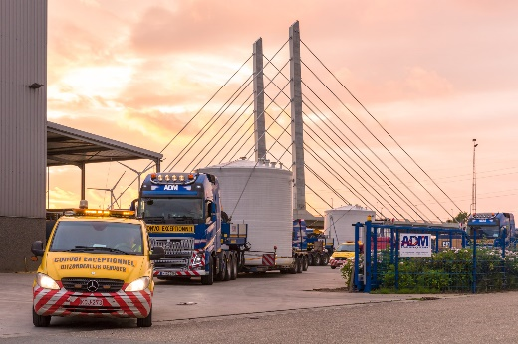
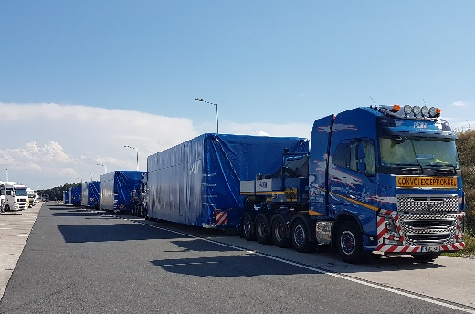
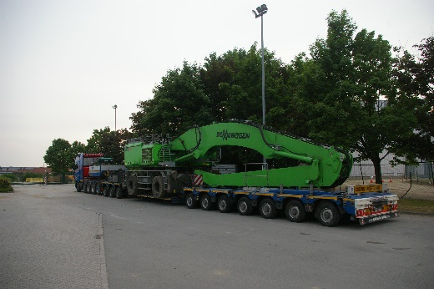
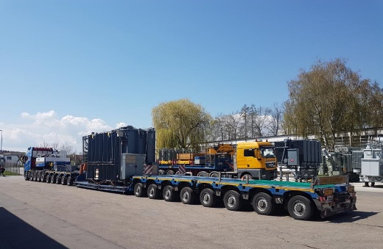
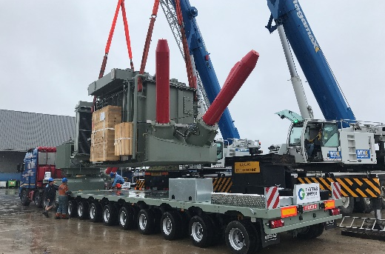
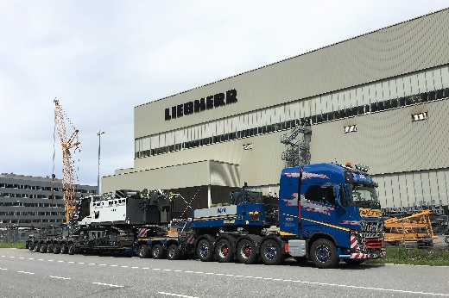
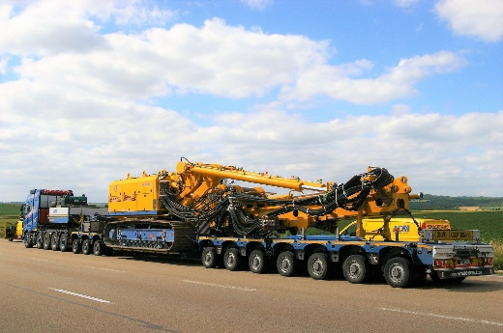
BELGIUM THLG member since 2002
Participation in other Groups:
Join us on social media

