Slide 1
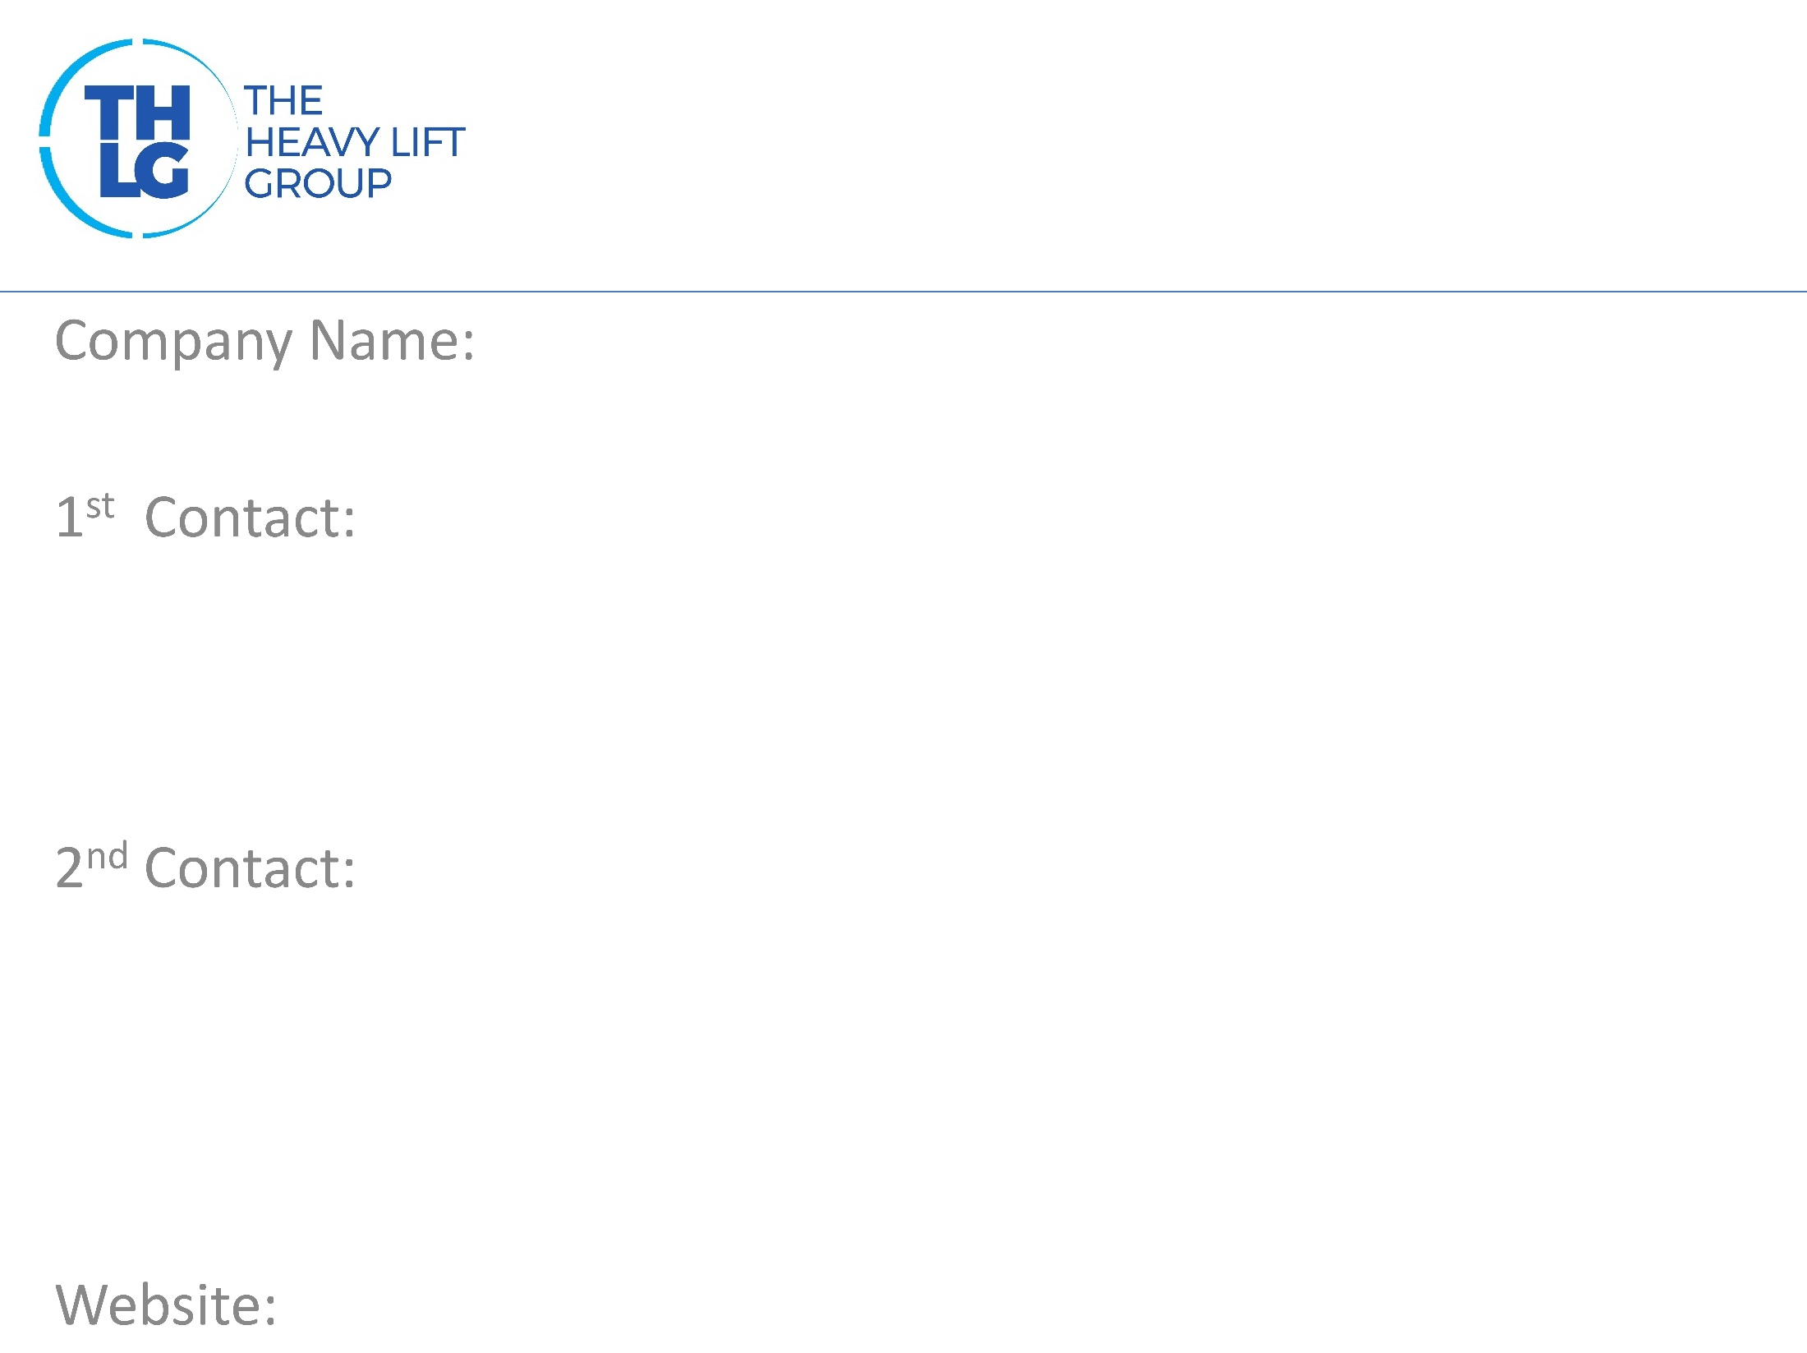
BELGIUM THLG member since 2015
ProMare
Mr. John Engelborghs T: +32 3 2312131 M: +32 476 081195 john@promare.be
www.promare.be

Slide 2
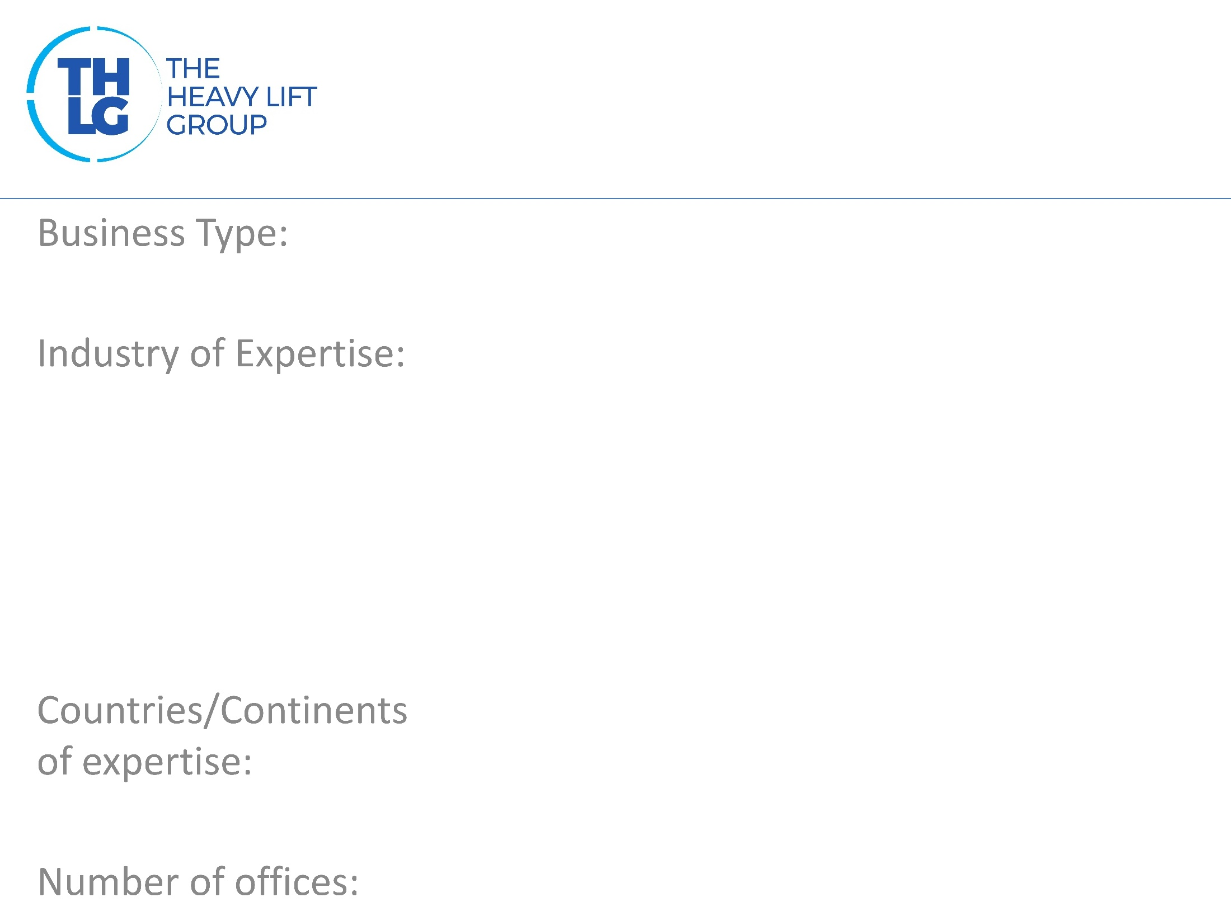
BELGIUM THLG member since 2015
Project forwarding, Heavy Lift handling Turnkey Projects to Africa
Mining Power Machinery Paper
Europe, Africa
1

Slide 3
BELGIUM THLG member since 2015

Slide 4
BELGIUM THLG member since 2015
Project forwarding Truck, train, barge, vessel, airfreight Heavy Lift Handling Project Management Chartering Customs formalities Industrial packing Warehousing IMO cargo

Slide 5
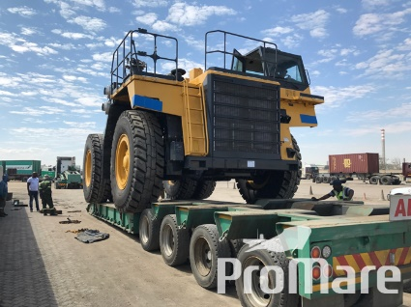
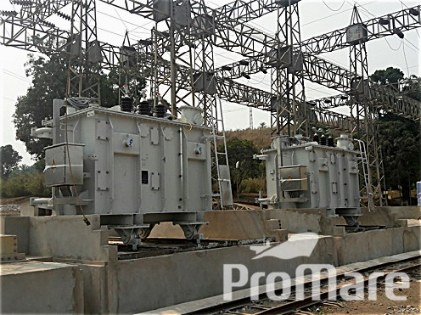
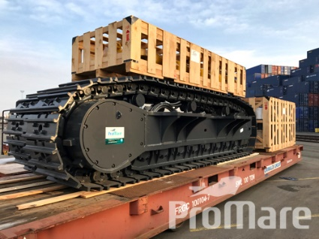
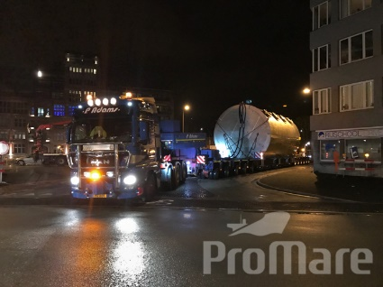
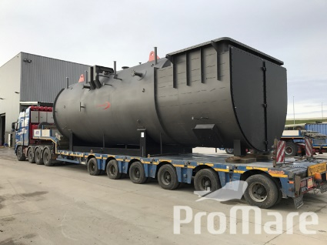
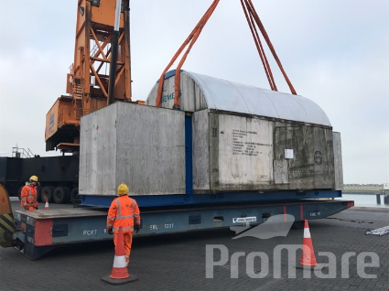
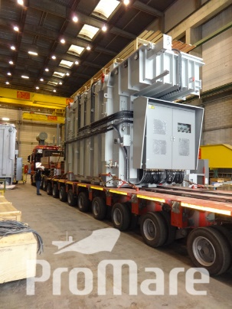
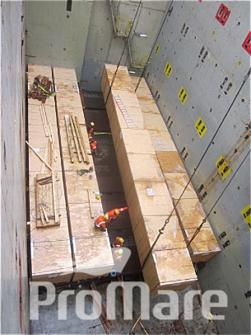
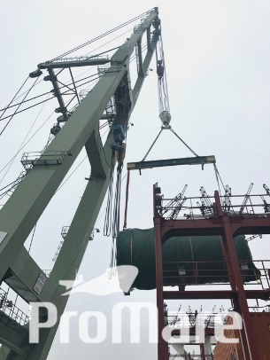
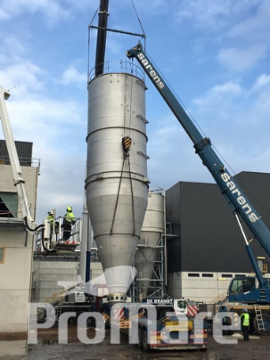
BELGIUM THLG member since 2015
Lubumbashi, DRC
Sanga, DRC
Kiffa, Mauritania
Dakar, Senegal Aalst, Belgium
Lommel, Belgium Willebroek, Belgium

