Slide 1
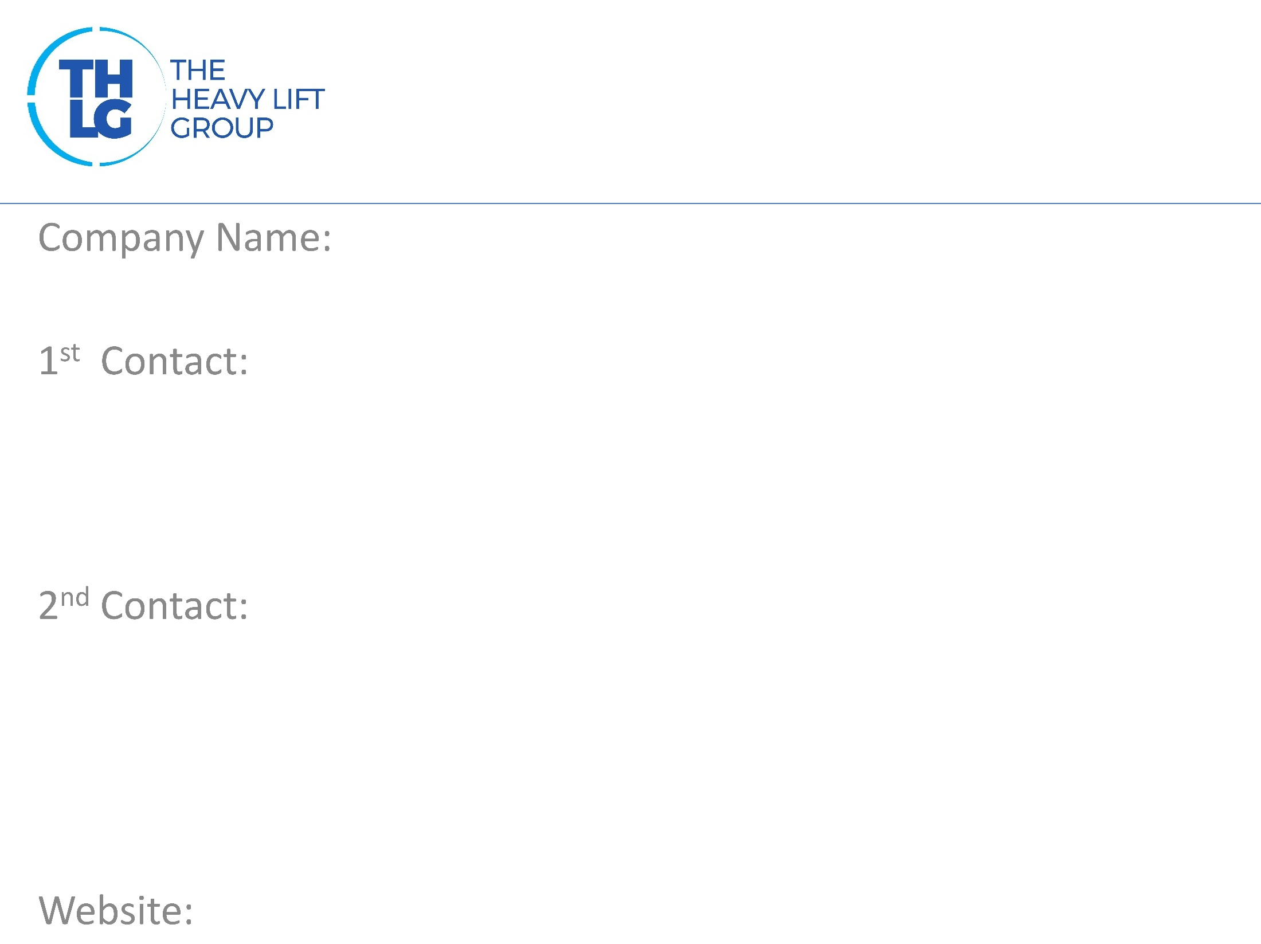
BRAZIL THLG member since 2015
FOX Brasil | Project Logistics
Mr. Murilo Caldana / Project Director T: +55 11 3543 0273 M:+55 11 99819 1146 murilo@foxbrasil.com
Guilherme Furquim Horch / Project Manager T: +55 11 3543 0270 M:+55 11 94552 7024 project1@foxbrasil.com
www.foxbrasil.com

Slide 2
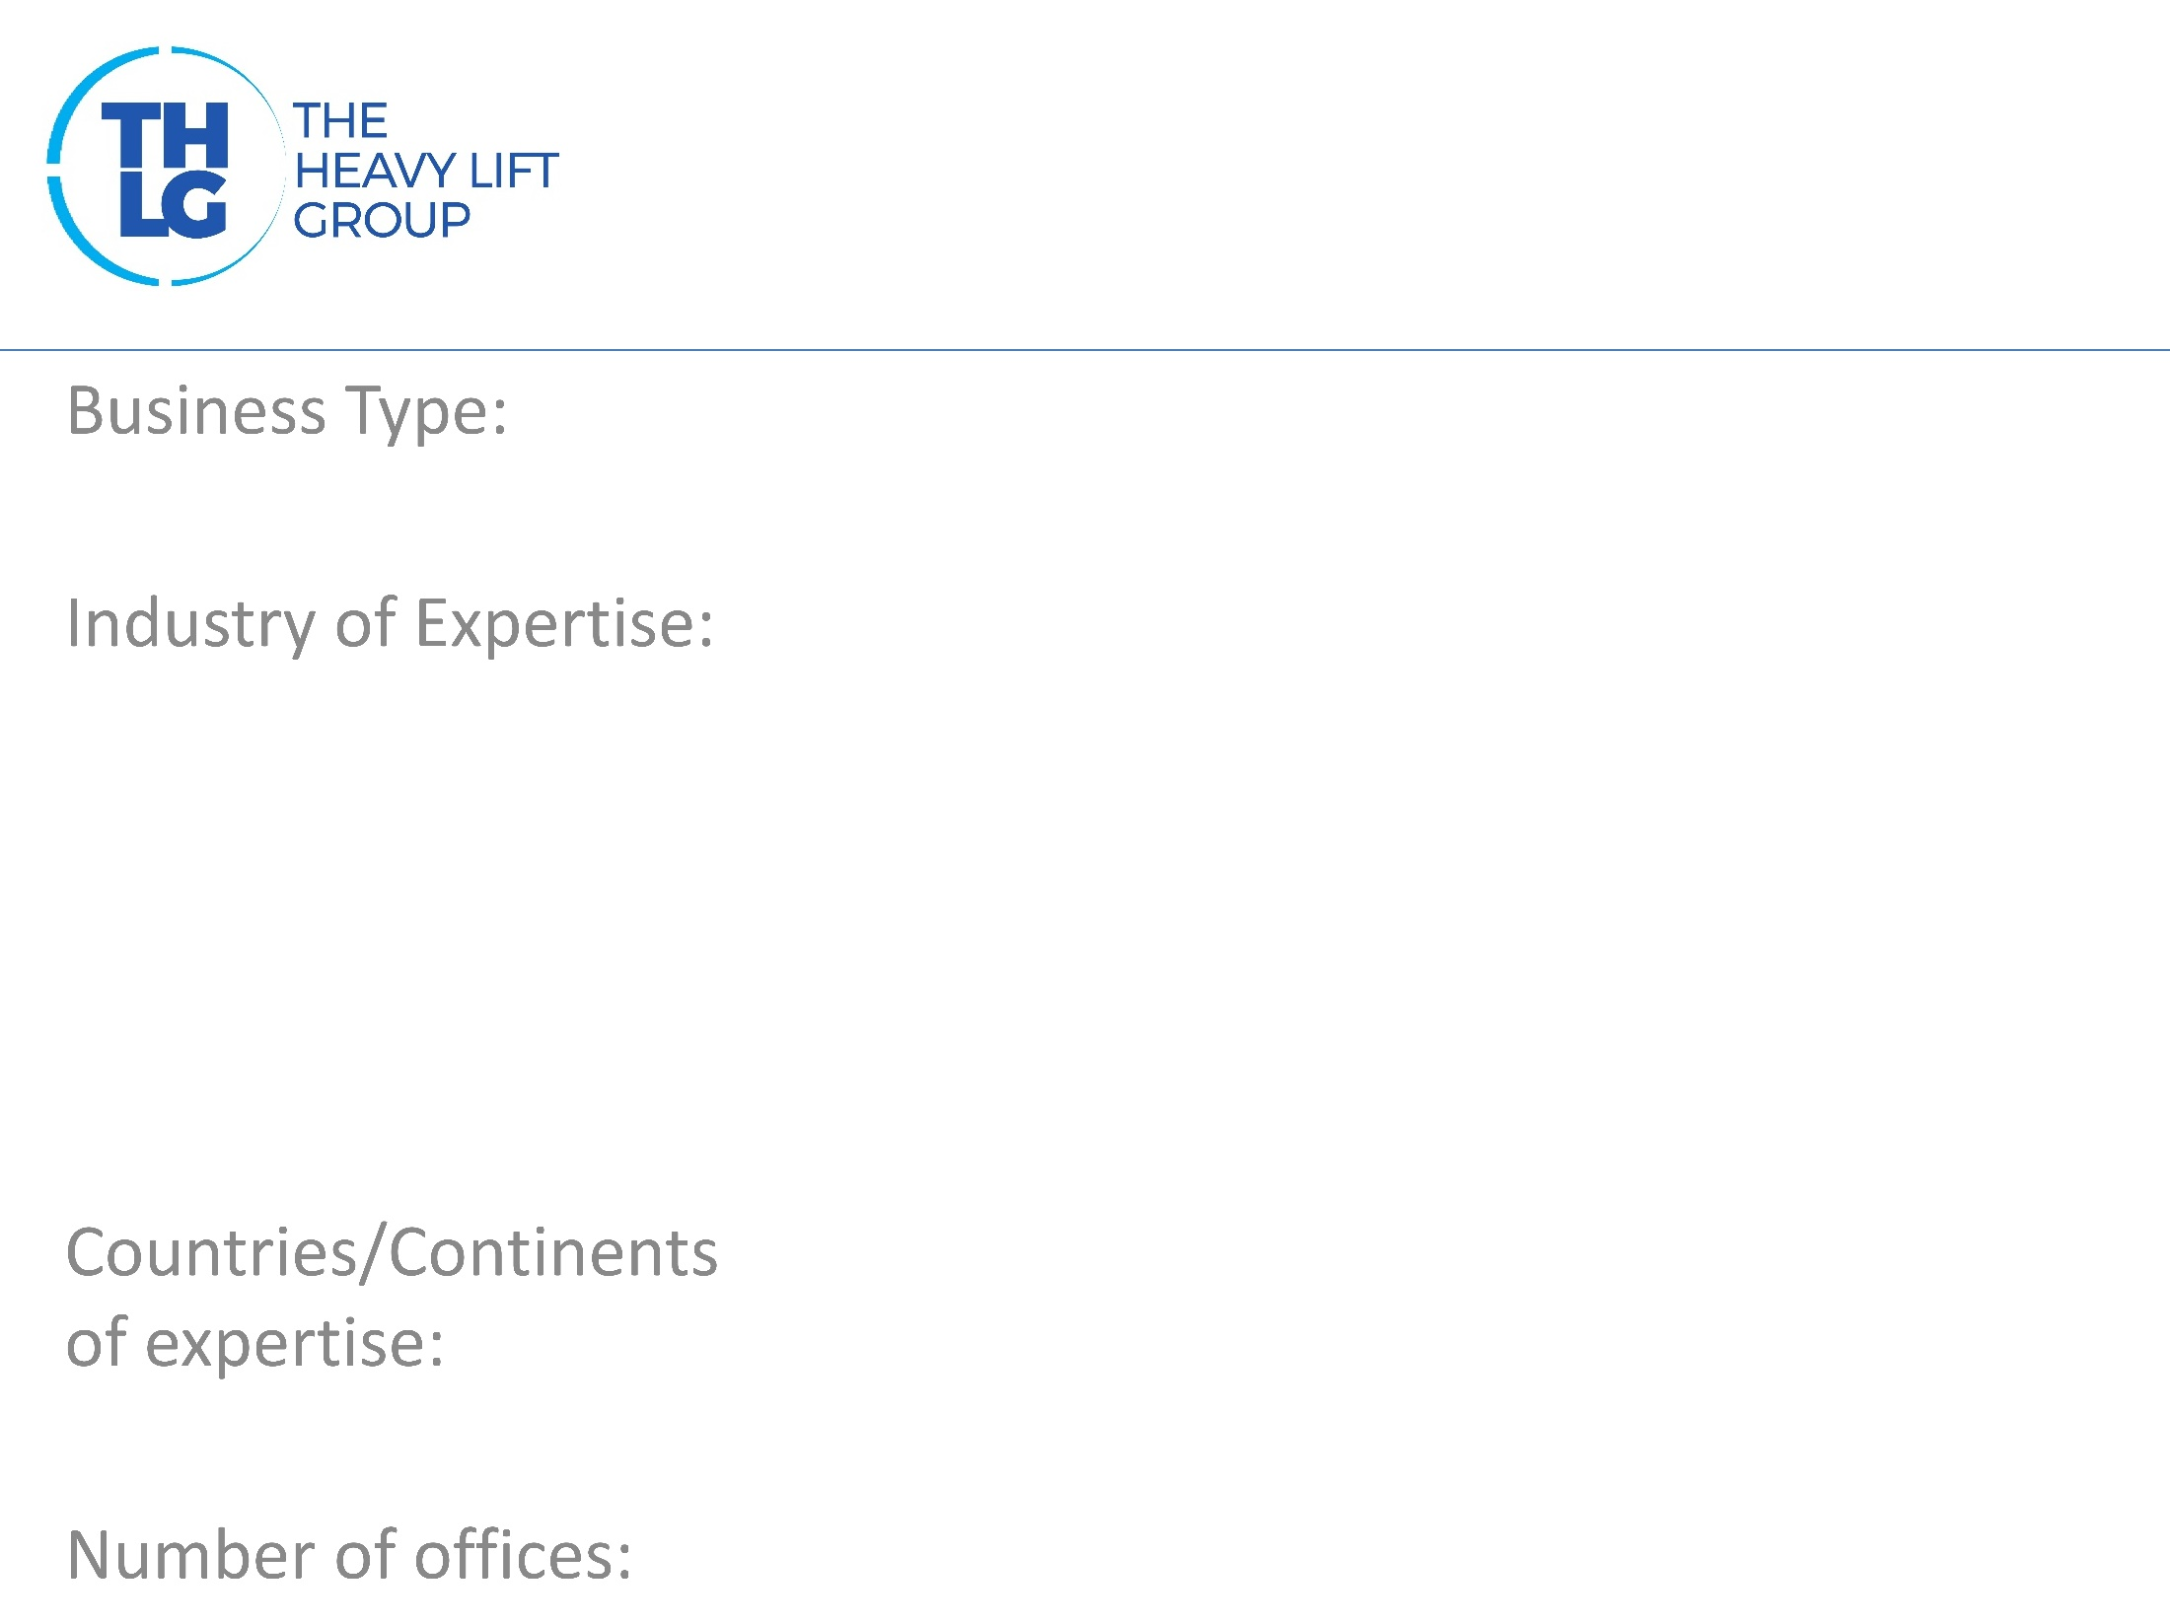
BRAZIL THLG member since 2015
Freight Forwarders
Power: Biomass, Hydro, Thermo, Wind Mining Machinery Pulp & Paper Oil & Gas Chemical & Petrochemical Industrial Projects High & Heavy Agro, Food & Feed Civil Engineering Projects
Brazil and LATAM
1 – Brazil

Slide 3
BRAZIL THLG member since 2015

Slide 4
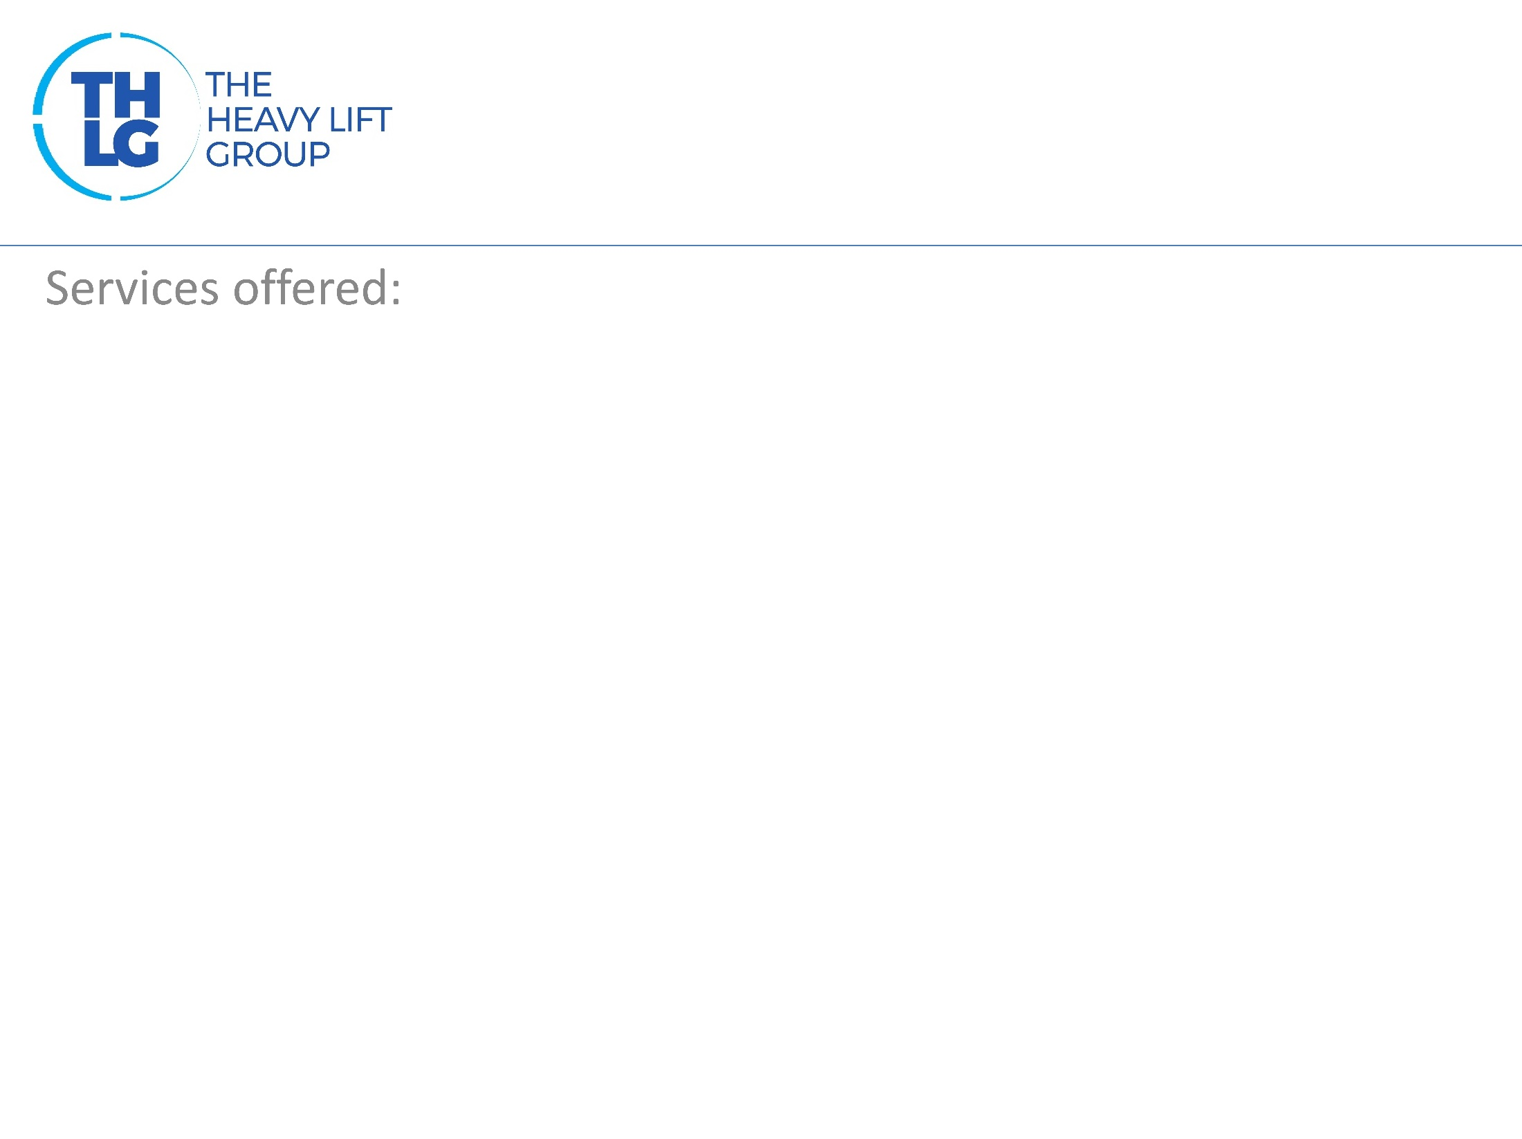
BRAZIL THLG member since 2015
Bespoke logistic and transport solutions; Air, Land & Sea transportation; Break Bulk, RoRo, over dimensioned and sensitive cargoes, part and full charters; Crating, packing and inventory services; Route survey, structural and geometric studies; Delivery and discharge at jobsites; Hiring and Management of cranes, forklifts and special lifting devices. Consultancy services on customs procedures and studies for tax exemptions; Design, planning, execution and management of complete logistic projects (turnkey); Domestic and Worldwide insurance coverage;

Slide 5
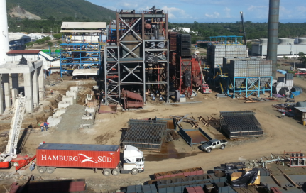
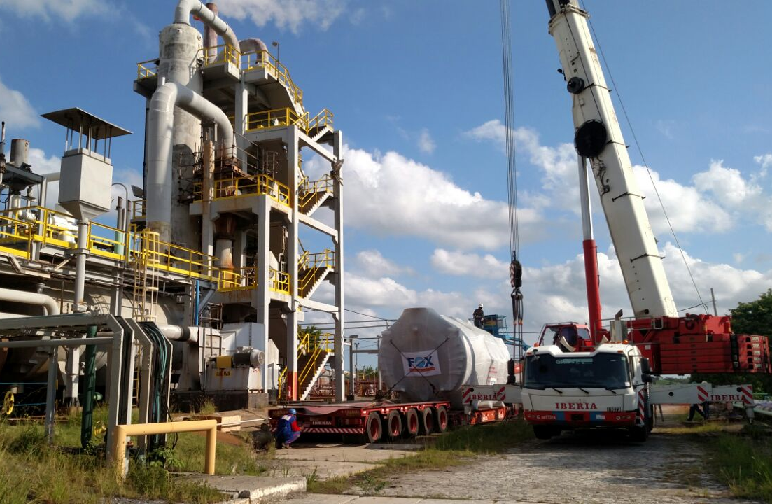
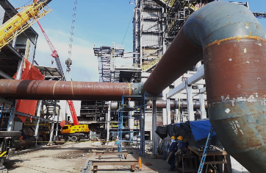
BRAZIL THLG member since 2015
Join us on social media
Thermo Power Plant
Petrochemical Plant
Biomass Power Plant
Participation in other Groups:

