Slide 1
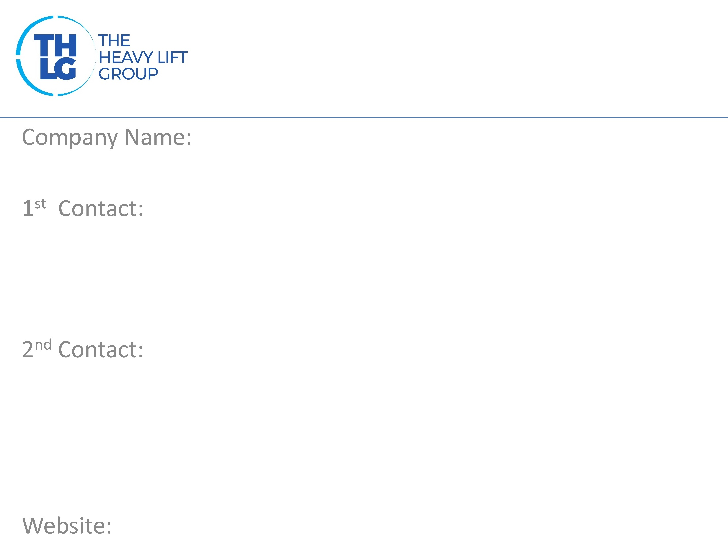
CANADA THLG member since 1996
BNSF Logistics Canada Inc.
Mr. Donald Kinsella / National Account Manager T: +1 (416) 620-3975 M:+1 (416)807-1699 Don.kinsella@bnsflogistics.com
Ms. Janet MacKund / VP Operations T: +1 (416) 620 3973 M:+1 (416) 826-6214 janet.mackund@bnsflogistics.com
www.bnsflogistics.com

Slide 2
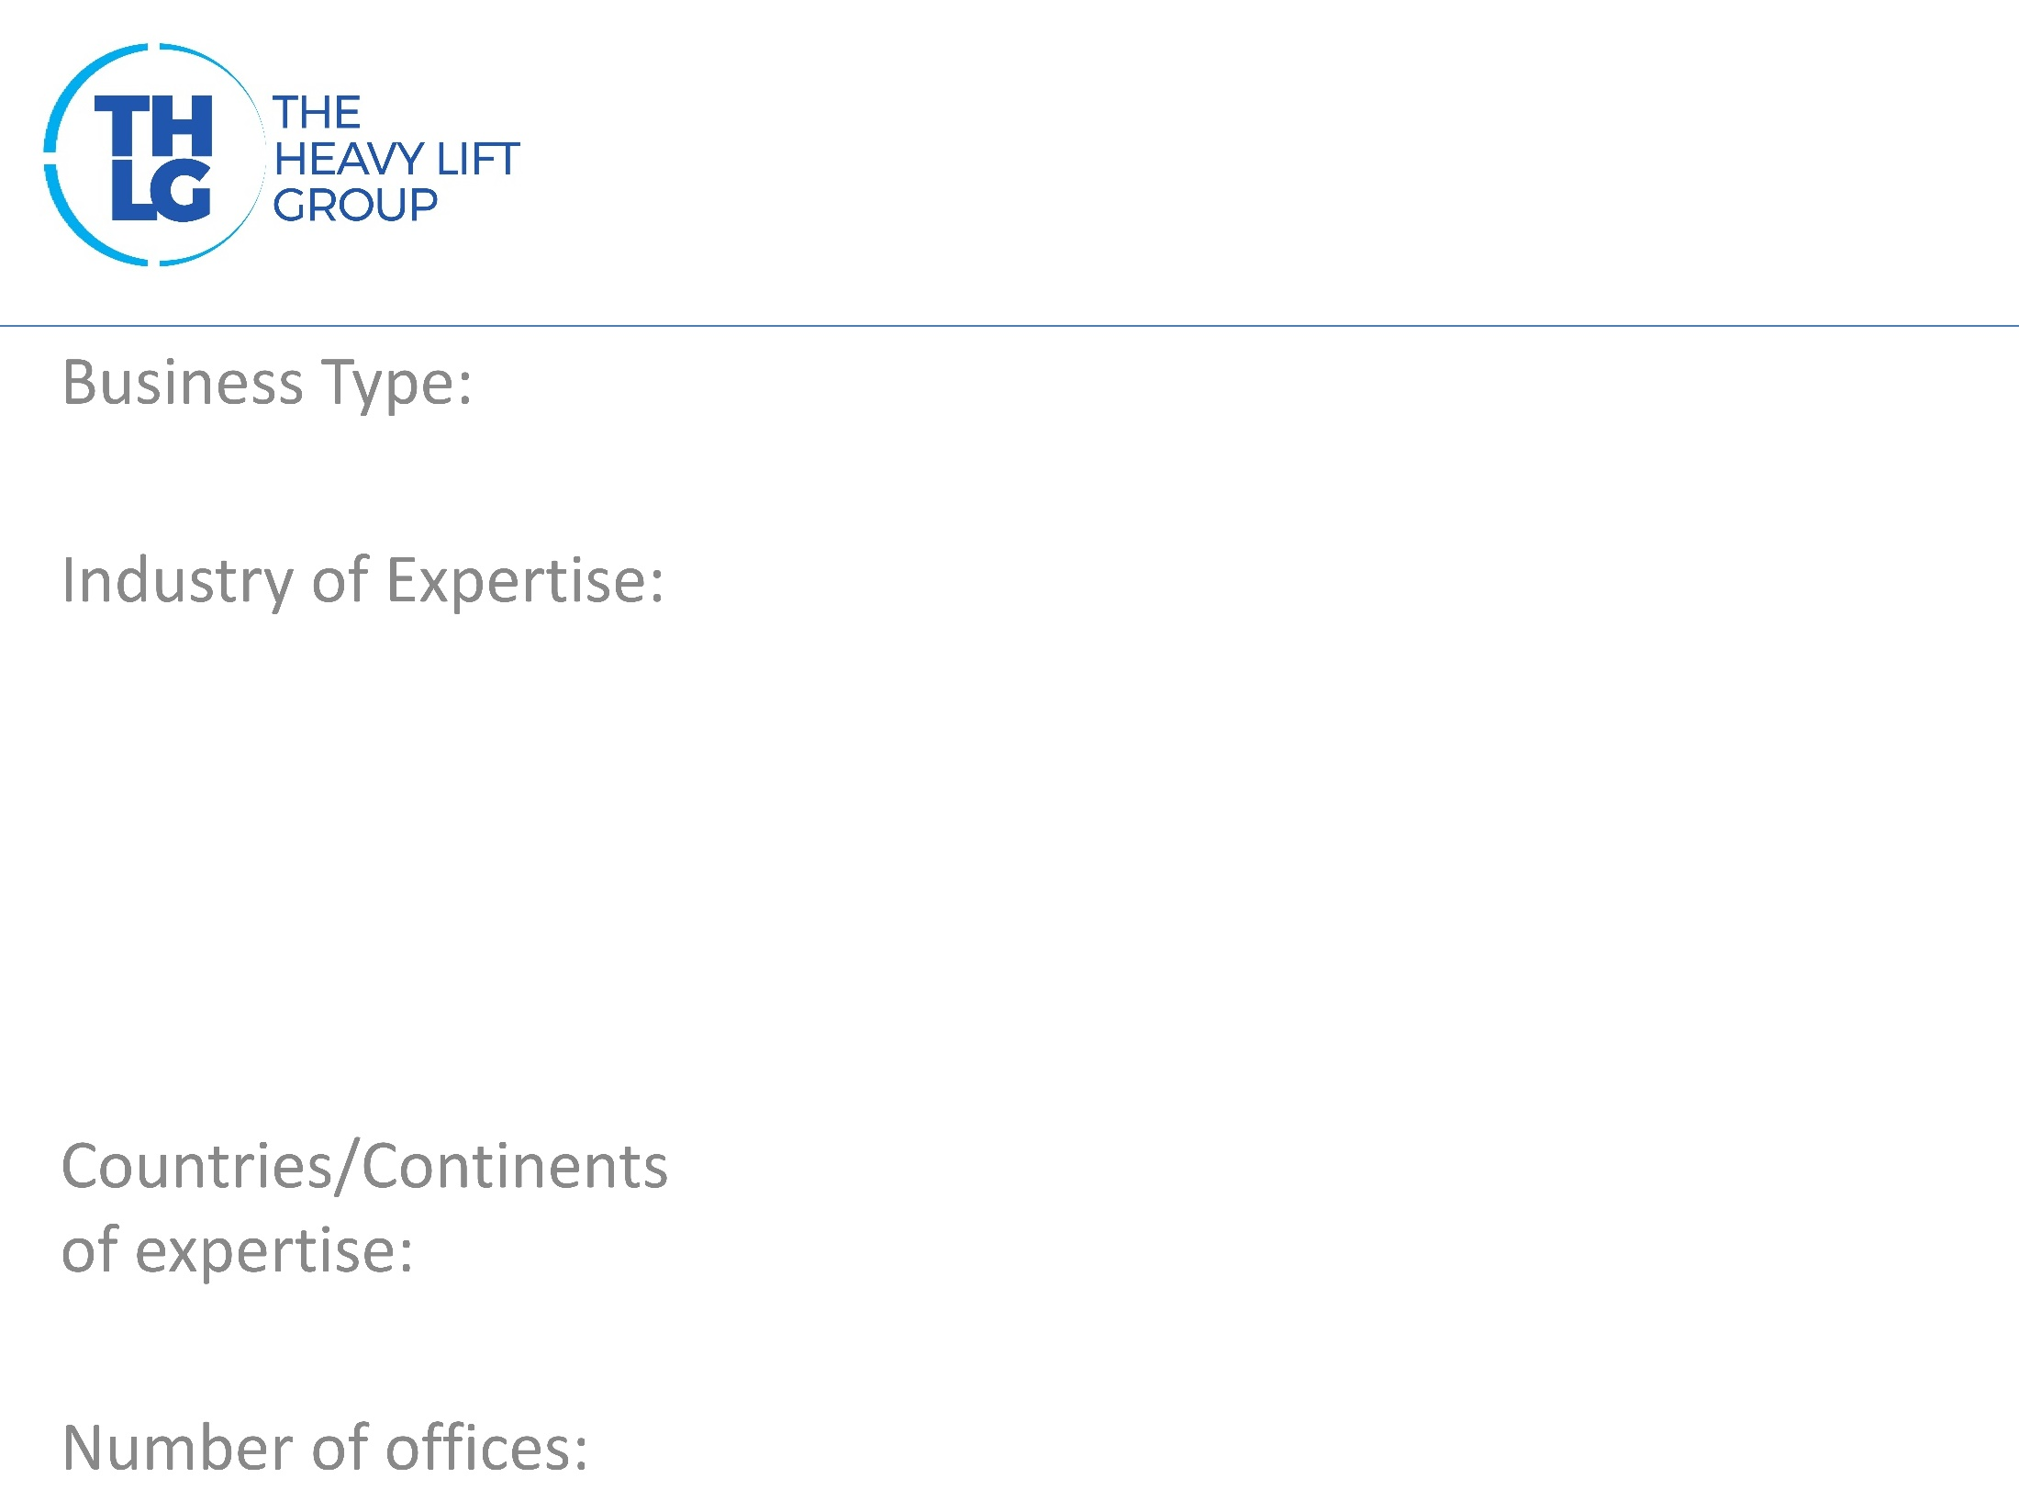
CANADA THLG member since 1996
Freight Forwarders – Project Heavy Lift Ocean, Air, Rail
Oil & Gas Power Gen: Wind, Thermal, Renewable Mining and Minerals Government and Defense Civil Engineering and Machinery Petrochemical Aerospace and Aviation
Canada, North America. Global Import Export
4 – CANADA ( TORONTO,MONTREAL CALGARY, EDMONTON )

Slide 3
CANADA THLG member since 1996
Project Solutions and Execution: All modes, Road & Rail, Ocean, River, Air Planning route surveys Customs services Asset protection and Warehousing OTR Heavy Haul General freight forwarding services Airfreight Rail freight, engineering and clearance Wind Project management Project Supervision

Slide 4
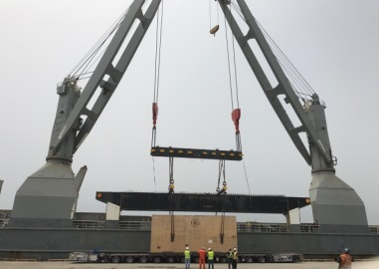
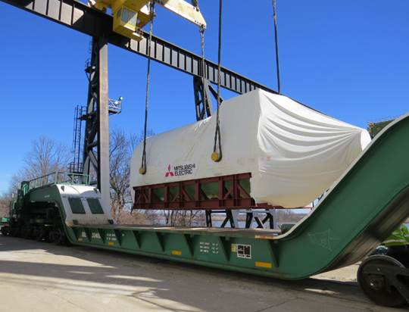
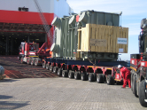
CANADA THLG member since 1996
Join us on social media
Electrification Project Expertise
Rail
Project Cargo Expertise
Project Road
Read all about our projects:
Participation in other Groups:

