Slide 1
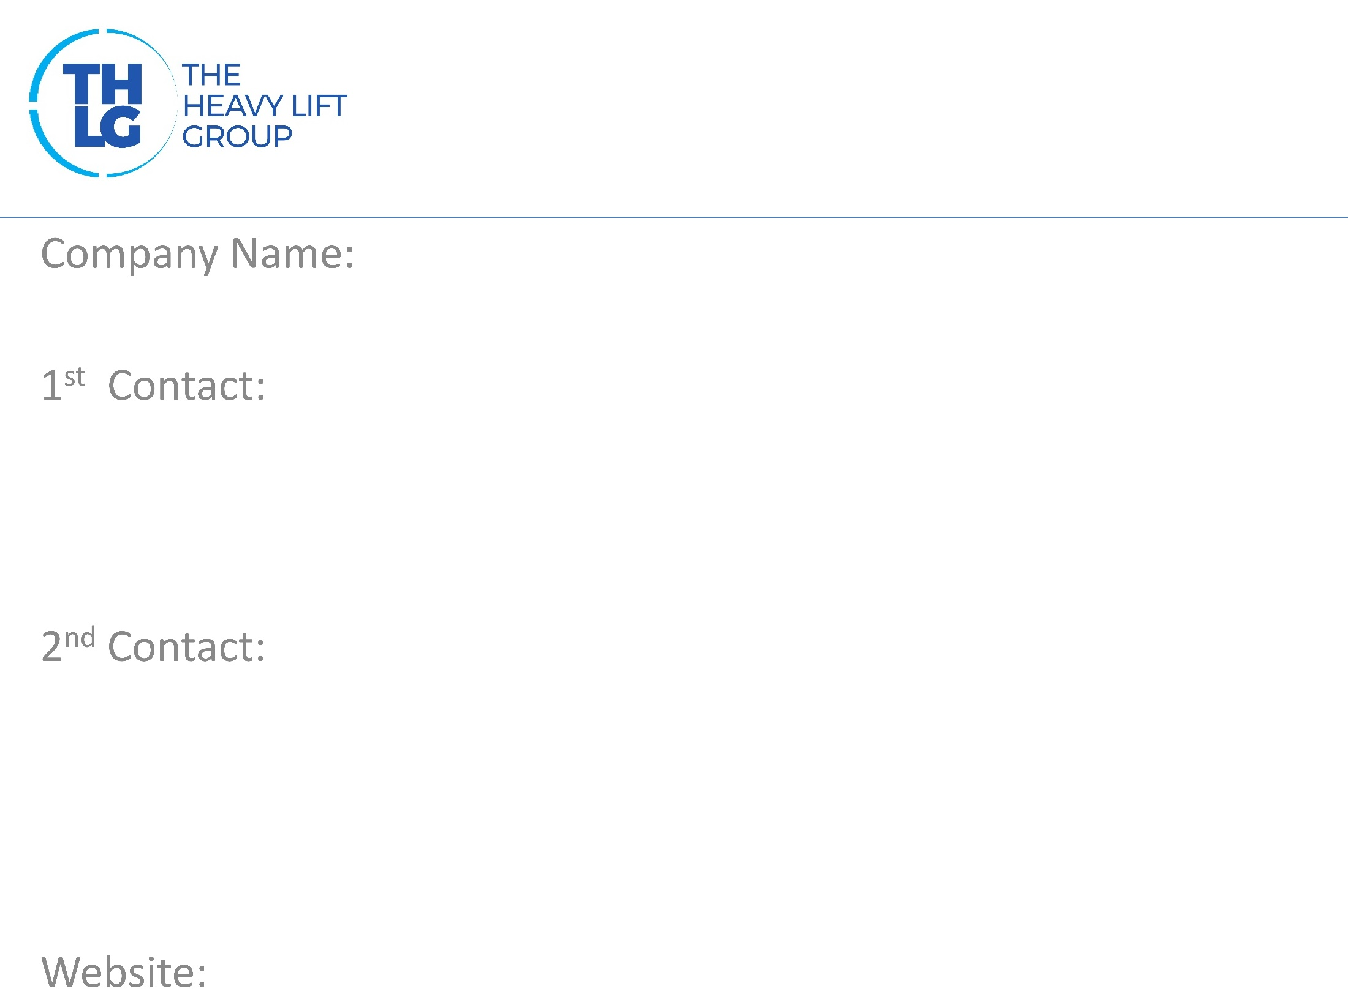
CHINA/TAIWAN THLG member since 2010
Asia Imperial Cargo Logistics
Mr. Scott Hsieh/ Manager Director T: +86-21-63569749/ ext. 869 M:+8613816260678 hscott@aicl.com.cn
Ms. Jean Yuan/ Project Deputy Manager T: +886-2-27013036/ ext. 205 M:+886920062105 yjean@aicl.biz
www.aicl.biz

Slide 2
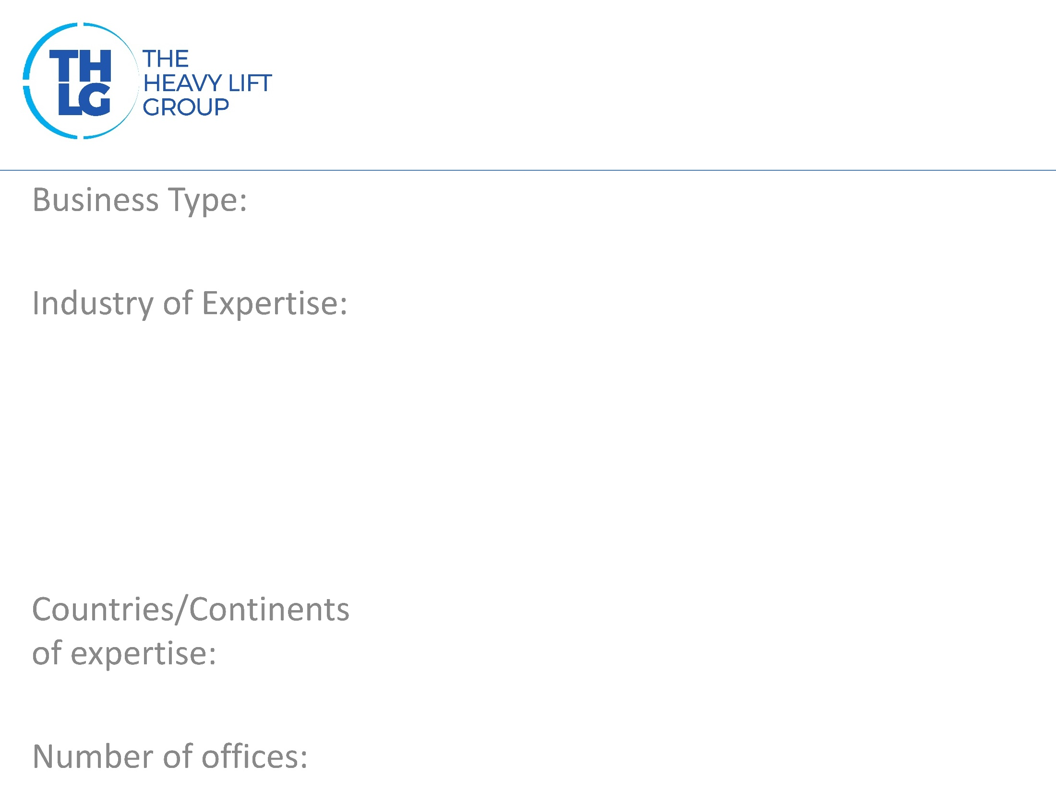
CHINA/TAIWAN THLG member since 2010
Freight Forwarders
Transformer Steel Oil & Gas/Offshore Equipment Wind Energy Heavy Machinery Yacht Chemical Product
China, Taiwan, USA, Canada, Germany, Italy
5 – China, 2 – Taiwan

Slide 3
CHINA/TAIWAN THLG member since 2010

Slide 4
CHINA/TAIWAN THLG member since 2010
Port operations Project planning, management and execution Customs Formalities Warehousing LCL/FCL Airfreight Inland Road Transport To Door Service and Placement

Slide 5
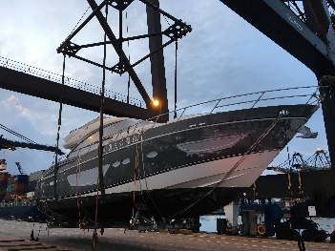
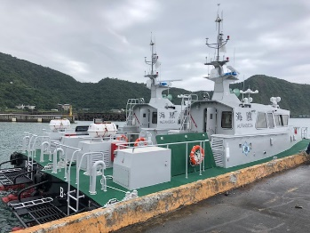
CHINA/TAIWAN THLG member since 2010
Yacht Loading
Patrol Boat Loading
Read all about our projects:
Visit our website:
www.aicl.biz
Participation in other Groups:

