Slide 1
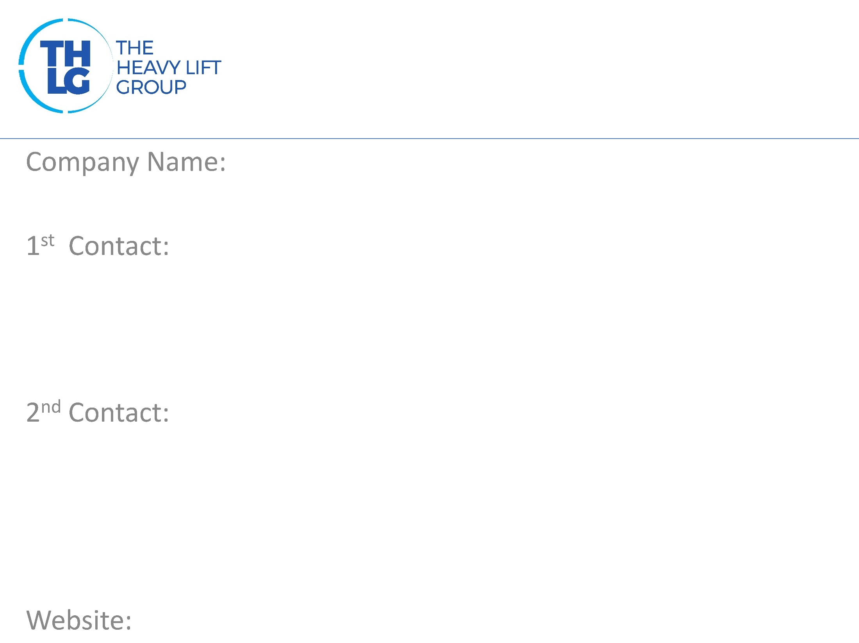
CHINA member since 2008
Hisiang Logistics Company Limited
Mr. George Ma/ Managing Director T: +86-10-85902801 M:+86-13901179301 george.ma@hisiang.com
Mr. David Yan/ BD Director T: +86-10-85902802 M:+86-13801300754 david.yan@hisiang.com
www.hisiang.com

Slide 2
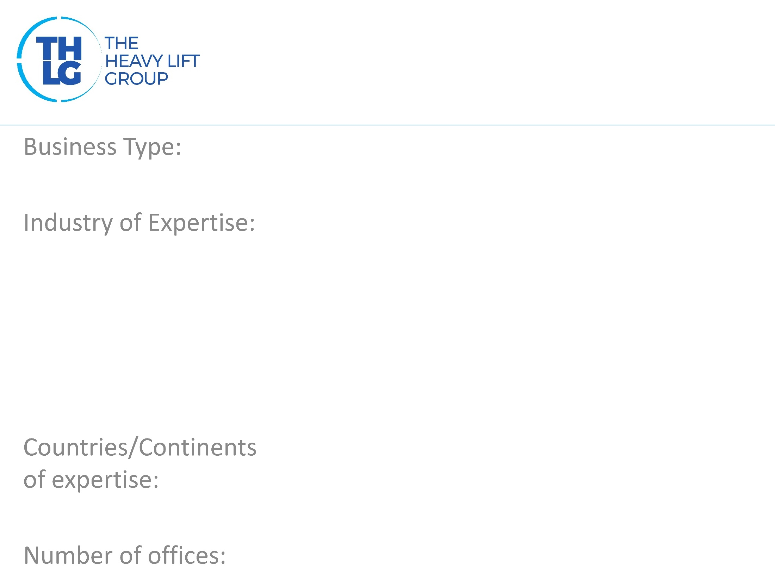
CHINA member since 2008
Freight Forwarders
Power: Wind, Thermo, Water, Oil & Gas Machinery Petrochemical Medical Auto Industry
China; European; The Middle East; CIS; Southeast Aisa; North America; ETC.
4 in China; 1 in Germany

Slide 3
CHINA member since 2008

Slide 4
CHINA member since 2008
Air freight inbound and outbound Sea freight inbound and outbound Rail freight inbound and outbound FCL/LCL/Bulk cargo Warehousing and inland trucking service Door-to-door delivery service Project cargo operation and management Customs clearance service National Road Transport International Road Transport Transport of oversized cargo Aircraft and vessel charter International trade

Slide 5
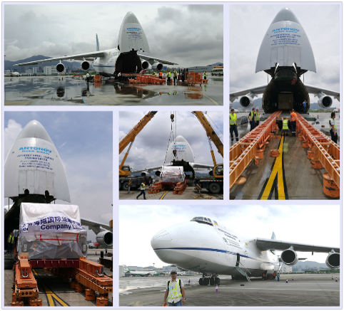
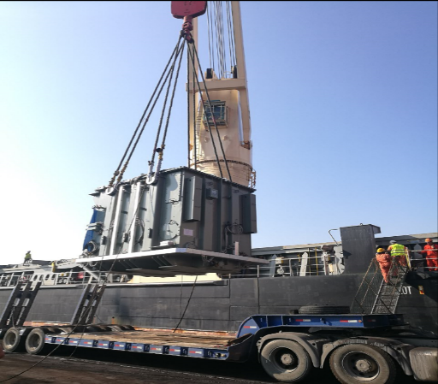
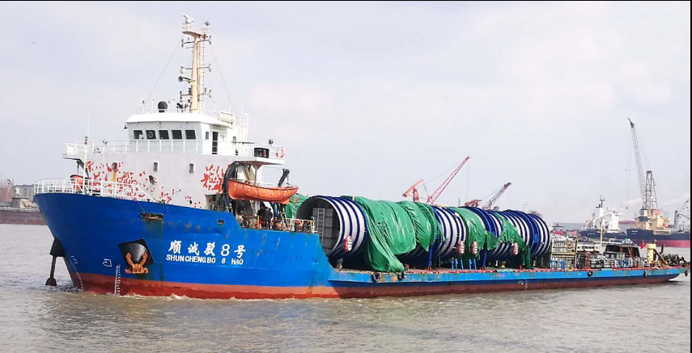
CHINA member since 2008
Flight Charter
Oversize Cargo
Vessel Charter

