Slide 1
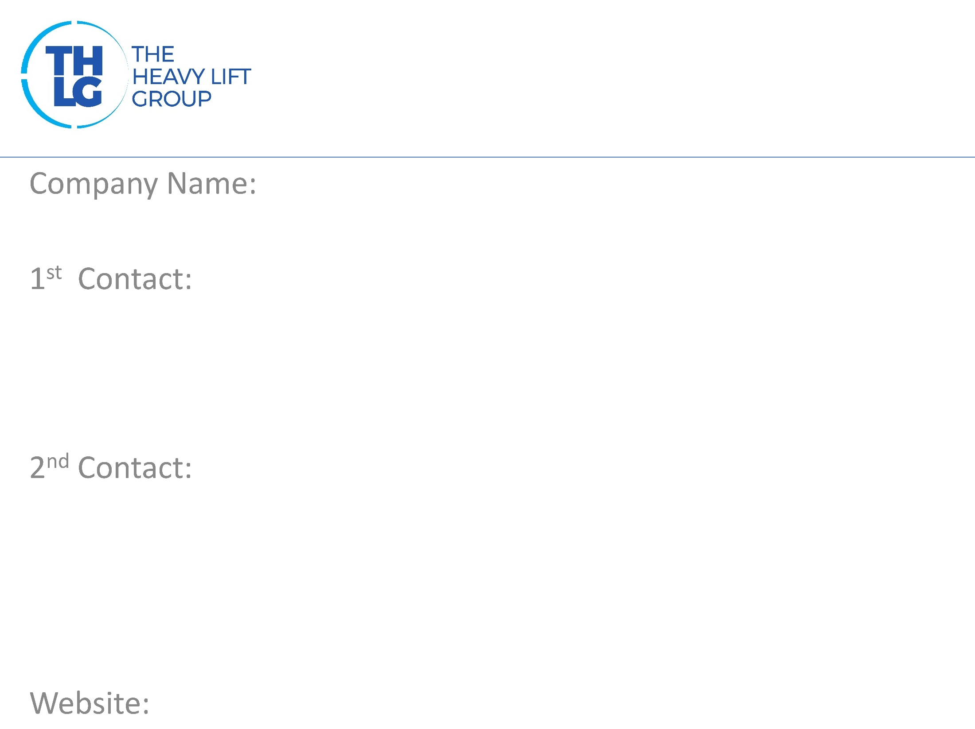
FRANCE THLG member since 2007
SOGEBRAS
Mr. JOHANN FELTGEN/ Manager T: +33240904142 M:+33603963709 j.feltgen@sogebras.fr
Mr. Christophe Letanter / Deputy Manager T: +33240904142 M:+33616121659 c.letanter@sogebras.fr & agency@sogebras.fr
www.sogebras.com

Slide 2
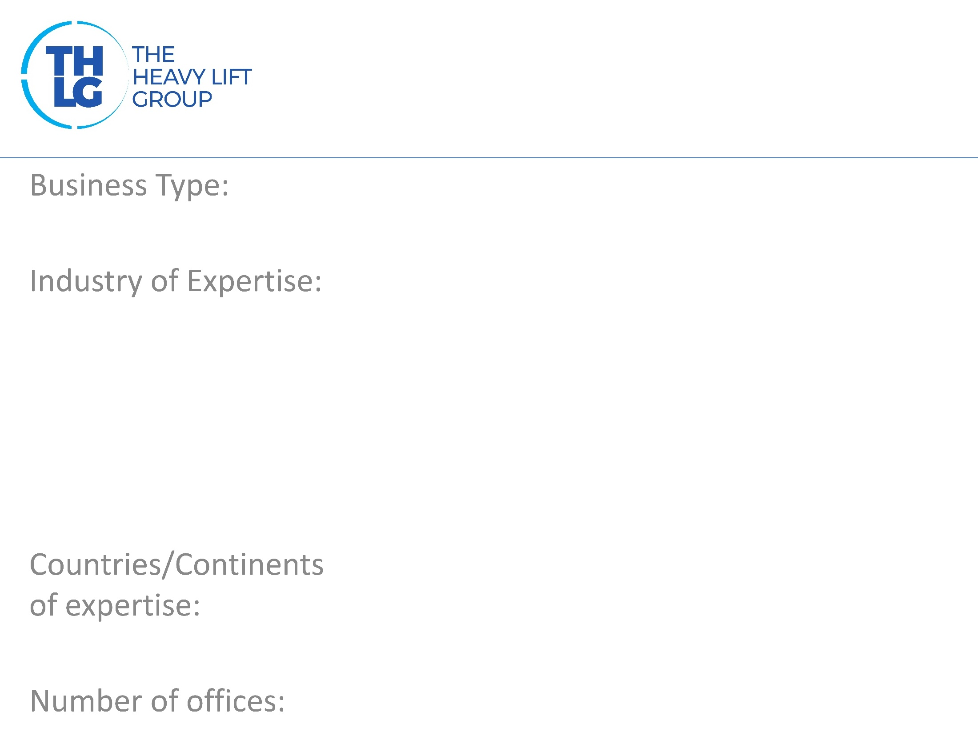
FRANCE THLG member since 2007
Port Operators / Stevedoring / Ship and Liner Agency / Forwarding
Oil & Gas Renewable Energy ( Onshore and Offshore windmills ) Cruise Vessels building Iron products Any types of Heavy Lifts
France / Ivory Coast
France 12 / Ivory Coast 1

Slide 3
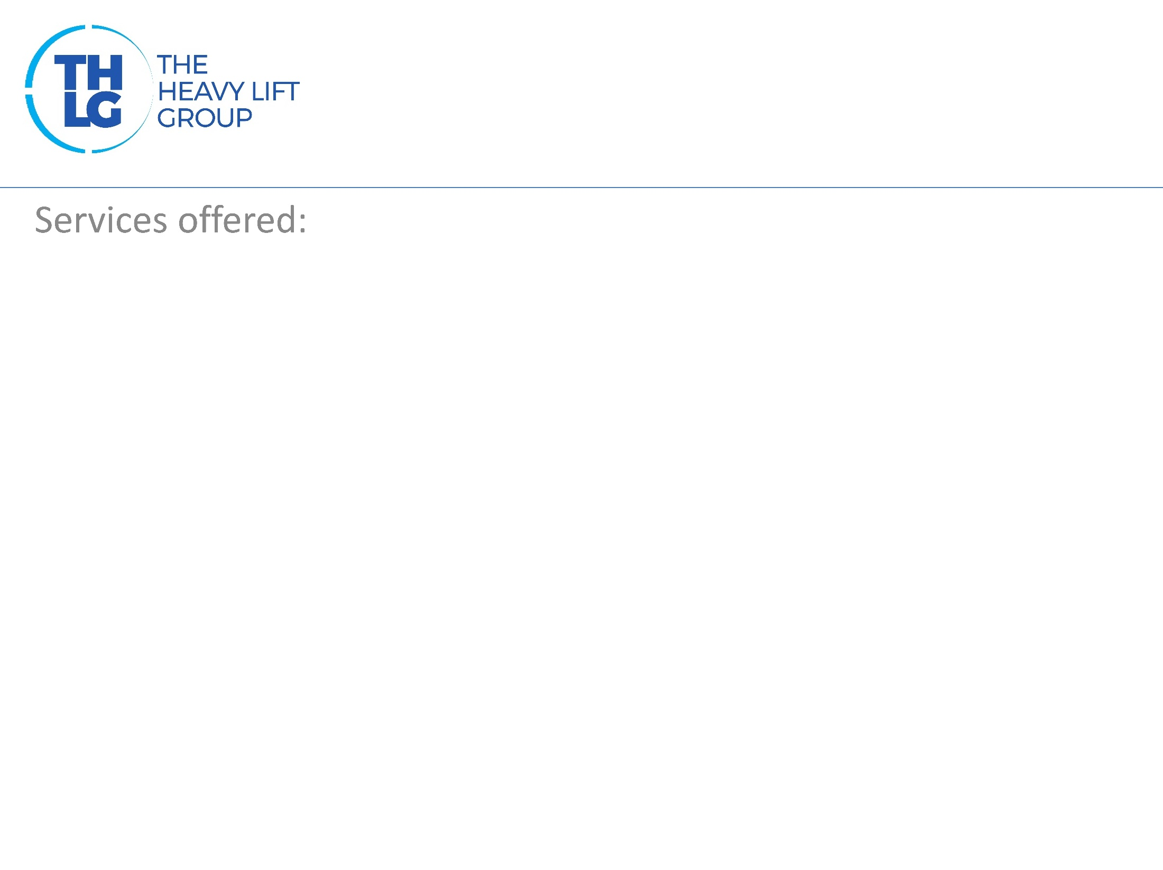
FRANCE THLG member since 2007
*Stevedoring *Storage *Liner Agency ( Marfret and Rickmers ) *Ship agency *Forwarding Agent / Customs clearance Key accounts : General Electric Man Diesel Arcelor STX Enercon Nordex Vestas Network in all Western and Northern French Ports

