Slide 1
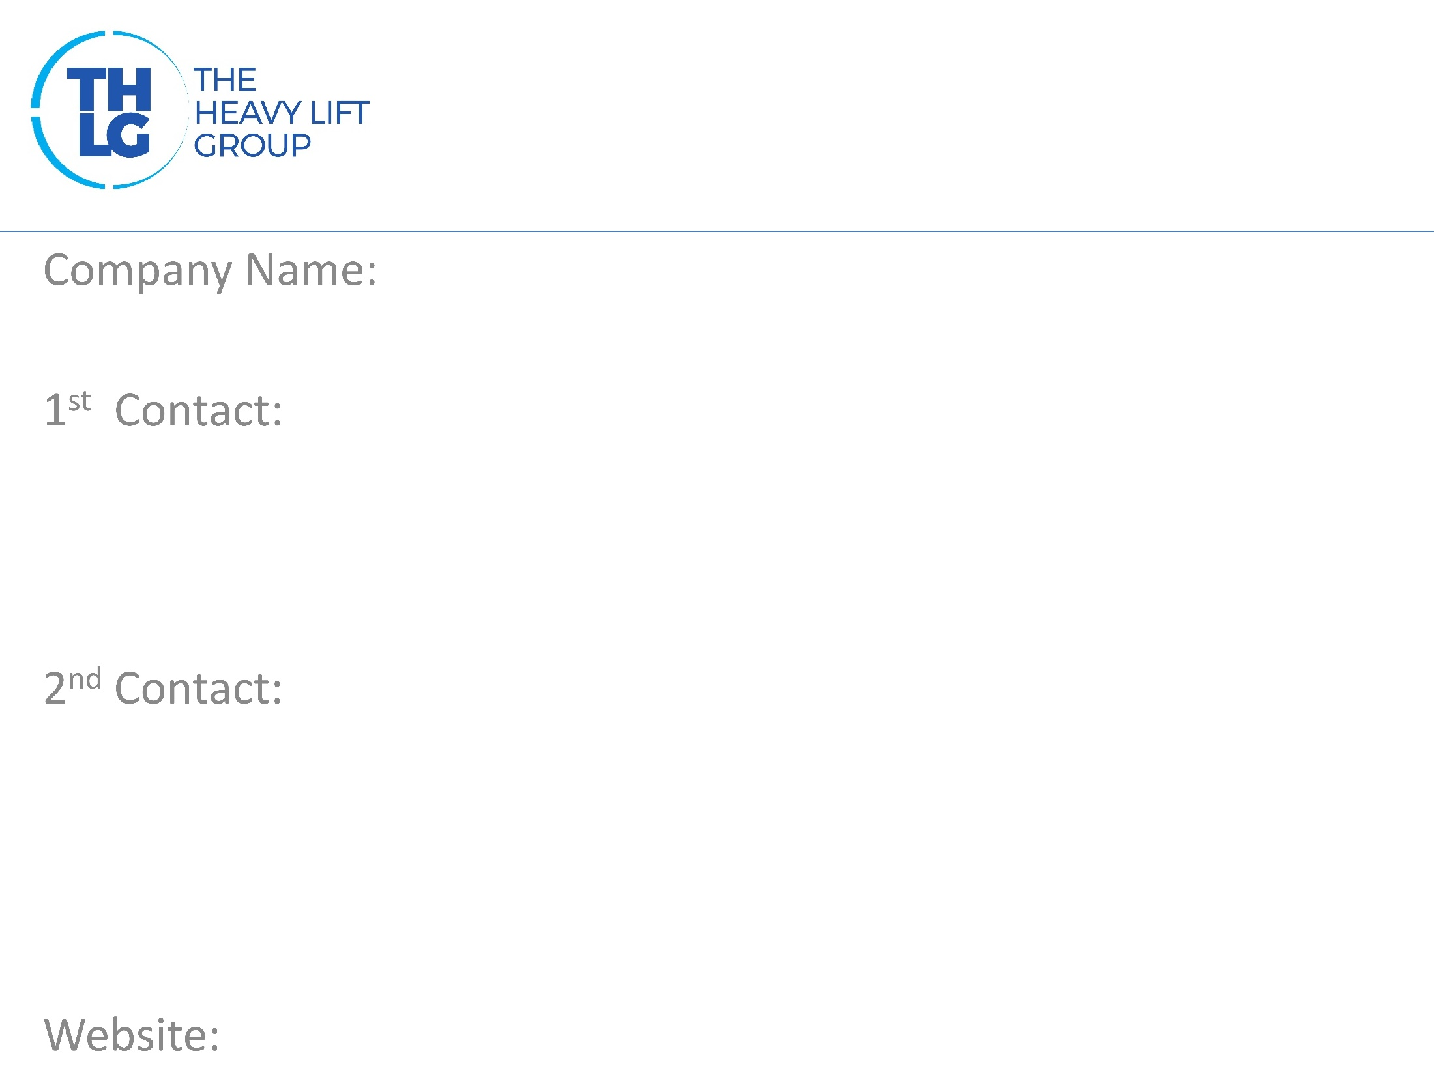
KAZAKHSTAN THLG member since 2005
GLOBALINK LOGISTICS DWC-LLC Tel: +7 (727) 258-88-80 Fax: +7 (727) 258-88-85 E-mail: sales@globalinklogistics.com
Siddique Khan CEO s.khan@globalinklogistics.com
Aftab Ahmed Group General Manager Corporate a.ahmed@globalinklogistics.com
www.globalinklogistics.com

Slide 2
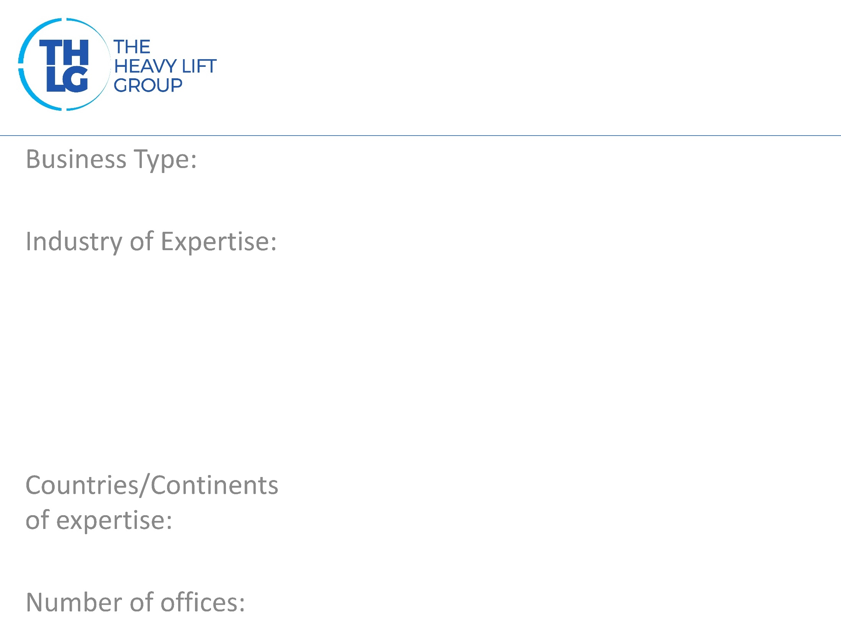
KAZAKHSTAN THLG member since 2005
Freight Forwarders
Power Mining Machinery Oil & Gas Industrial Projects High & Heavy Civil Engineering Projects Construction
Central Asia, Caucasus and Caspian Region
Kazakhstan -10; Kyrgyzstan, Uzbekistan, Azerbaijan, Turkmenistan, Tajikistan, Georgia, Ukraine, Armenia, Russia, UAE

Slide 3
KAZAKHSTAN THLG member since 2005

Slide 4
KAZAKHSTAN THLG member since 2005
Customer tailored transportation consultancy Project logistics feasibility studies Road studies Project logistics budget and planning Project flow descriptions Cargo supervision during loading and unloading, as well as in transit Full/Partial charter by ocean and air Consolidation, packing, crating and containerization Purchase order management and cargo tracking Transport Insurance Oversize cargoes transportation Heavy loads Barge Service Module Movement Pre shipment inspection Cargo surveying Customs and shipping documentation

Slide 5
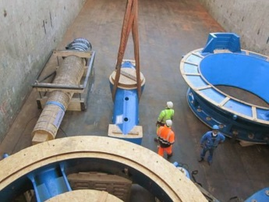
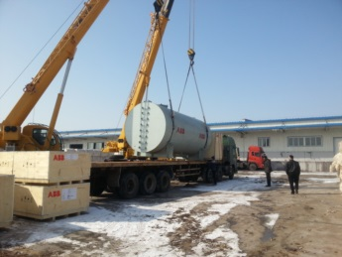
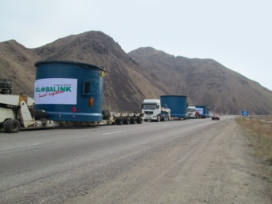
KAZAKHSTAN THLG member since 2005
http://globalinklogistics.com/servicescategary/Project-Logistics
Join us on social media
Participation in other Groups:

