Slide 1
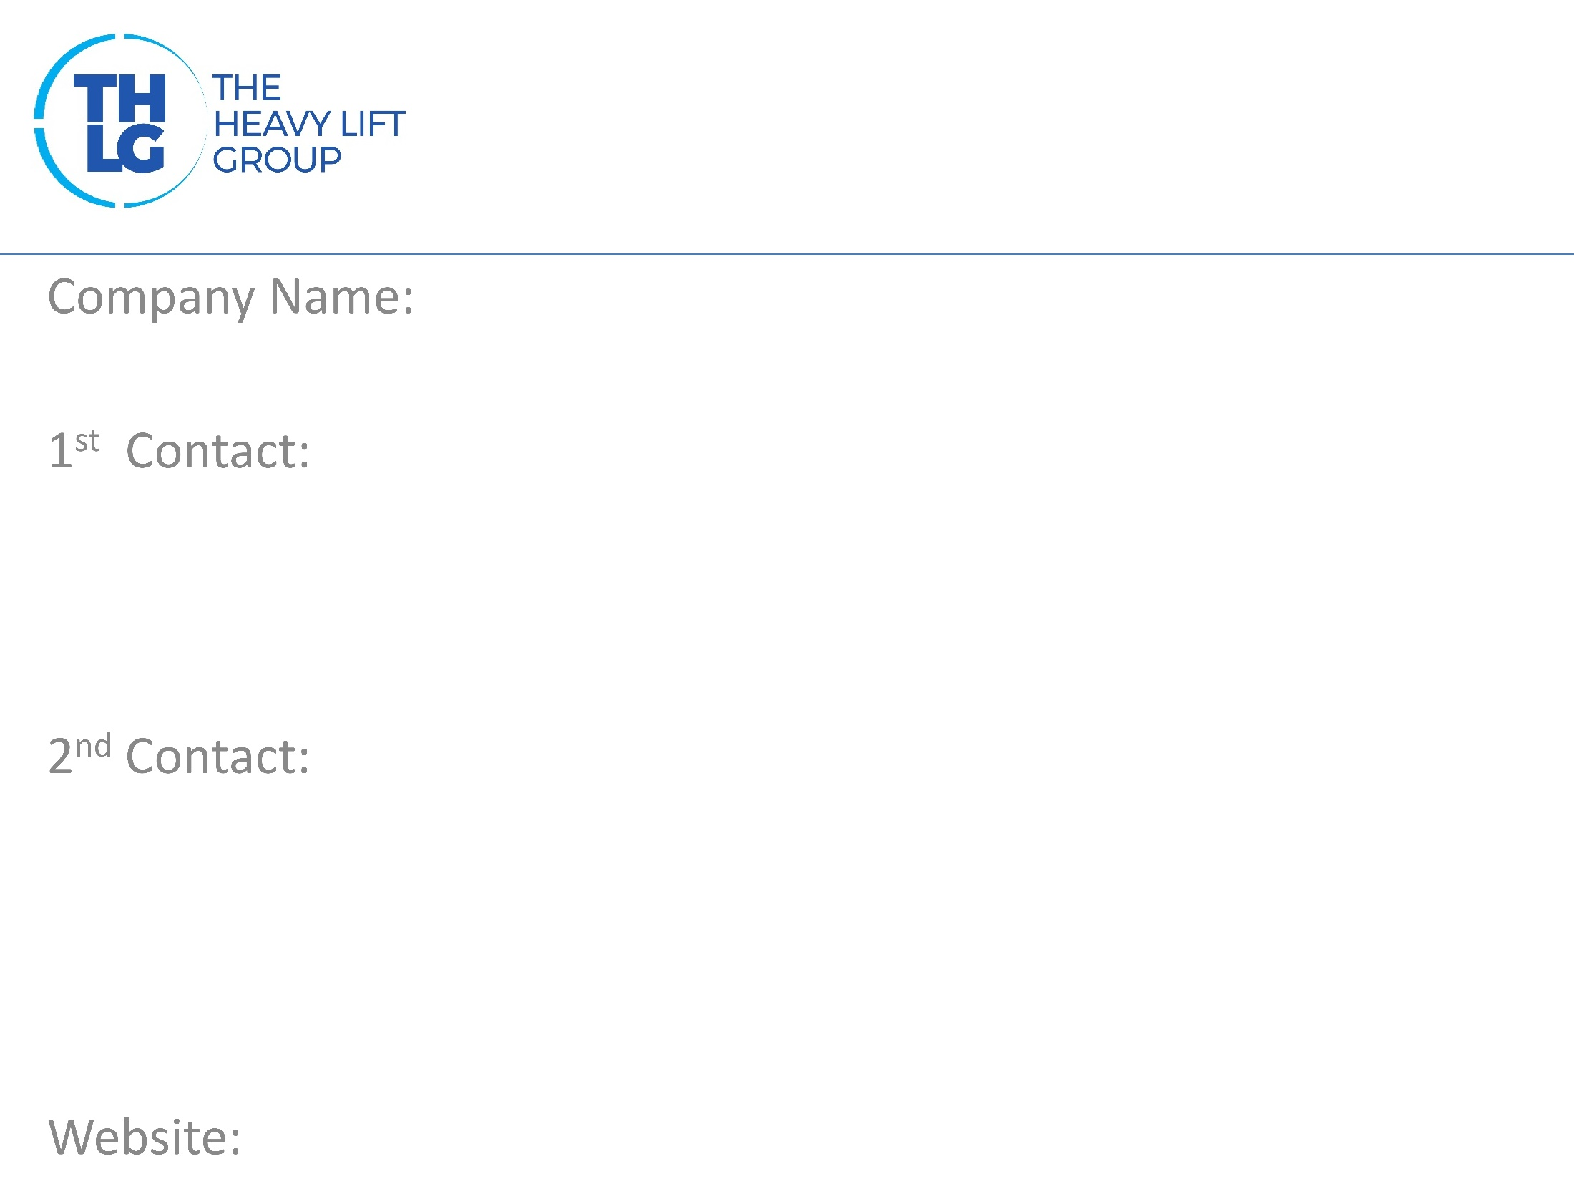
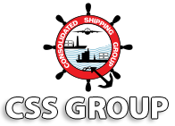
UAE THLG member since 2012
Consolidated Shipping Services LLC| Project Logistics
Mr. Raj George (Sr. VP – Projects) T : +971 4 8872333 / Ext 151 M : +971 506532149 george@cssdubai.com
Mr. Sreenath.V (VP – Projects & CFS) T : +971 4 8872333 / Ext 130 M : +971 504543395 sreenath@cssdubai.com Mr. Sajith V (Manager – Projects Operations T : +971 4 8872333 / Ext 122 M : +971 506571221 sajithv@cssdubai.com
www.cssgroupsite.com

Slide 2
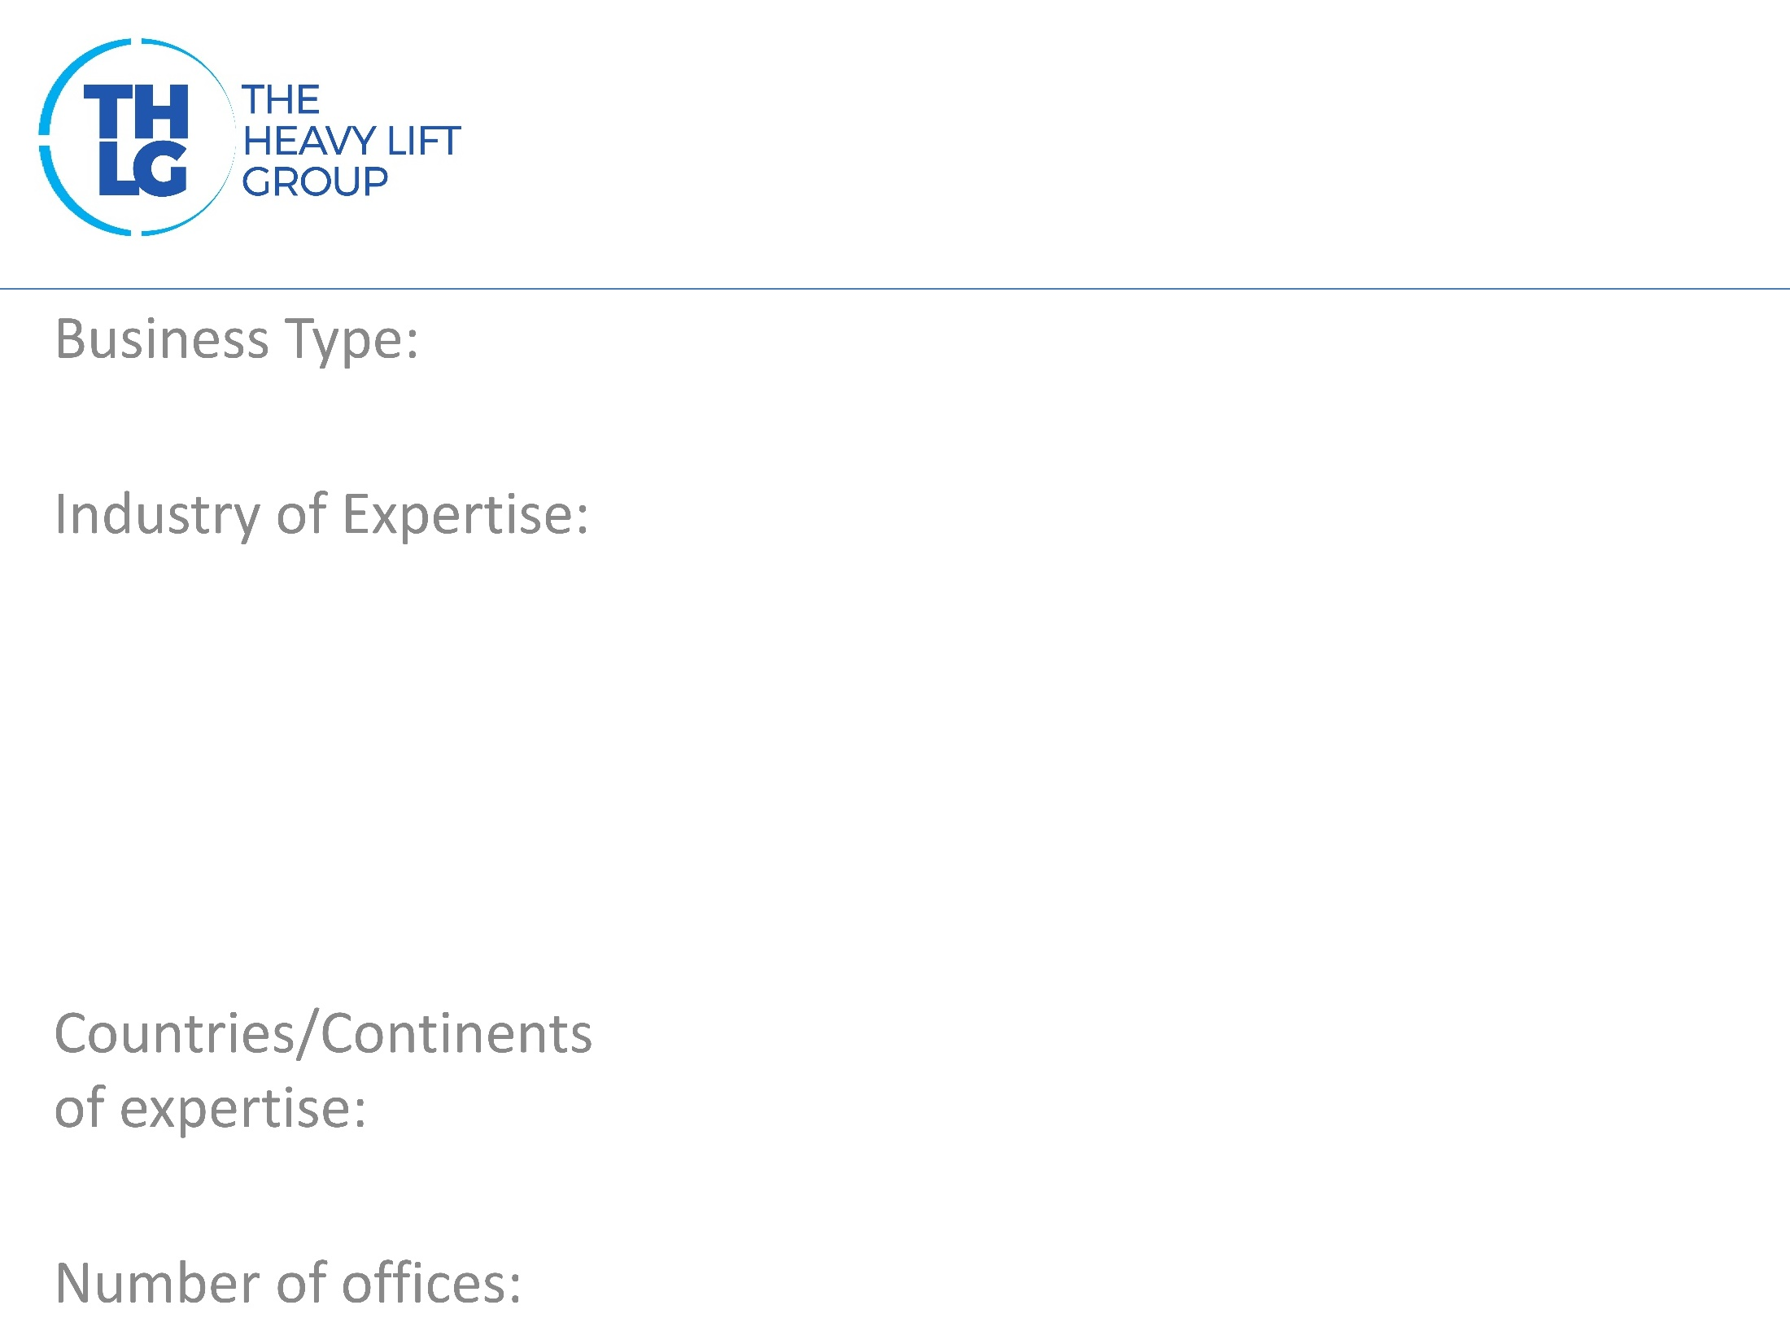
UAE THLG member since 2012
Freight Forwarders
Power Machinery Oil & Gas Petrochemical Industrial Projects Yachts Construction
Middle East / Indian subcontinent
14 (Middle East) , 10 (Indian Subcontinent)

Slide 3
UAE THLG member since 2012
Petrofac International
Entrepose Contracting
Maritime Industries Services
Oilfields Supply Centre
Drake & Scull
Weatherford Group
Smith International
Schlumberger
GE Electric
Dodsal Engineering
Baker Hughes
Consolidated Ccontractors International Company
Gulf Piping Company
Gulf Specialized Mechanical & Engineering Co’
Eversendai Offshore
Gulf Craft
ABB
Adyard Abu Dhabi
MI Gulf Services
Halliburton Pipelines & Process Services
Technostat
Kentz
Global Process Systems
OMV GmBH
Lamprell Dubai
National Oil Well
Christensen Gulf Services
Larsen & Toubro Limited
Total
SBM Atlantia
GE Oil & Gas
ALSTOM Transport SA

Slide 4
UAE THLG member since 2012
CSS successfully manage every aspect of logistics during the projects life span
Management defined strictly by the complexity of cargo
Monitoring purchase orders globally with updates
Dedicated hands on projects / contract co-ordination
Expert onsite supervision at origin, destination or any other transit point as required
Technical planning for all heavy lifts and over dimensional loads via special trucks, barges, ocean vessels and aircrafts
Optimal combination of liner services part / full charters to meet project /contract needs
Detailed and accurate documentation with status updated report
Advise on optimal cargo specifications to minimize cost and maximize safe handling

Slide 5
UAE THLG member since 2012
Dubai METRO Expansion project (Transport)
Al Zour New Refinery project – Kuwait (Oil & Gas)
DEWA Substation project – Dubai (Power)
Sweihan Solar Park project – Abu Dhabi (Solar)
BeAAT Expansion project – Abu Dhabi (Waster Water Treatment)
Participation in other Groups:

