Slide 1
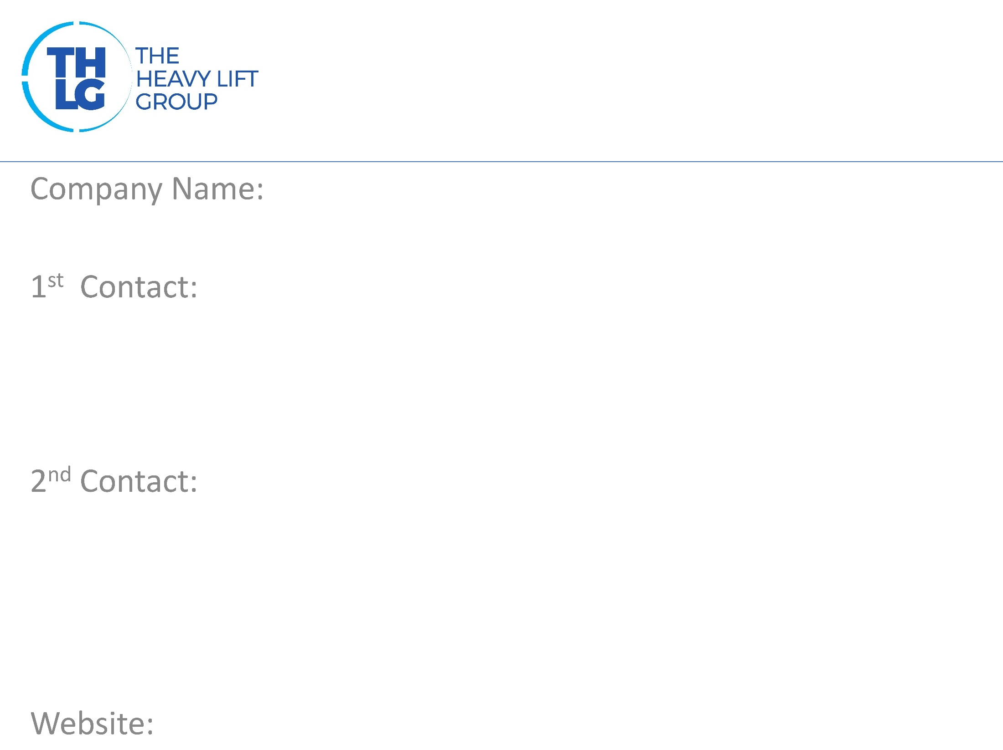
Switzerland, USA, Japan THLG member since 2006
Rhenus Project Logistics
Region | Contact 01 | Contact 02
USA | Colin D’Abreo Cell: +1 917-297-7355 colin.dabreo@us.rhenus.com | John Kitts Mob: +1 917 981 5991 Skype: jkittskog john.kitts@us.rhenus.com
SWITZERLAND | Roger Kuendig Tel. +41 (0)41 784 23 56 roger.kuendig@ch.rhenus.com | Tobias Koenig +4915115052758 tobias.koenig@de.rhenus.com
JAPAN | Seiichiro Onishi +81-70-2161-3155 Seiichiro.onishi@jp.rhenus.com | Carsten Schroeter +49 175 184 63 10 Carsten.Schroeter@de.rhenus.com
www.rhenusproject.com

Slide 2
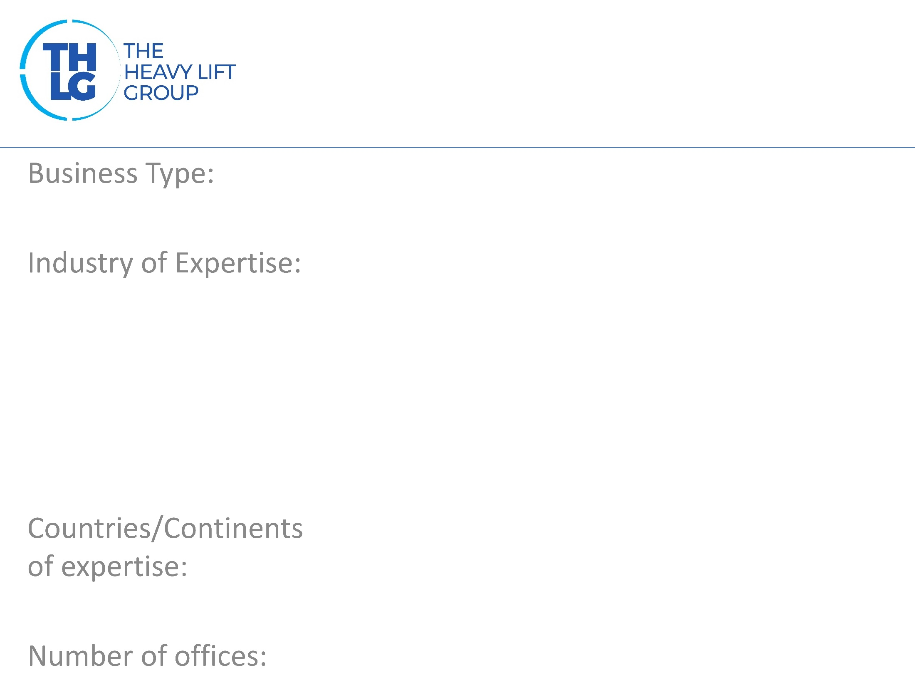
Switzerland, USA, Japan THLG member since 2006
Freight Forwarders – Project Logistics
Power: Renewable, Hydro, Fossil Fuel Mining Heavy Machinery, Industrial Equipments Petrochemical
Global
23 offices globally

Slide 3
Switzerland, USA, Japan THLG member since 2006

Slide 4
Switzerland, USA, Japan THLG member since 2006
Technical Services
In house engineering expertise for heavy-lift and oversized cargo
Route surveys & technical feasibility analysis
Multi-modal transport experience
Supervision of handling, lashing and securing of cargo
Latest and safest packing arrangements
Liaison with public works and authorities, police escort, traffic management etc
Build temporary roads, bridges, jetties
Completely digitized operations- EDIs
Commercial Services
Break bulk and heavy-lift shipments
Air, Ocean, Road, Rail, Short-sea shipments
Unloading and installations at jobsite
Complete plant decommissioning and relocation
Shutdown management services
Charter and part charter services
Customs formalities
Packing services
H&S compliant labour and equipment arrangements
Ancillary Services
Offshore logistics
Port logistics services
Advanced Warehousing solutions
Digital platforms for track and trace / IoT based solutions for 360° overview and complete control – No installations needed!

Slide 5
Switzerland, USA, Japan THLG member since 2006
Join us on social media
Heavylift to Tunisia
Project Cargo to Russia
Heavylift to USA
Read all about our projects:

Slide 6
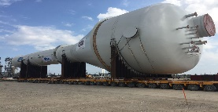
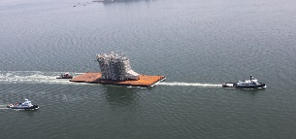
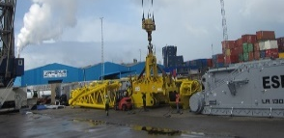
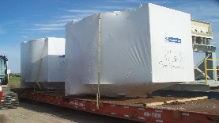
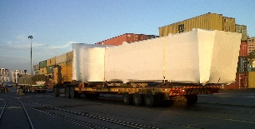
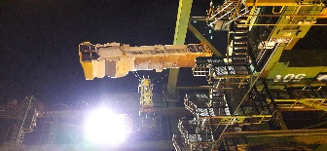
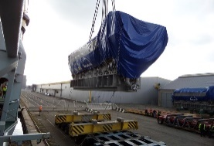
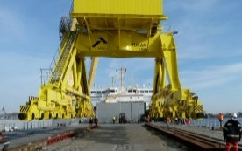
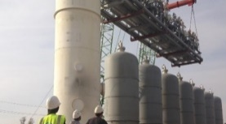
Switzerland, USA, Japan THLG member since 2006
Case Studies :
Region | Recent Projects
N America
S. America
W. Europe
E. Europe
Petrochemical
USA
Power
USA
Heavy Machinery
Mexico
Airport Equipment
El Salvador
Airport Equipment
Bolivia
Airport Equipment
Paraguay
Power
Germany - Bangladesh
Solar
China - England
Heavy Machinery
Germany - Tunisia
Petrochemicil
Russia
Power
Uzbekistan
Heavy Machinery
Turkmenistan

Slide 7
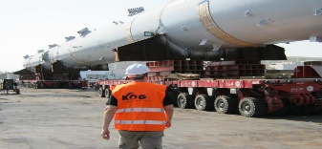
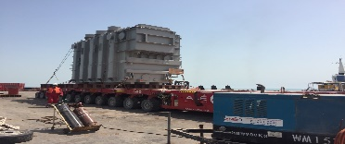
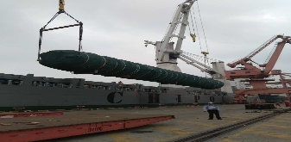
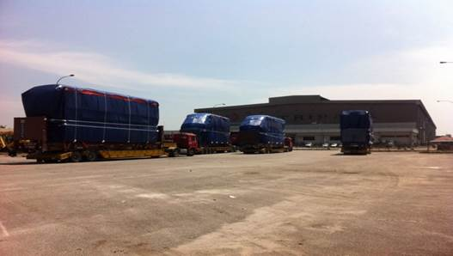
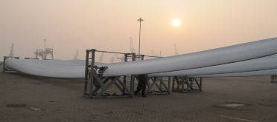
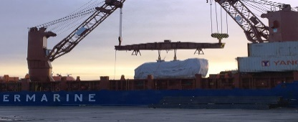
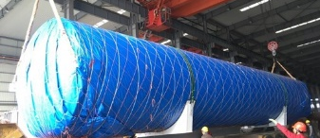
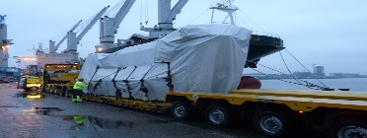
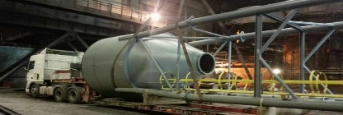
Switzerland, USA, Japan THLG member since 2006
Case Studies :
Region | Recent Projects
Middle East
Africa
India / South East Asia
China
Petrochemical
UAE
Power
Bahrain
Petrochemical
South Africa
Rolling Stock
India
Wind
India
Heavy Machinery
Bangladesh
Petrochemical
China - Ghana
Power
Germany - China
Heavy Machinery
China – Russia

Slide 8
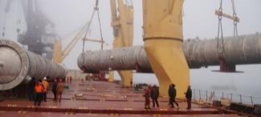
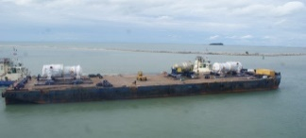
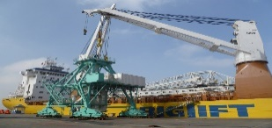
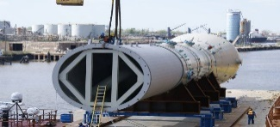
Switzerland, USA, Japan THLG member since 2006
Case Studies :
Region | Recent Projects
Asia Pacific
Japan
Petrochemical
Vietnam
Power
Thailand
Heavy Machinery
Philippines
Petrochemical
Japan - USA

