Slide 1
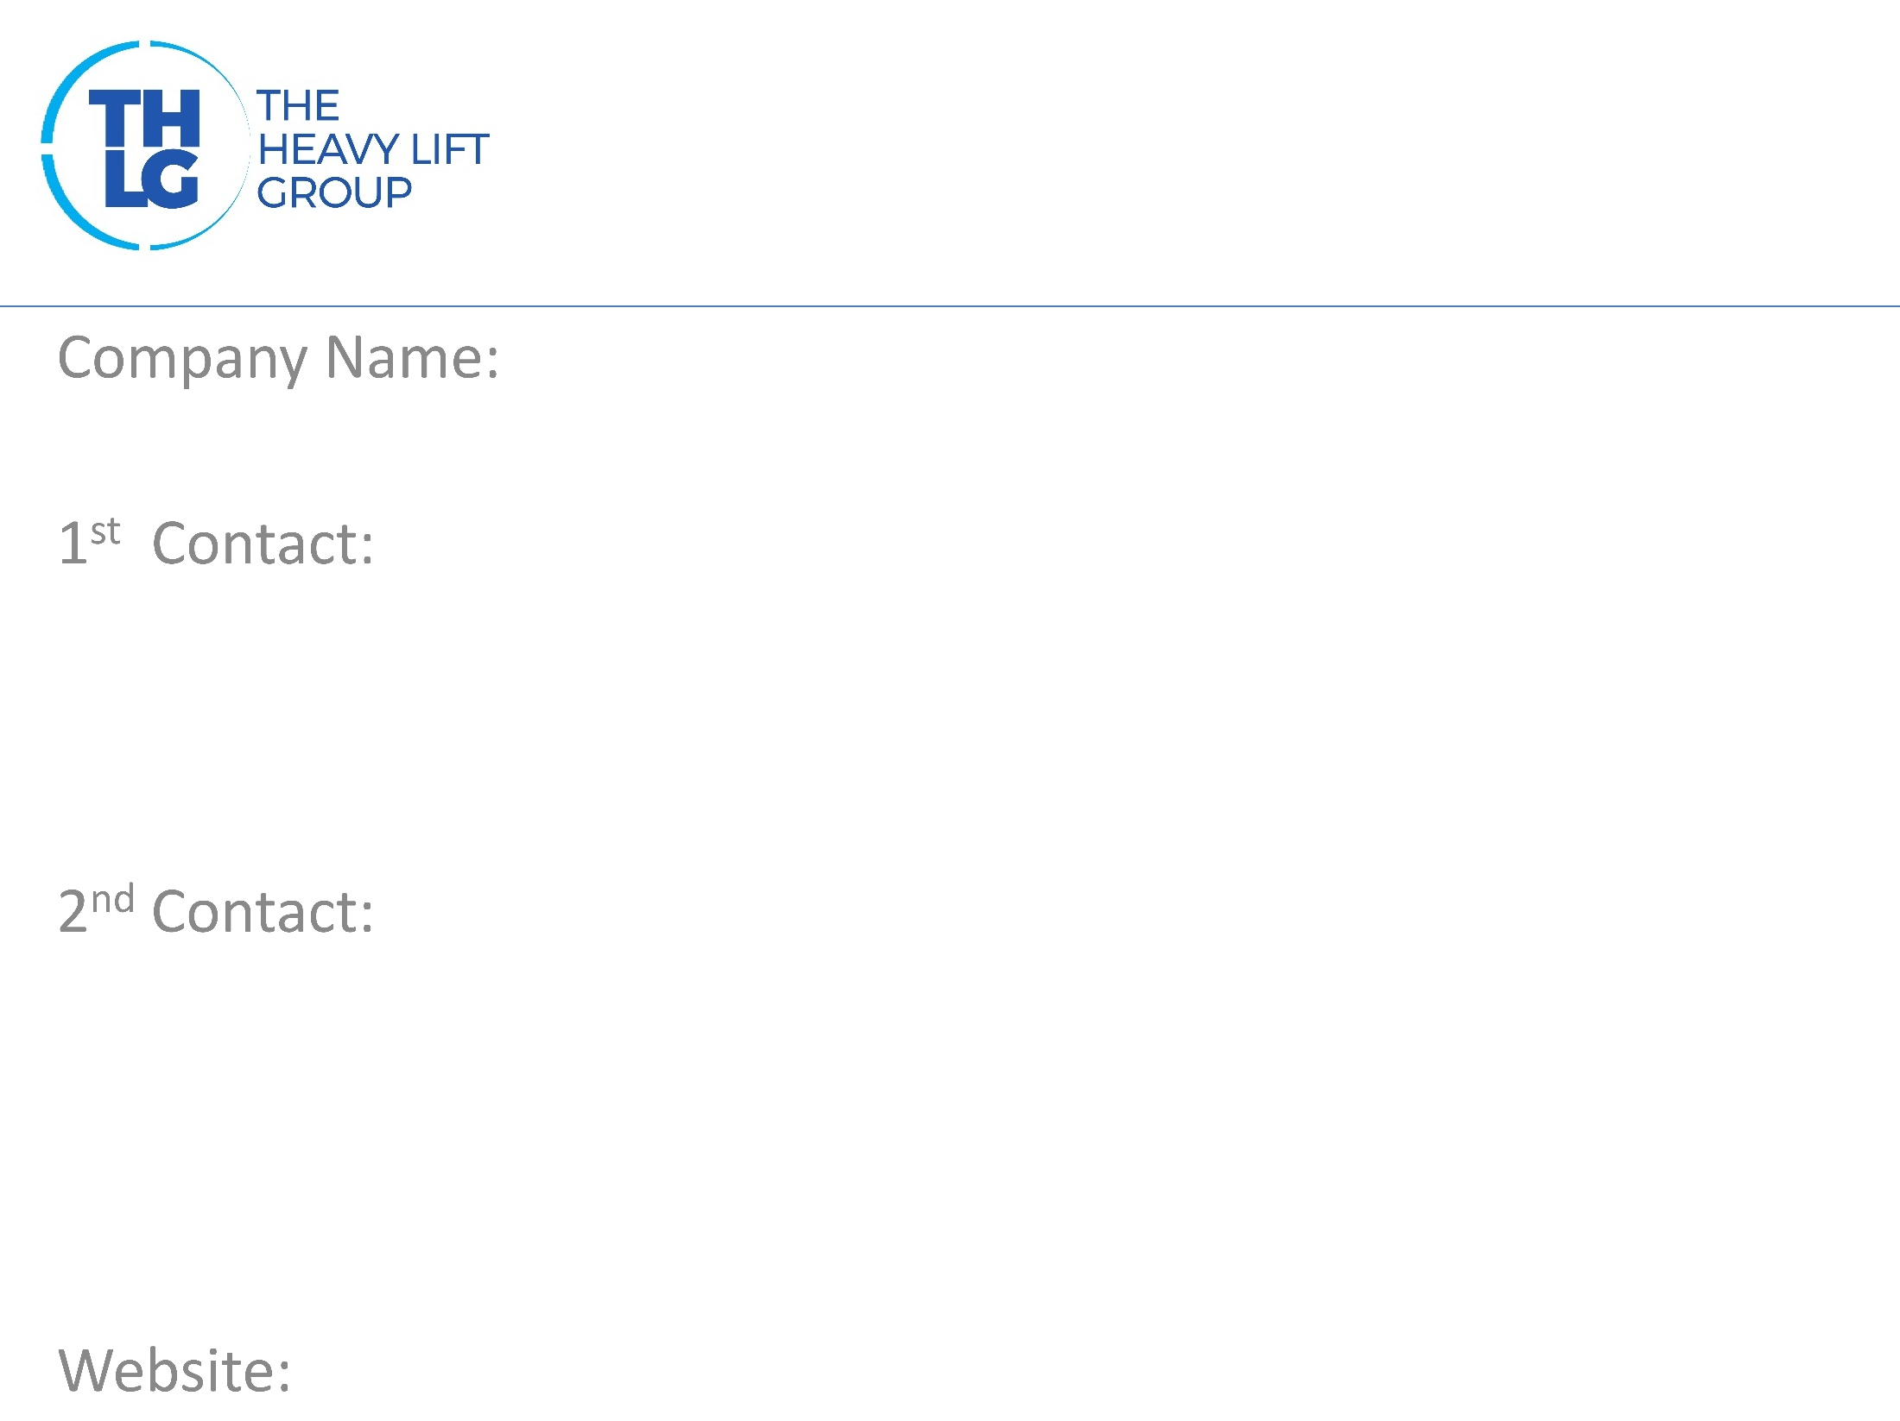
USA THLG member since 2018
Specialized Power Logistics
Richard Flores/ President/Partner T: +1 877-212-5425 M:+1 832-356-7372 Richard@shipspl.com
Kenny Kim/ Project Mgr/Inside Sales T: +1 877-212-5425 rfq@shipspl.com
www.shipspl.com

Slide 2
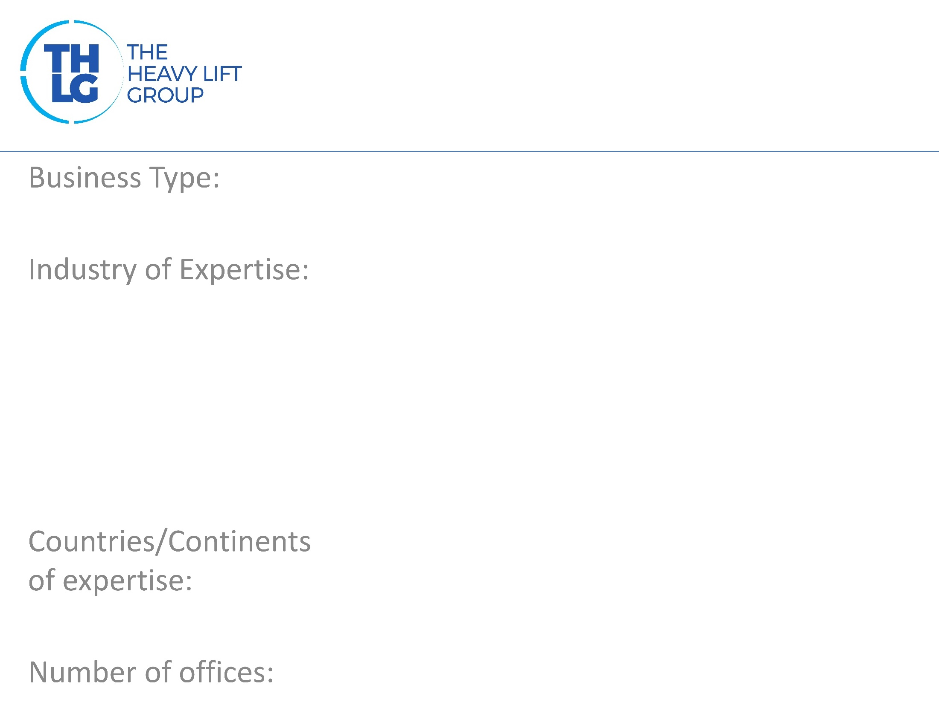
USA THLG member since 2018
Project management– Rail
Power: Transformers, Generators Wind, Thermo Mining Machinery Petrochemical
United States Of America, Mexico, Canada
1 - Houston

Slide 3
USA THLG member since 2018

Slide 4
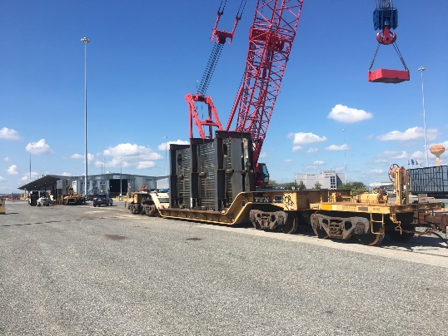
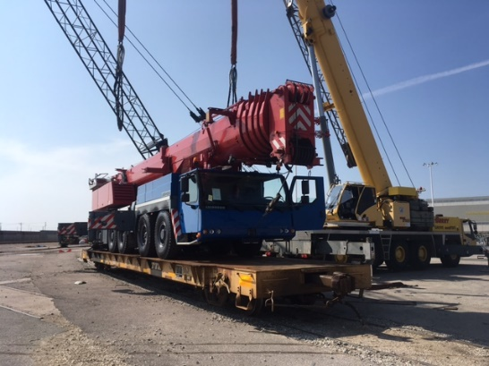
USA THLG member since 2018
Rail Hi-wide Logistics Rail car ordering Project planning, management and execution Rail car securing/tie down Rail Clearances (drawings) Feasibility studies/Route Surveys Heavy Haul Barge Transport ON-site Supervisors Port supervision GPS/Impact Recorders

Slide 5
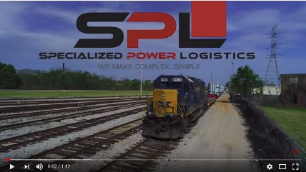
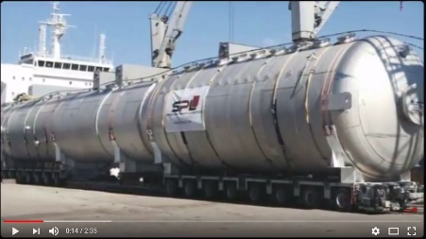
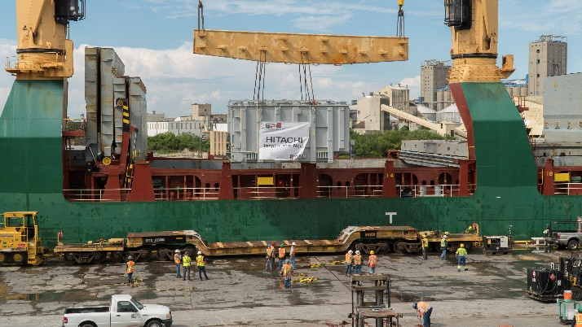
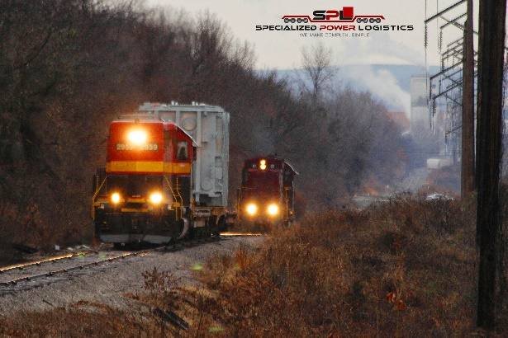
USA THLG member since 2018
Join us on social media
Transformer Delivery Video
Special Train Video
Vessel Delivery Video
Participation in other Groups:

