Slide 1
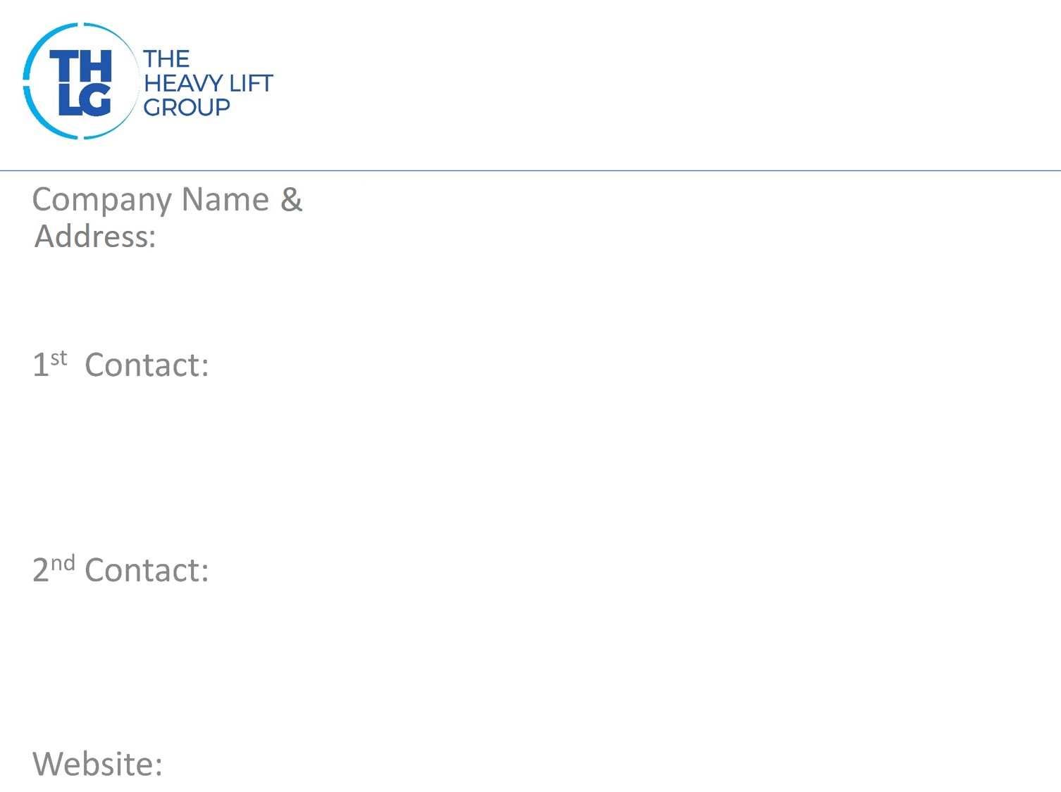
International For Transit & Transport C/O Home Link Global Trade FZE P.O.Box: 329614 Ras Al Khaimah-U.A.E
Mohammed A Al Khouli Tel: +963-11-2266893 Fax: + 963-11-2266837 Mobile: +963-95-7553408 or + 971-50-2055086 E-mail: ifttme@gmail.com or mohammed@Khouli.me
Danya Elawi Tel: +963-11-2266893 Fax: + 963-11-2266837 Mobile: +963-95-0006496 E-mail: sales@heavyload-homelink.com
www.iftt.me

Slide 2
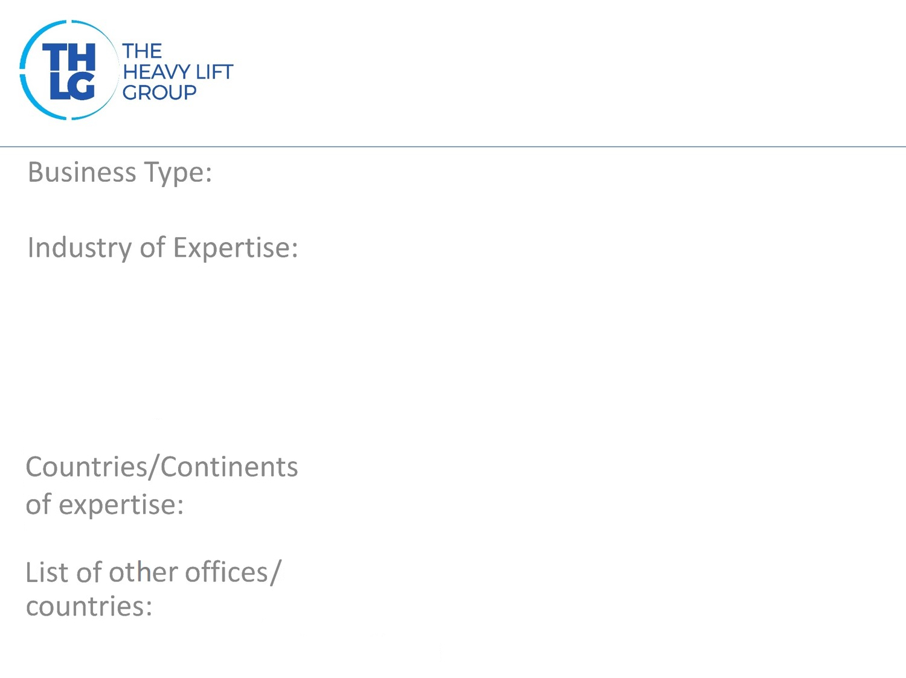
Company logo
Freight Forwarding, Project Transport, Crane Rentals, Events & Aid Logistics
Oil & Gas, Energy, Engineering, Cranes & lifting Equipments
Middle & Near East, Africa, South East Asia, North & Latin America
Damascus- Syria Tartous - Syria

Slide 3
PVE cranes Middle East LLC
Van Schaften Truck
Weatherford Oil Tools Middle East
Public Establishment of Electricity- Syria
Sapesco
Al Furat Petroluem Company (Shell Subsidiary)
Al Mansoori Specialized Services
Deir E Zzour Petroleum Co (Total Elf Subsidiary)

Slide 4
Over Size Cargo & Projects
Over Size Cargo & Project Logistics
Cranes , Lifting Equipment's & Self Propelled Machinery Relocation
Heavy Cranes Rental & Services
Shipping Agencies: NVOCC (Containers) LCL Breakbulk
Aid & Ration deliveries for Red Cross , UN & NGO’s
Transit Cargo handling from Syria to Iraq & Jordan
Door to Door Sea or Air consolidation Import from selected origins
Door to Door Balikabian from Syria/Lebanon/Jordan
Events & Exhibition logistics
Relocation of Household , Personal, Offices including handling Diplomatic Goods
Container Inspection & Repairs
Shipping Agencies
General Freight Forwarding
Relocations

Slide 5
2 Liebherr HS 895 Cranes Mobilization from Jebel Ali including
transport of basic machine of 65 Tons each
Seafreight of Kobelco Crane from Port Rashid
Oilfield Equipment from Sharjah/UAE to Gas Fields in Syria
Participation in other Groups:
SAG- SFIFF

