Slide 1
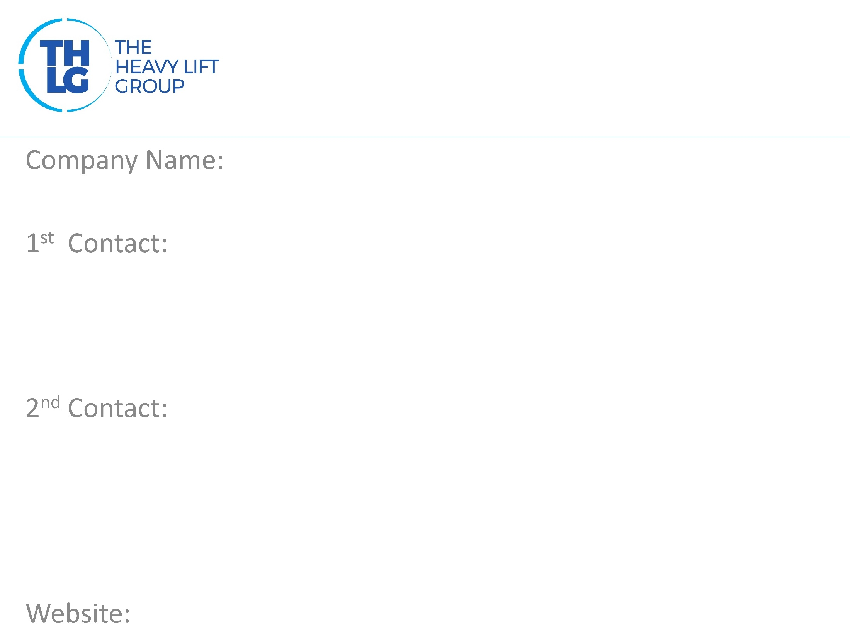
AUSTRIA THLG member since 2013
Spedition “Thomas” GmbH
Mr. Thomas Fruehauf / Project Manager T: +43 316 273490-16 M:+43 676 843757150 Thomas.fruehauf@sped-thomas.at
Mr. Karl Fruehauf / CEO T: +43 316 273490-10 karl.fruehauf@sped-thomas.at
www.sped-thomas.at

Slide 2
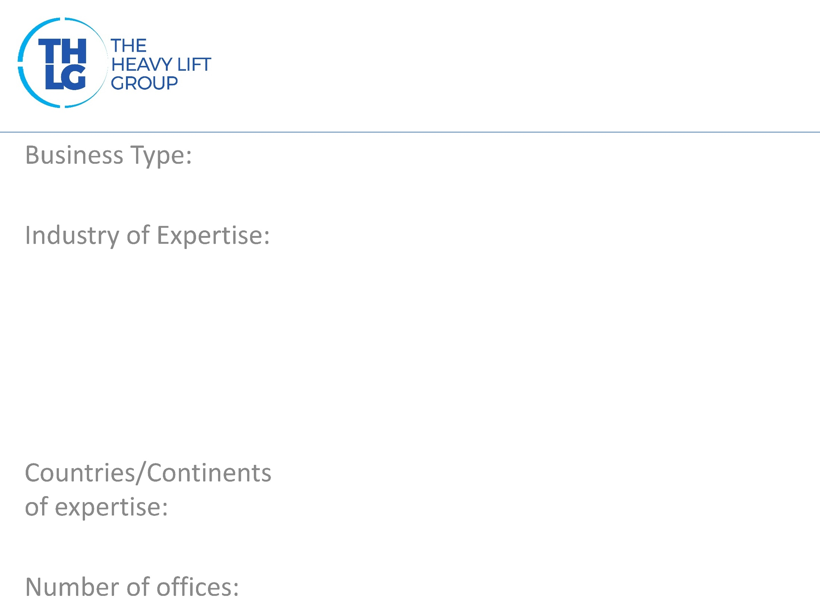
AUSTRIA THLG member since 2013
Freight Forwarders
Mining Machinery Industrial Projects High & Heavy Agro, Food & Feed
Europe
1 – Graz, Austria

Slide 3
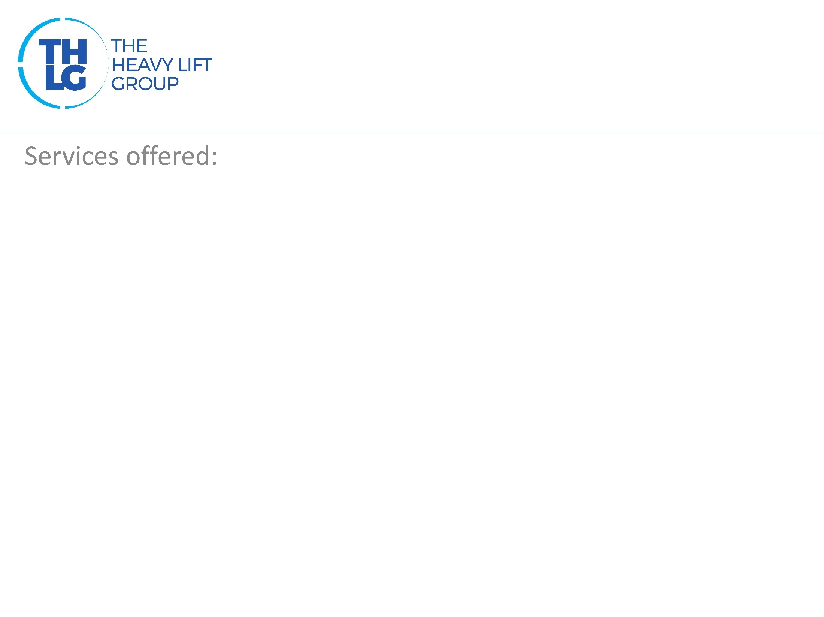
AUSTRIA THLG member since 2013
Complete logistic and transport solutions; Air, Land & Sea transportation; Break Bulk, RoRo, over dimensioned cargoes, part and full charters; Crating, packing and stowing services; Hiring and Management of cranes, forklifts and special lifting devices. Customs Service Worldwide insurance coverage

Slide 4
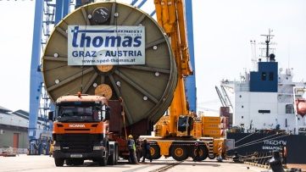
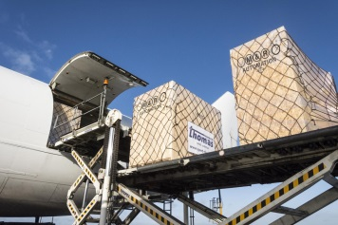
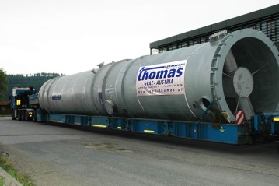
AUSTRIA THLG member since 2013
Filter-Station FRP
Automotive – Charter of 747
Filter Station Steel
FAN – Chile Mine
Participation in other Groups:

