Slide 1
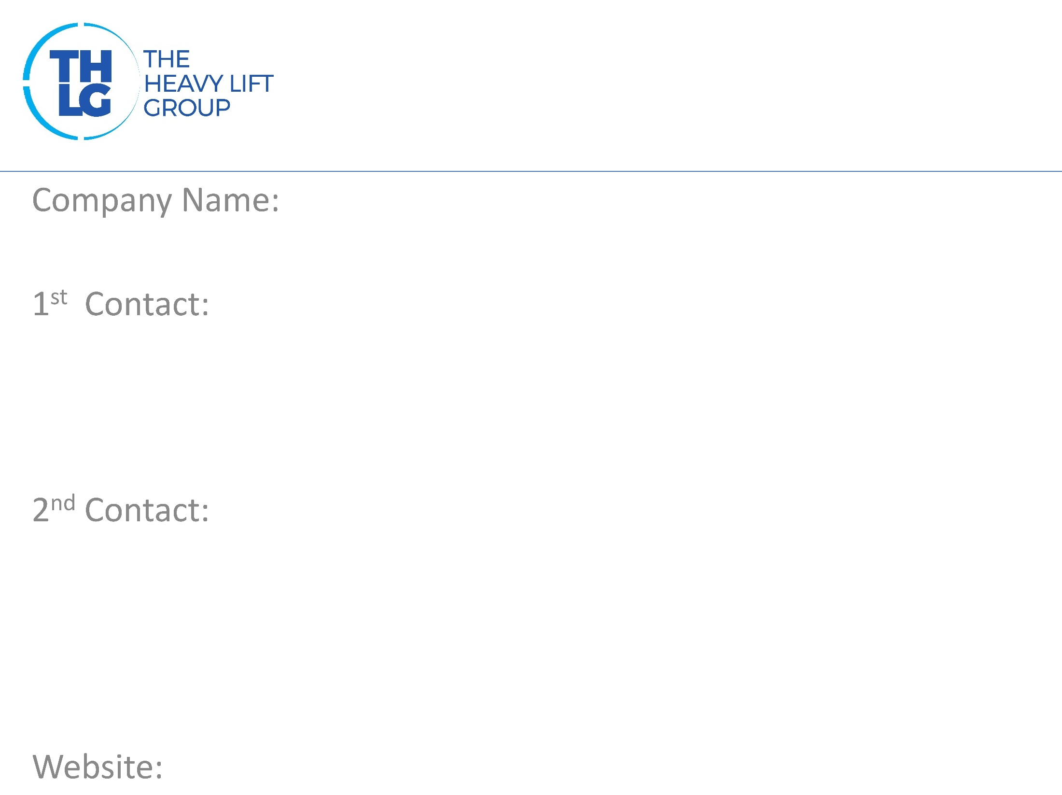
Norway THLG member since 1997
TP Shipping AS
Mr. Thomas Parlow Tel: +47 37044800 Cell: +47 91304215 thomas@tpshipping.no
Mr. Svein Åge Thorsen Tel: +47 37044800 Cell: +47 91880129 chartering@tpshipping.no
www.tpshipping.no

Slide 2
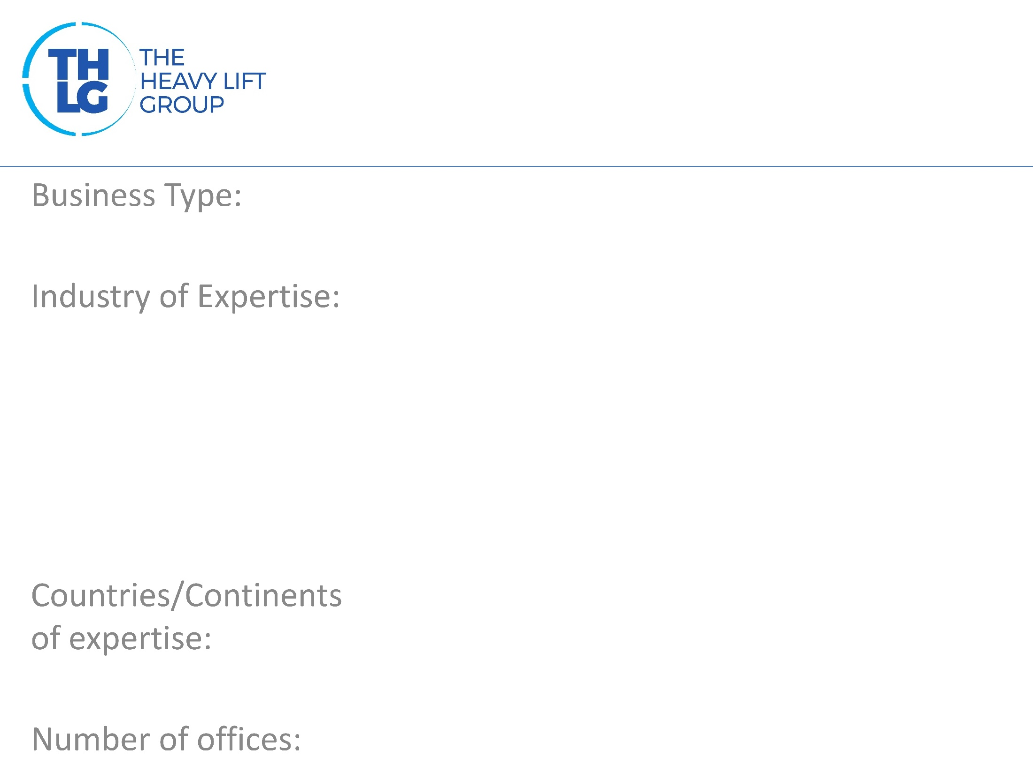
Norway THLG member since 1997
Shipbrokers – Air Chartering Intermodal logistics providers, Consultants
Offshore, Oil and gas, Renewables Fish-farm industry, Yachting industry Mining , Military, Shipyards. Harbour Equipment.
South east Asia, Middle East, South America, North America, East and WEST Africa , Cross trades , Caspian Sea, Europe
Arendal, Norway

Slide 3
Norway THLG member since 1997

Slide 4
Norway THLG member since 1997
Vessel chartering of specialized tonnage Semi-submersible ships and barges Heavylift ships Module carriers Offshore vessels Floating Cranes Flat-top barges Coasters Air charters Intermodal turn key deliveries Feasability studies Consultancies – Sale and Purchase

Slide 5
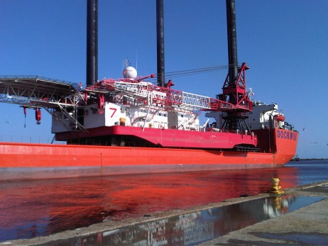
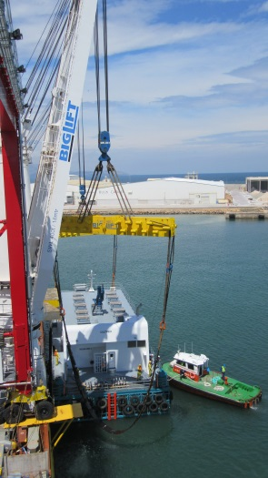
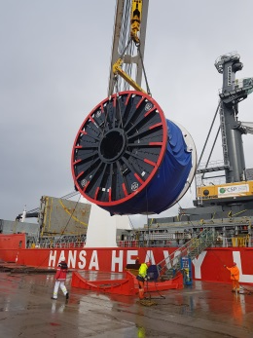
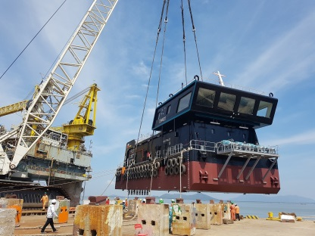
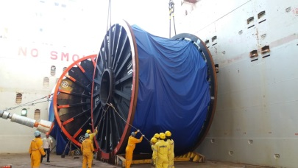
Norway THLG member since 1997
Join us on social media
Participation in other Groups:

