Slide 1
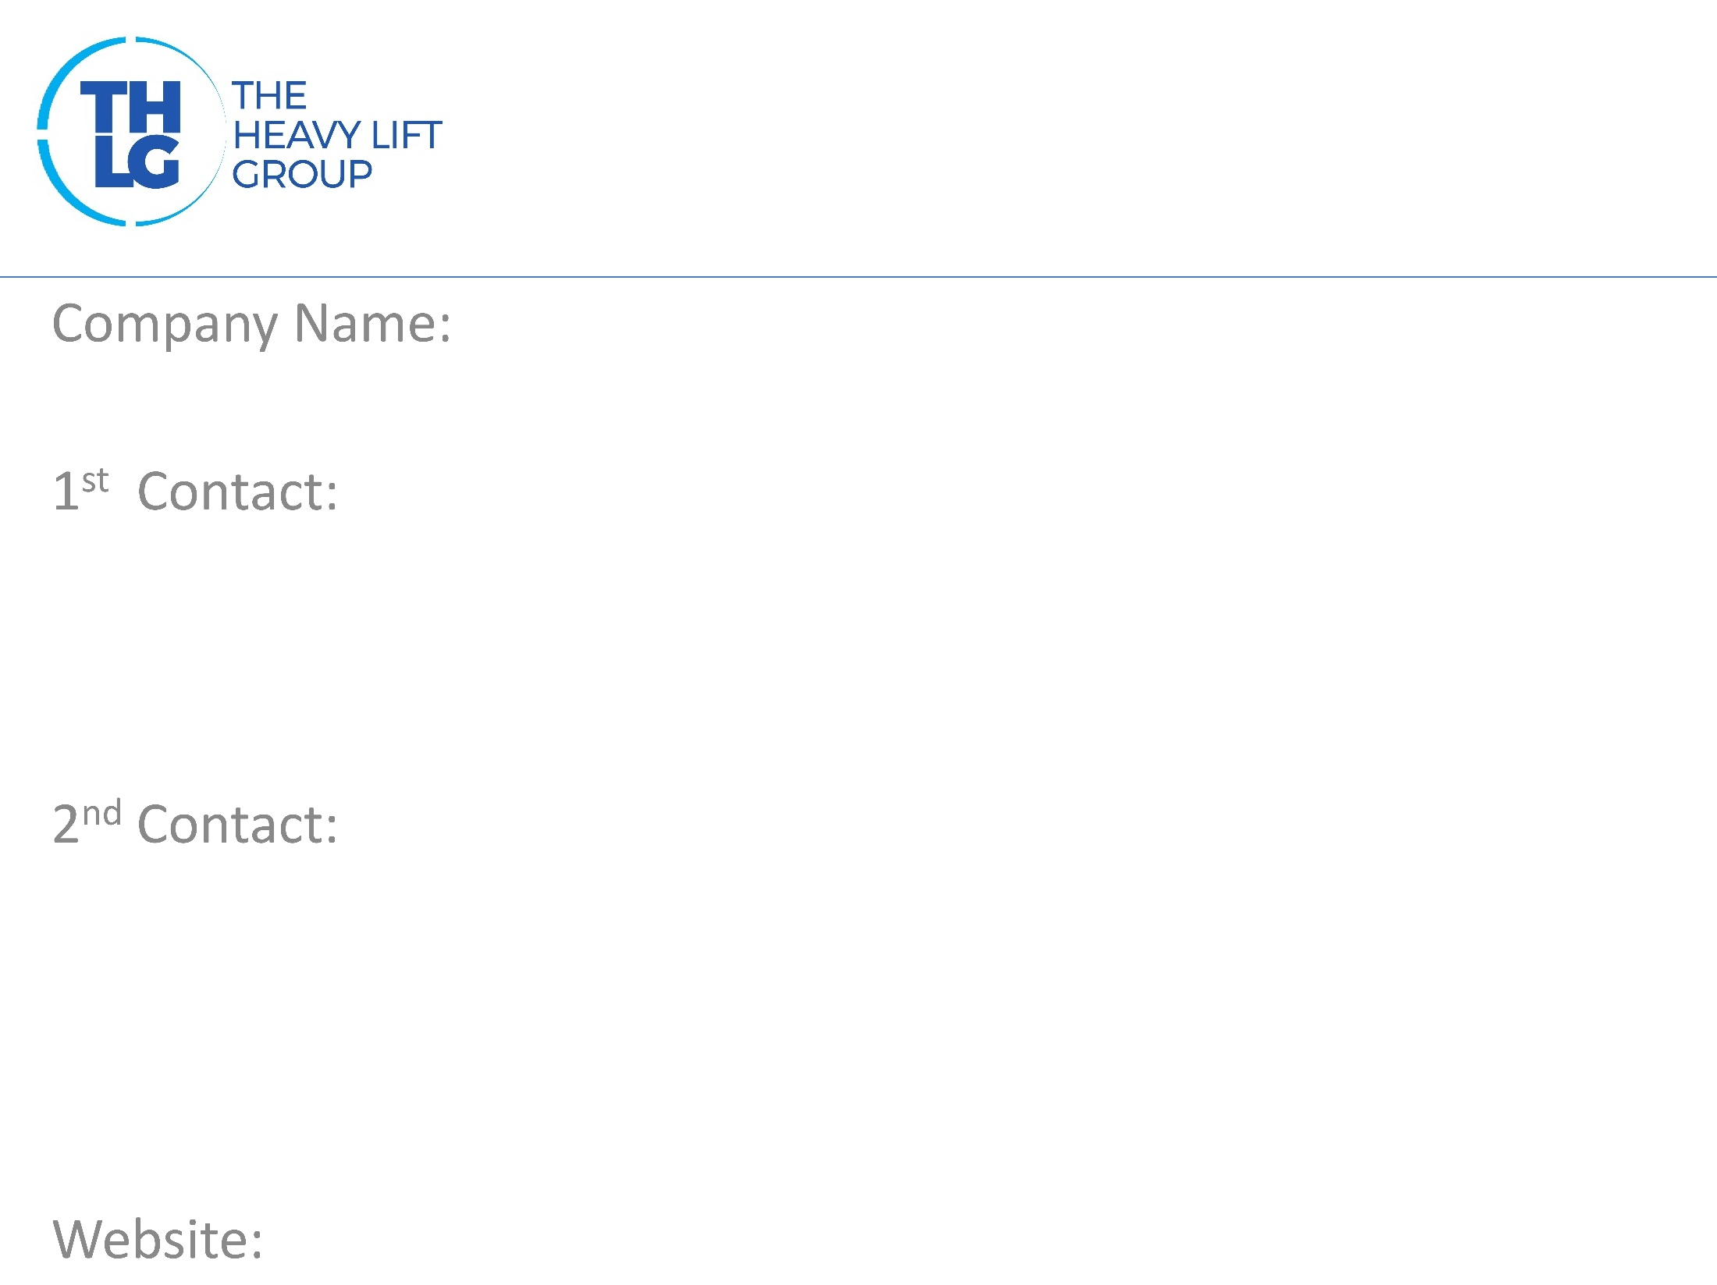
FRANCE THLG member since 2017
ASA France
Ms. Blanca CLAEYSSENS/ Managing Director M:+33 617603496 bc@asafrance.com
Mr. Peter CAEKEBEKE M:+33 617603496 aa@asafrance.com
www.asafrance.com

Slide 2
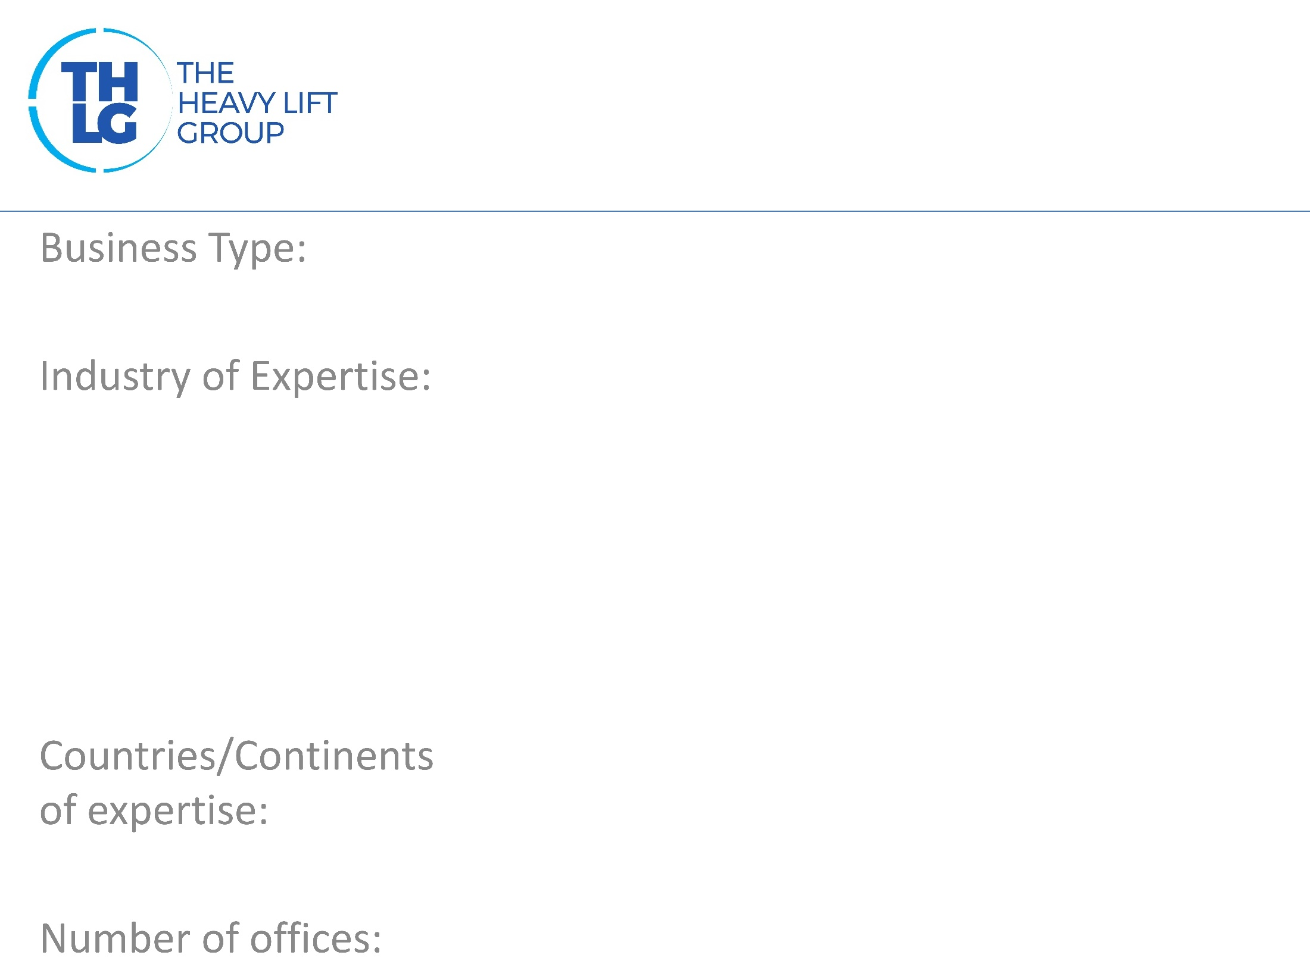
FRANCE THLG member since 2017
Risk mitigation
Project cargo Marine Aviation Heavy industry Construction
Europe, Worldwide
1 – Belgium, 2 – France

Slide 3
FRANCE THLG member since 2017

Slide 4
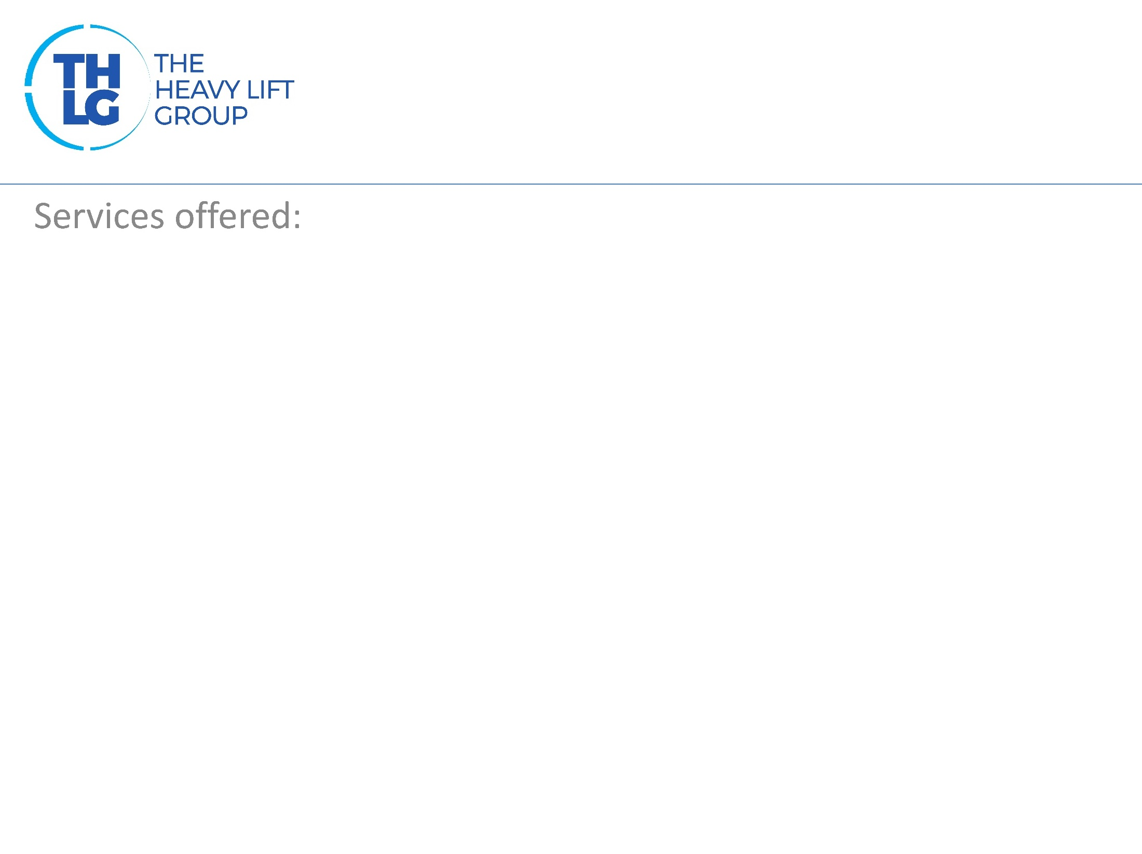
France THLG member since 2017
Risk mitigation Total risk management Consulting in transport Marine warranty surveys Transshipment supervision Heavy Lifting superintendence Lashing calculations Lashing and Securing certification

Slide 5
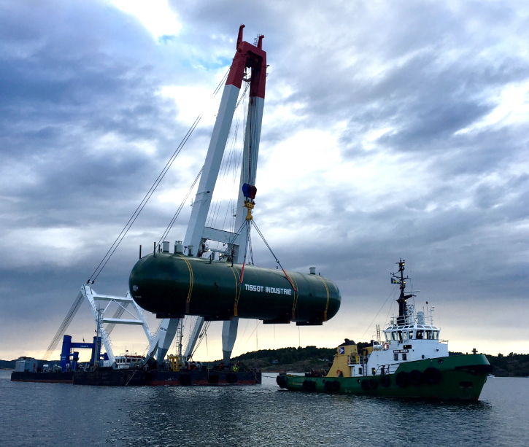
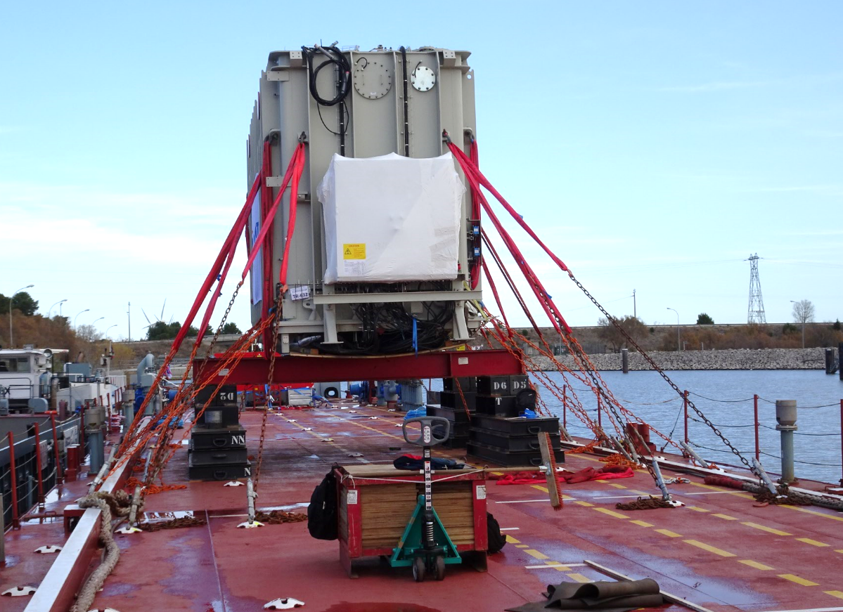
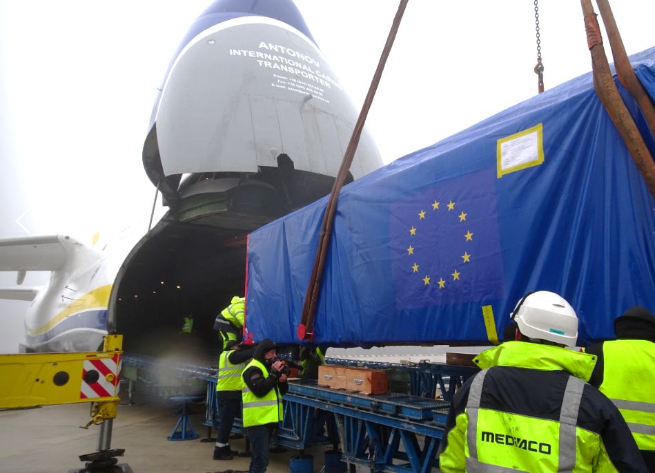
France THLG member since 2017
Join us on social media

