Slide 1
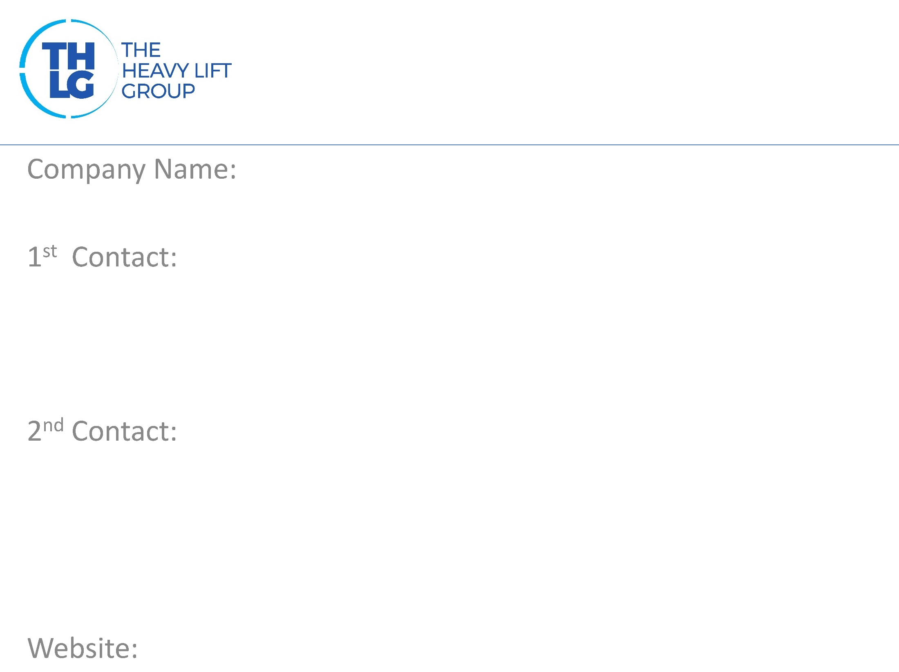
QATAR
JSL Global WLL
Mr. Jigar Shah – Director(Projects & 3PL) shah@jsl-global.net
Mr. Nishith Kothari – General Manager nishith@jsl-global.net
www.jsl-global.net

Slide 2
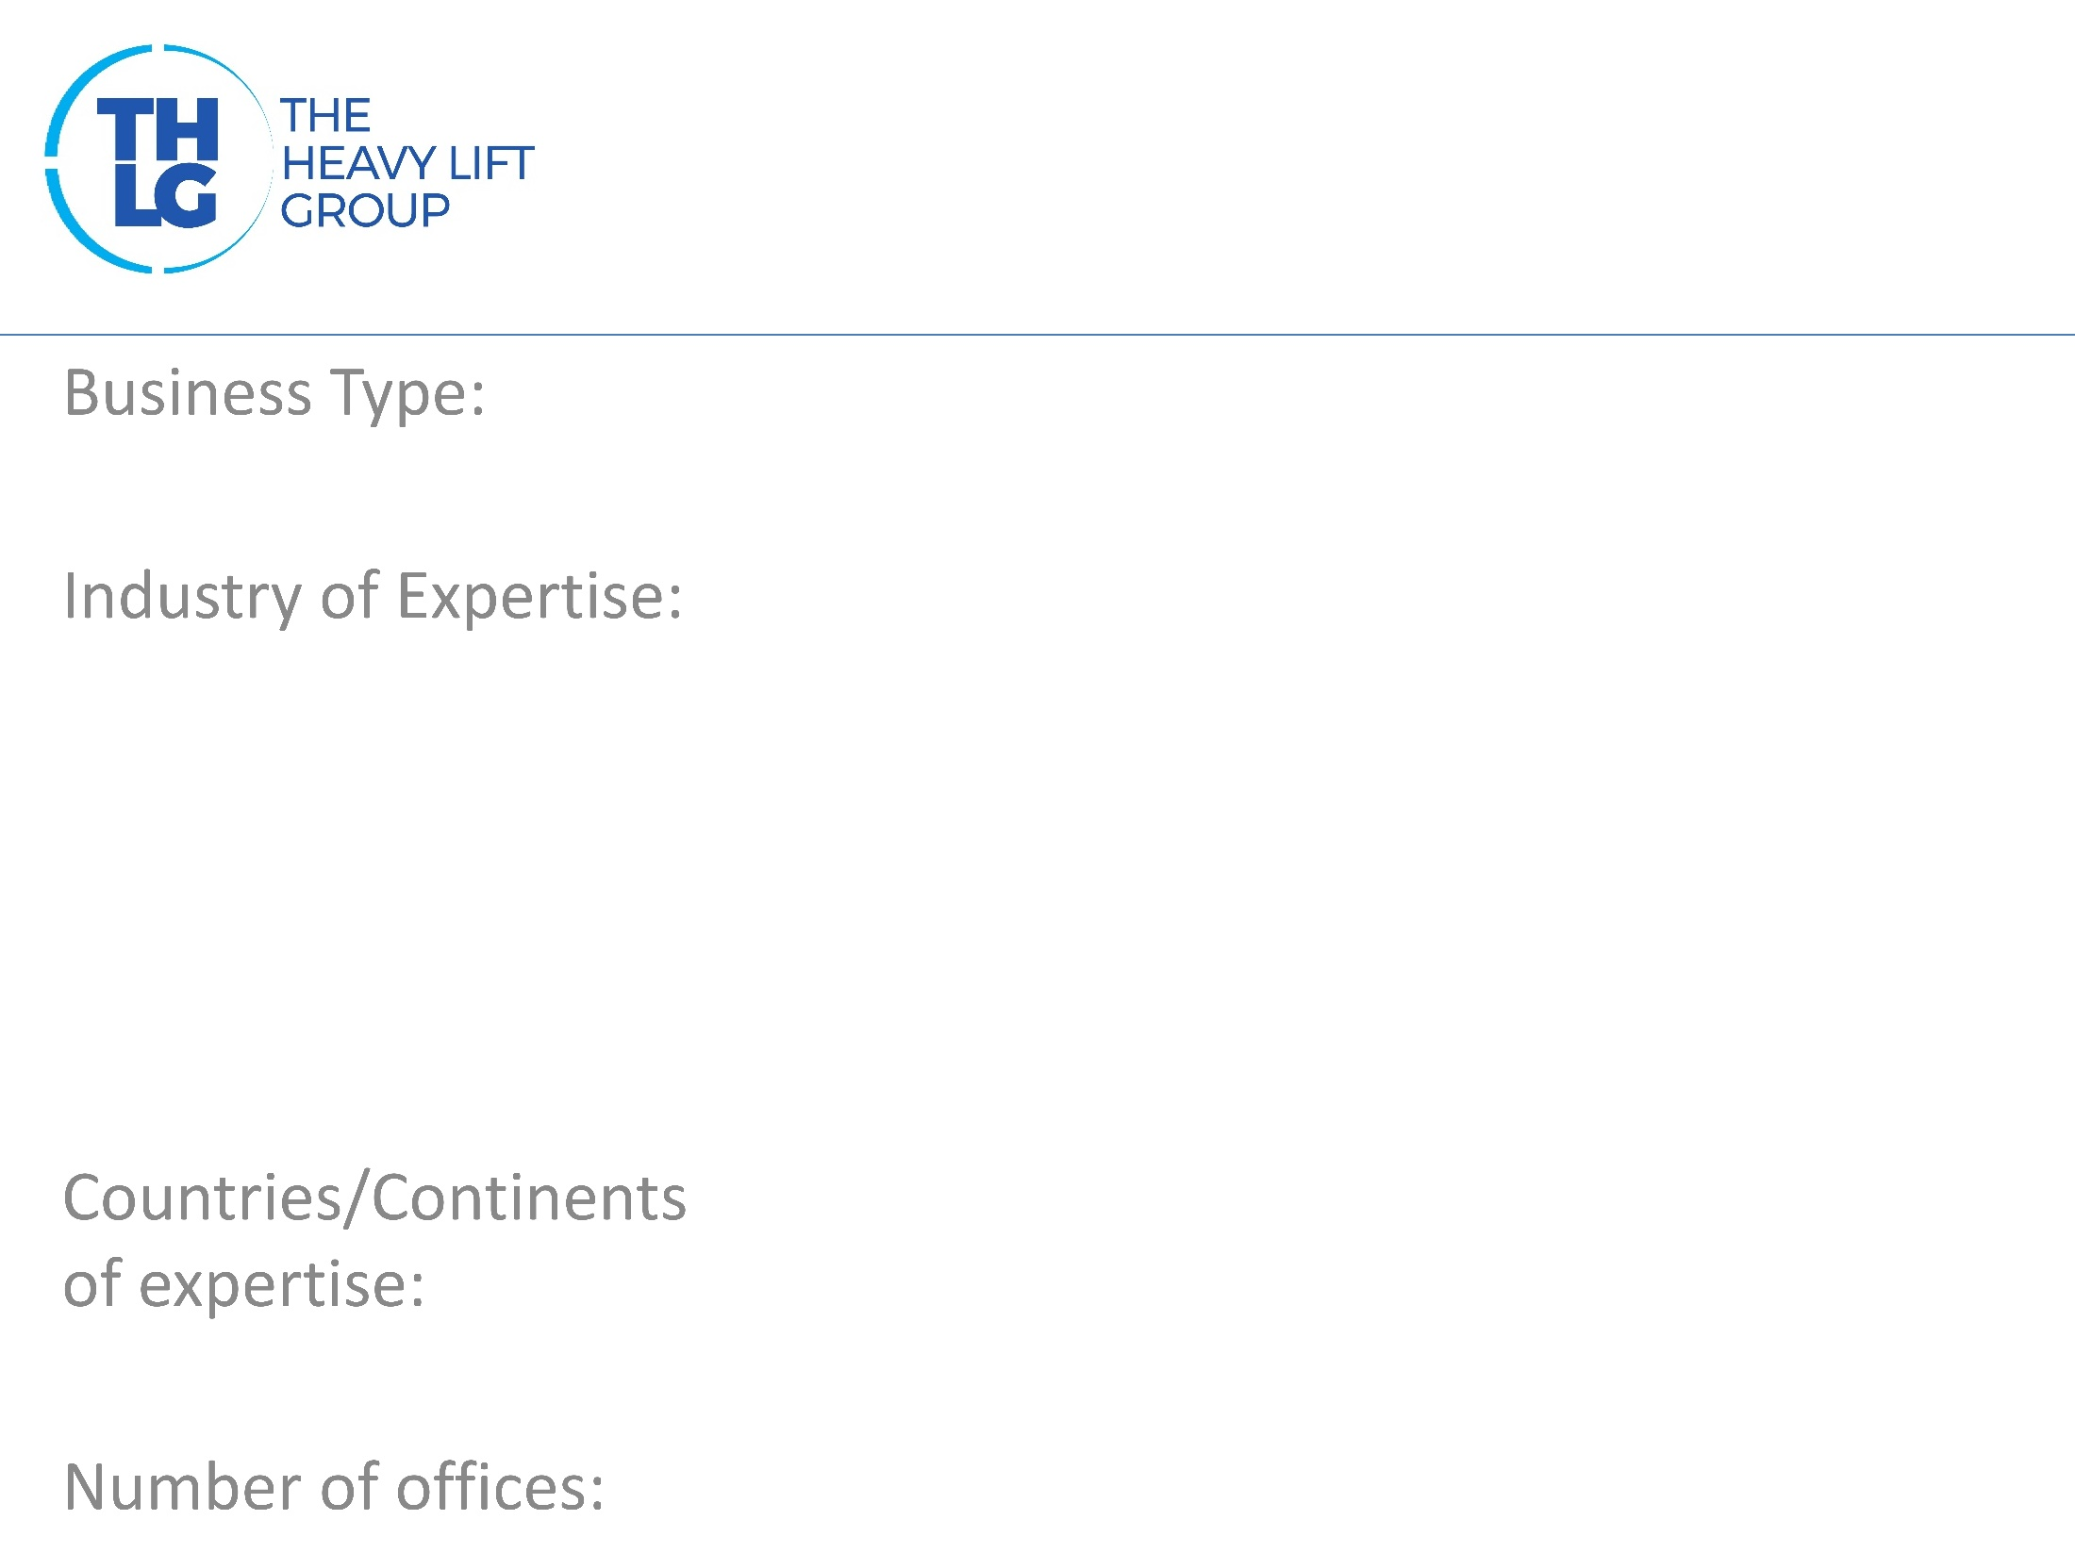
Project Logistics, Chemical Logistics, Cold Chain Logistics
Construction
Oil & Gas. JSL team has experience in handling TBMs, Rolling Stock, MSVs, MSDs, Locomotives, Transformers, Cryogenic Tanks, Cold Box & Heavy Construction Equipment
Qatar, Oman and Myanmar
3

Slide 3
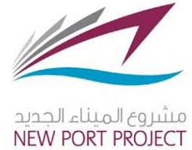
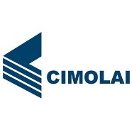
JSL Doha Project Clients

Slide 4
Project Logistics Chemical Logistics NVOCC Container Trading Warehousing Transportation Chiller/Freezer Trucks

Slide 5
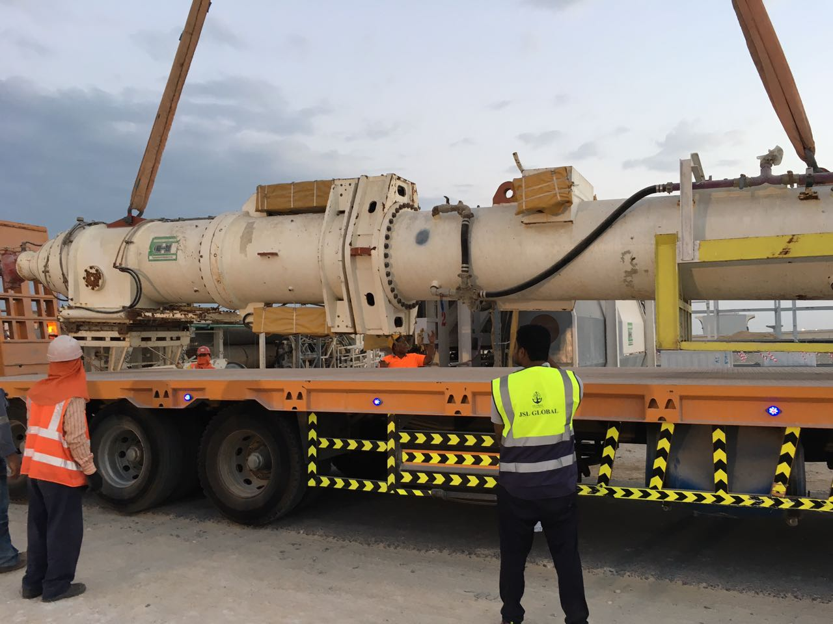
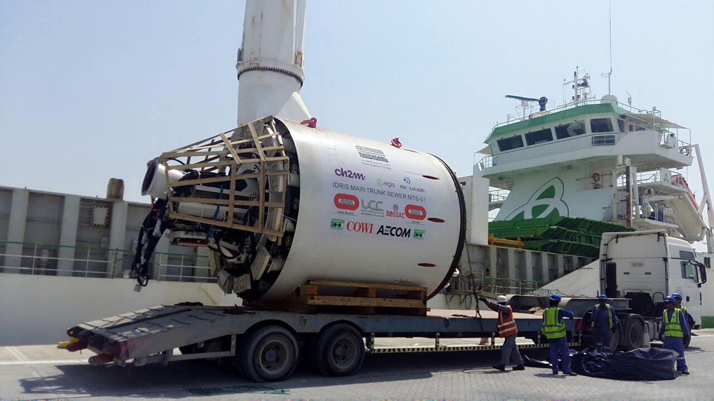
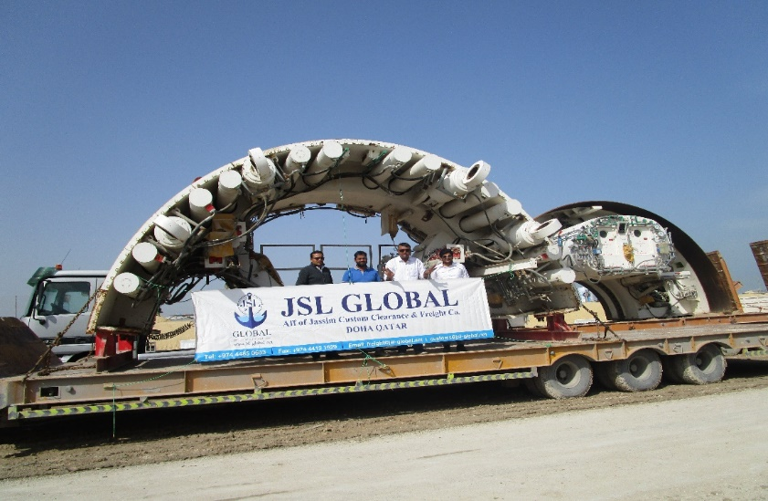
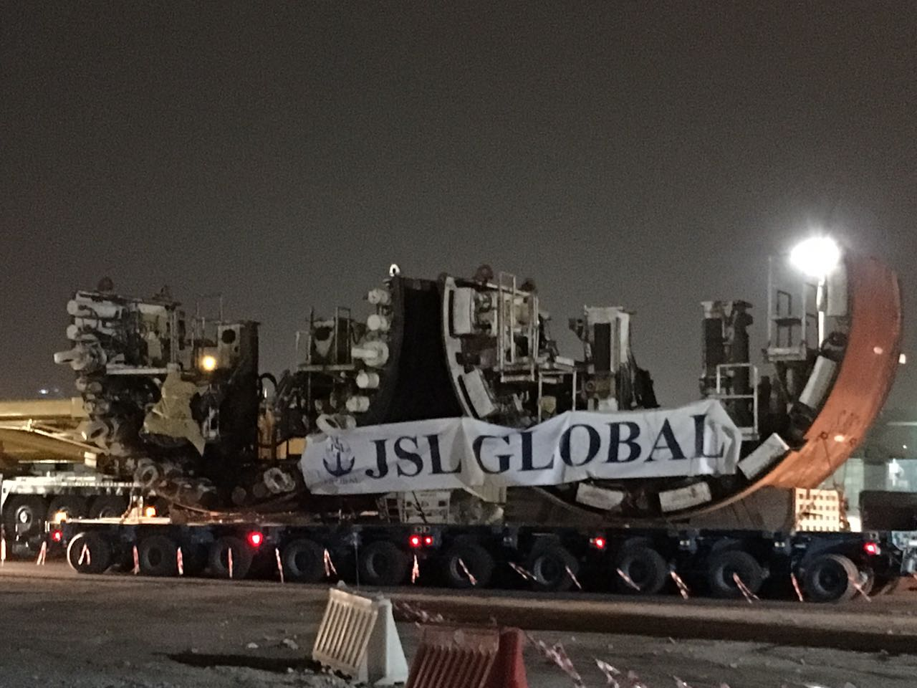
Tunnel Boring Machine – QDVC Red Line South
Tunnel Boring Machine – Idris MTS1 (Bouygues)
Tunnel Boring Machine – QDVC Red Line South (Doha Metro)

Slide 6
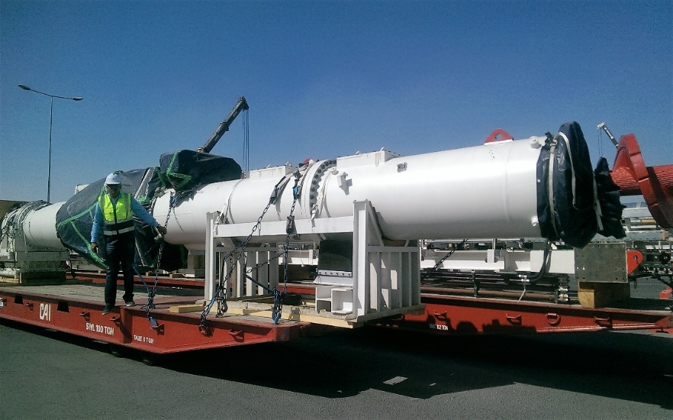
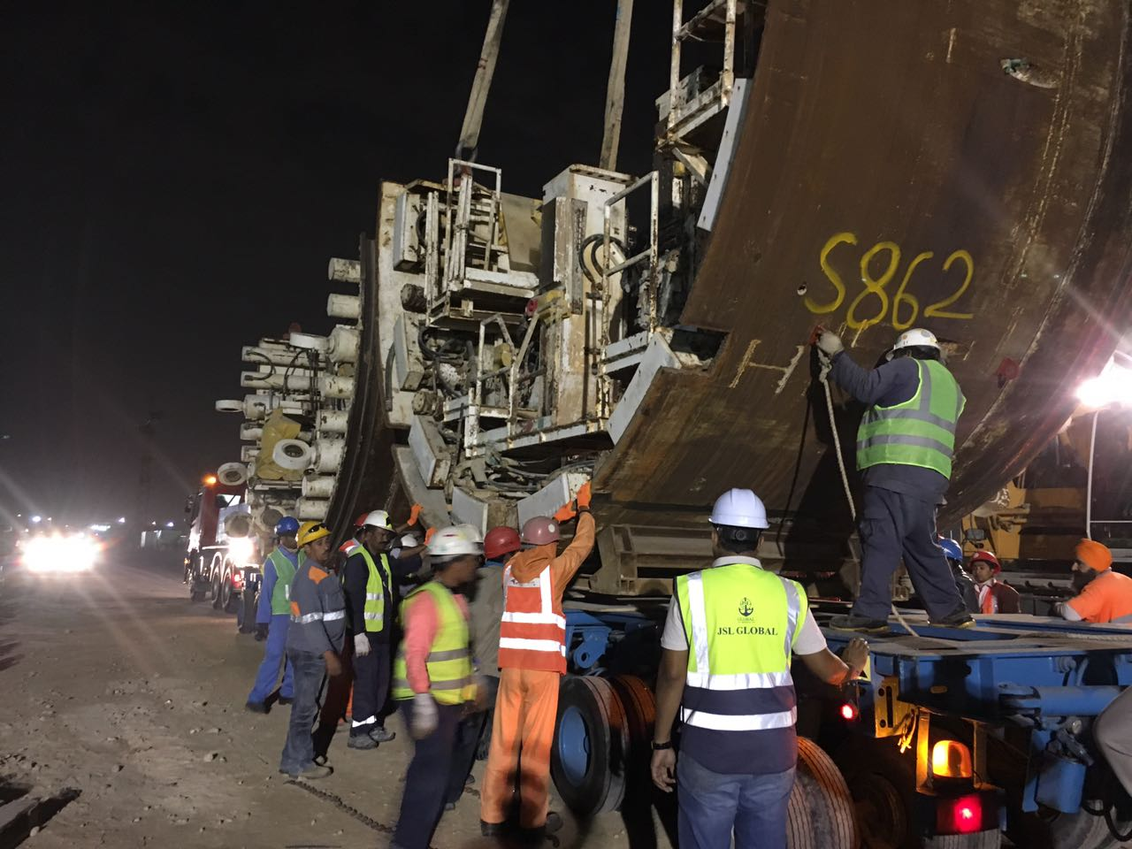
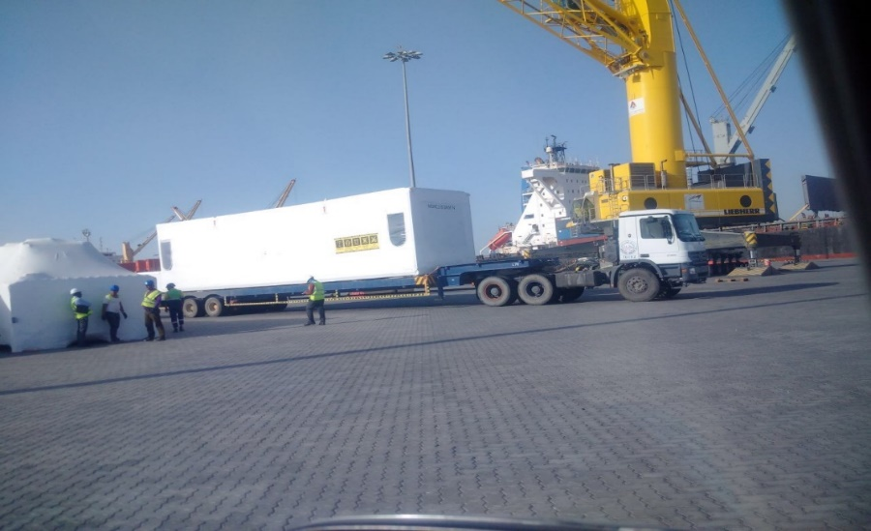
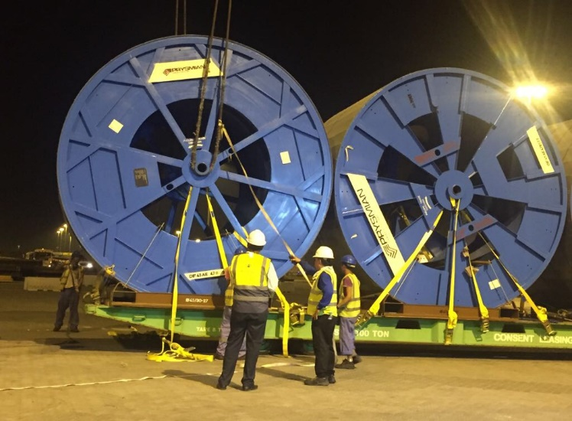
Tunnel Boring Machine – Qatar metro – ALYSJ JV
NPP – New Port Project, Qatar – Emerson
Qatar Water Electricity Project (Kahramaa- Phase-11
Prysmian Cables)

Slide 7
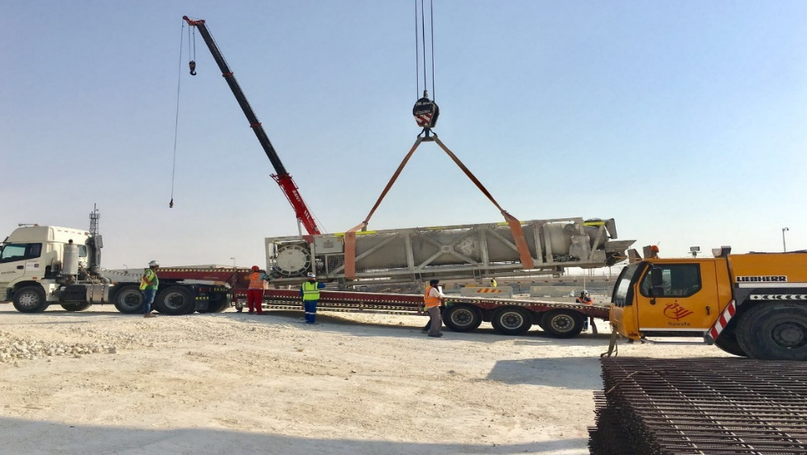
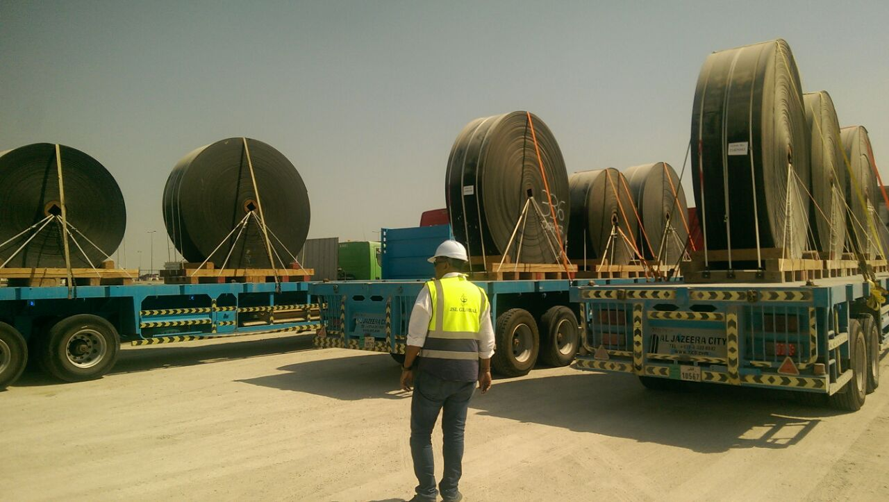
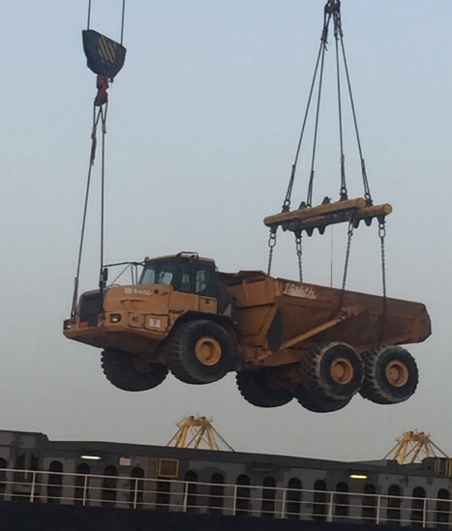
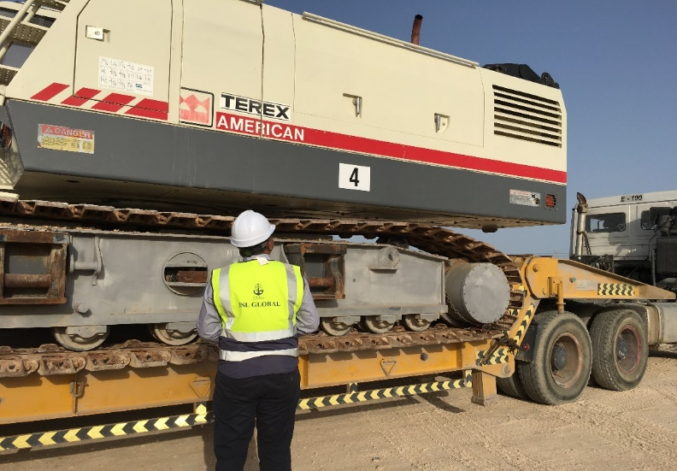
Muck Car – 18 Meter long – Gold Line Metro
Conveyor Belt System – Green Line Metro PORR Qatar
MTH Export Project
Hamad Port to Male, Maldives

Slide 8
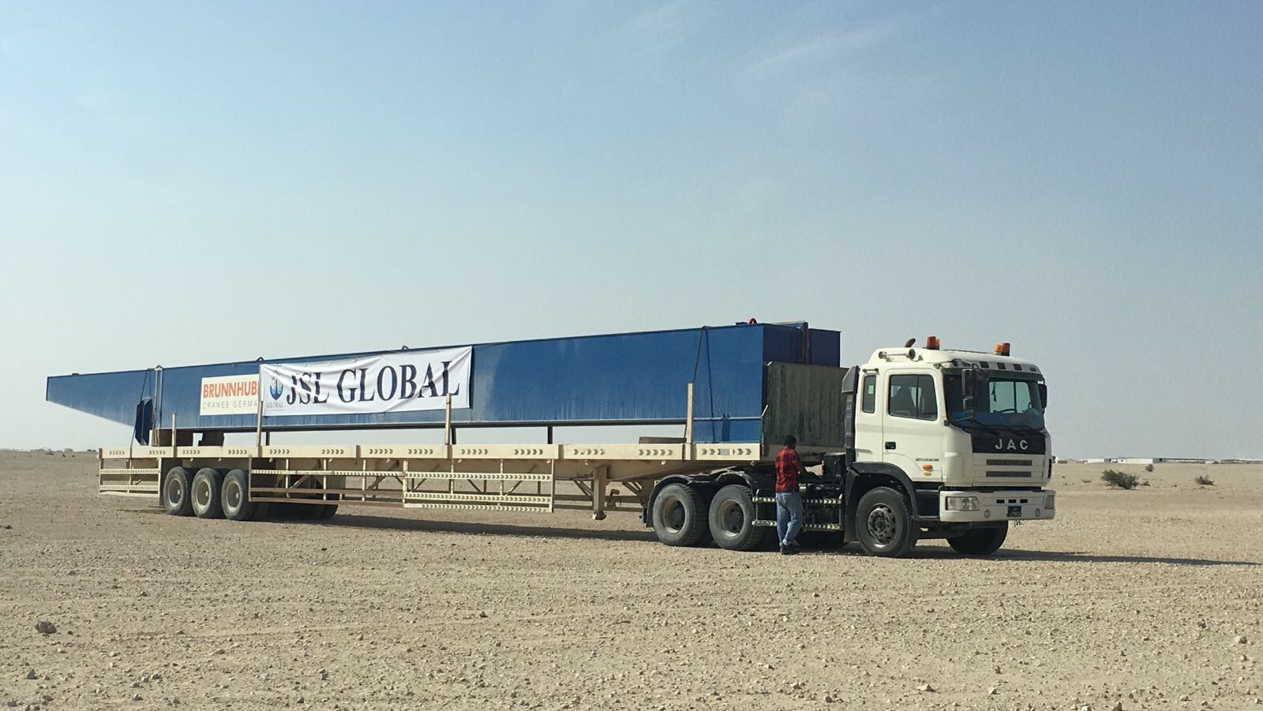
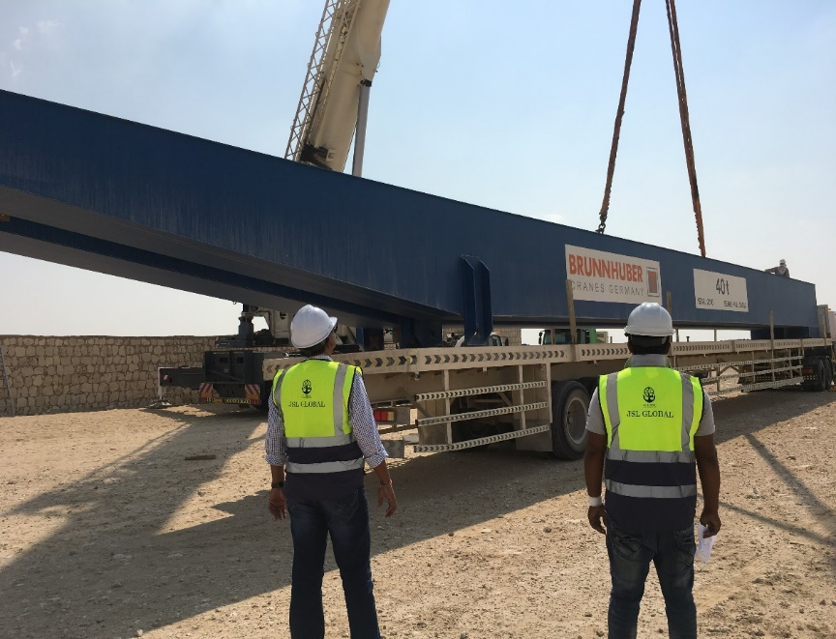
Qatar Sewage project – Idris MTS02 Gantry Crane Girders Export Total 08 pieces
Dimension: 27 meter long each / 30MT

Slide 9
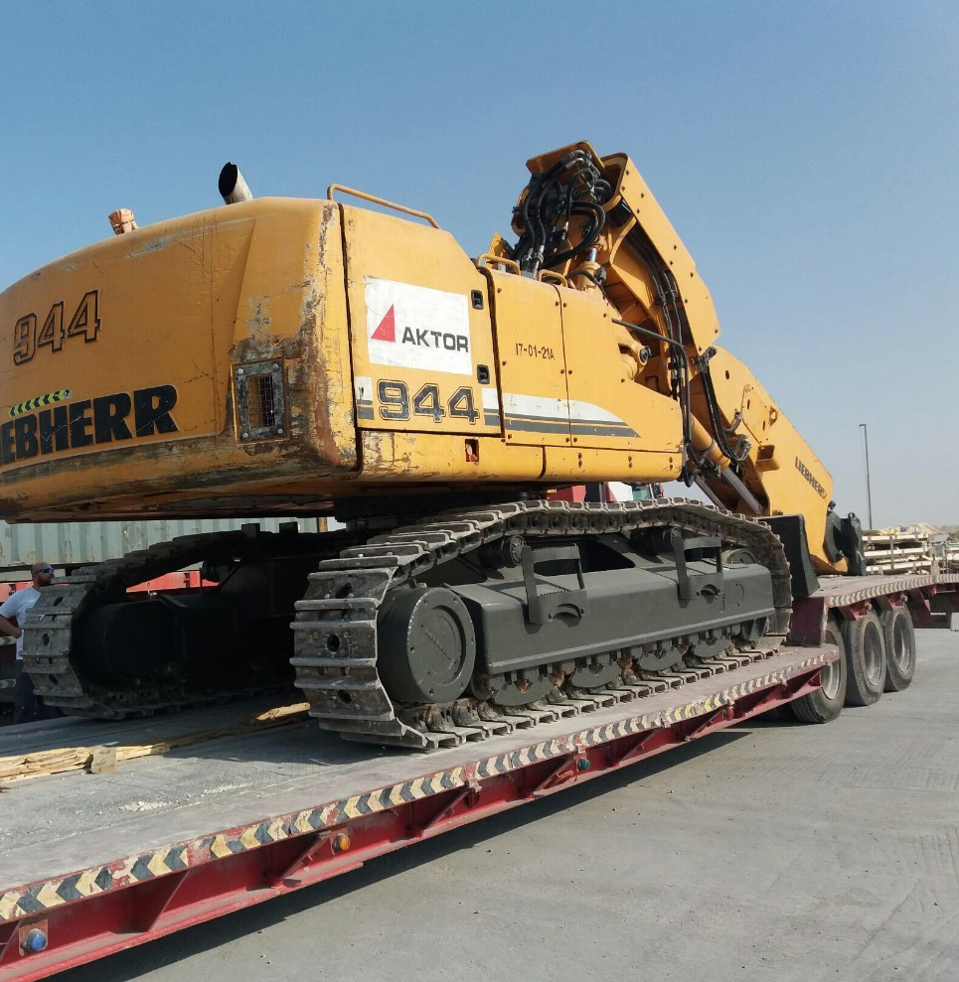
Doha Metro - Gold line
Client: Aktor Qatar 45MT Excavator
Hamad port to Piraeus, Greece RORO Vessel

Slide 10
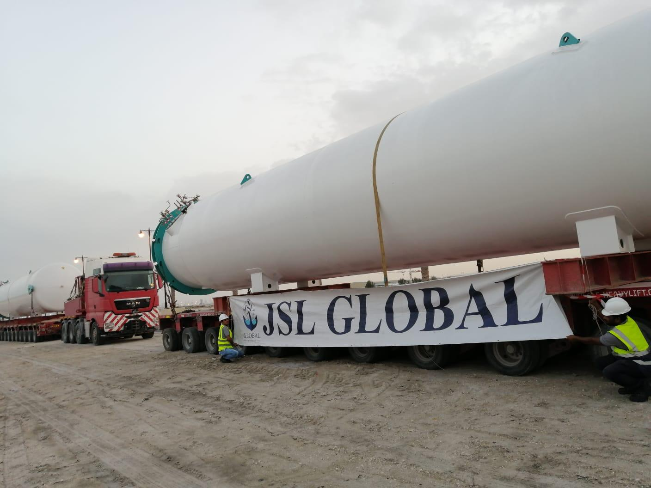
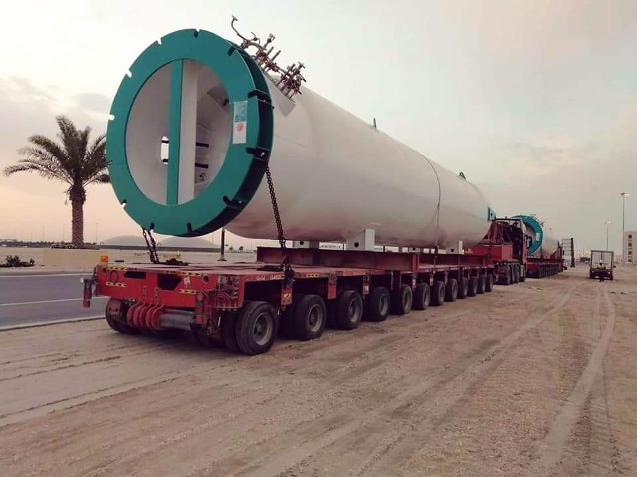
Umm Alhoul Power Plant - Handled 18x3.7x4 meter/ 42MT CO2 tank from Hamad Port to client site.

Slide 11
JSL Global Project Video: https://www.jsl-global.net/project-video/ JSL Global List of Projects: https://www.jsl-global.net/wp-content/uploads/2020/04/JSL-Global-Qatar-Project-Logistics-Experience.pdf JSL Global Summary of Projects: https://www.jsl-global.net/wp-content/uploads/2020/04/JSL-Global_Project-Experience-2020.pdf
Participation in other Groups: PL – Alliance & WWPC

