Slide 1
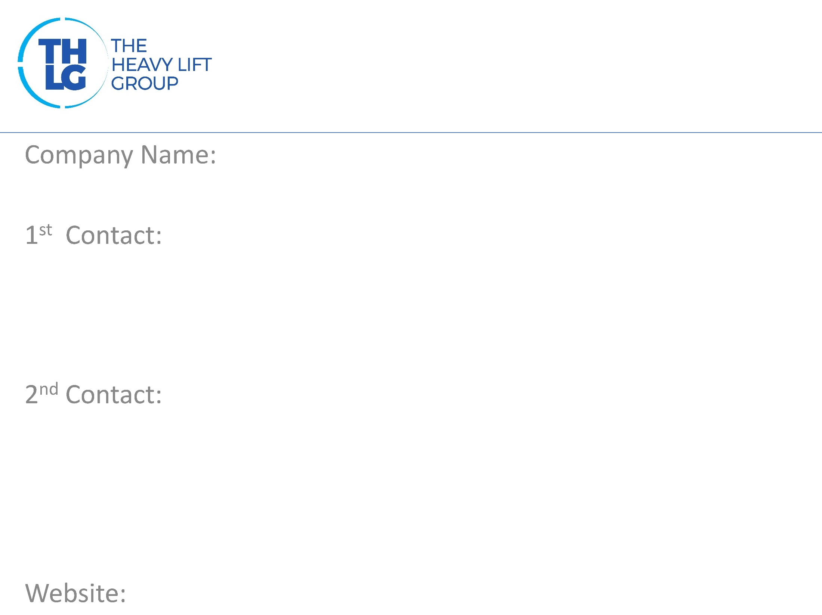
Saudi Arabia
Almajdouie Logistics Co LLC
Eyad Arafah
General Manager
arafahe@almajdouie.com
+966 13 8195310
+966504198825
3rd Contact
for PR and Marketing communication like news, logo etc.
Izaz Ahmed Watangi
Marketing Manager
izaza@almajdouie.com
+966138198251
+966507912676
Rais Ahmed
Commercial Manager
raish@almajdouie.com
+966 13 8198559
+966 508464255
www.mlc.sa

Slide 2
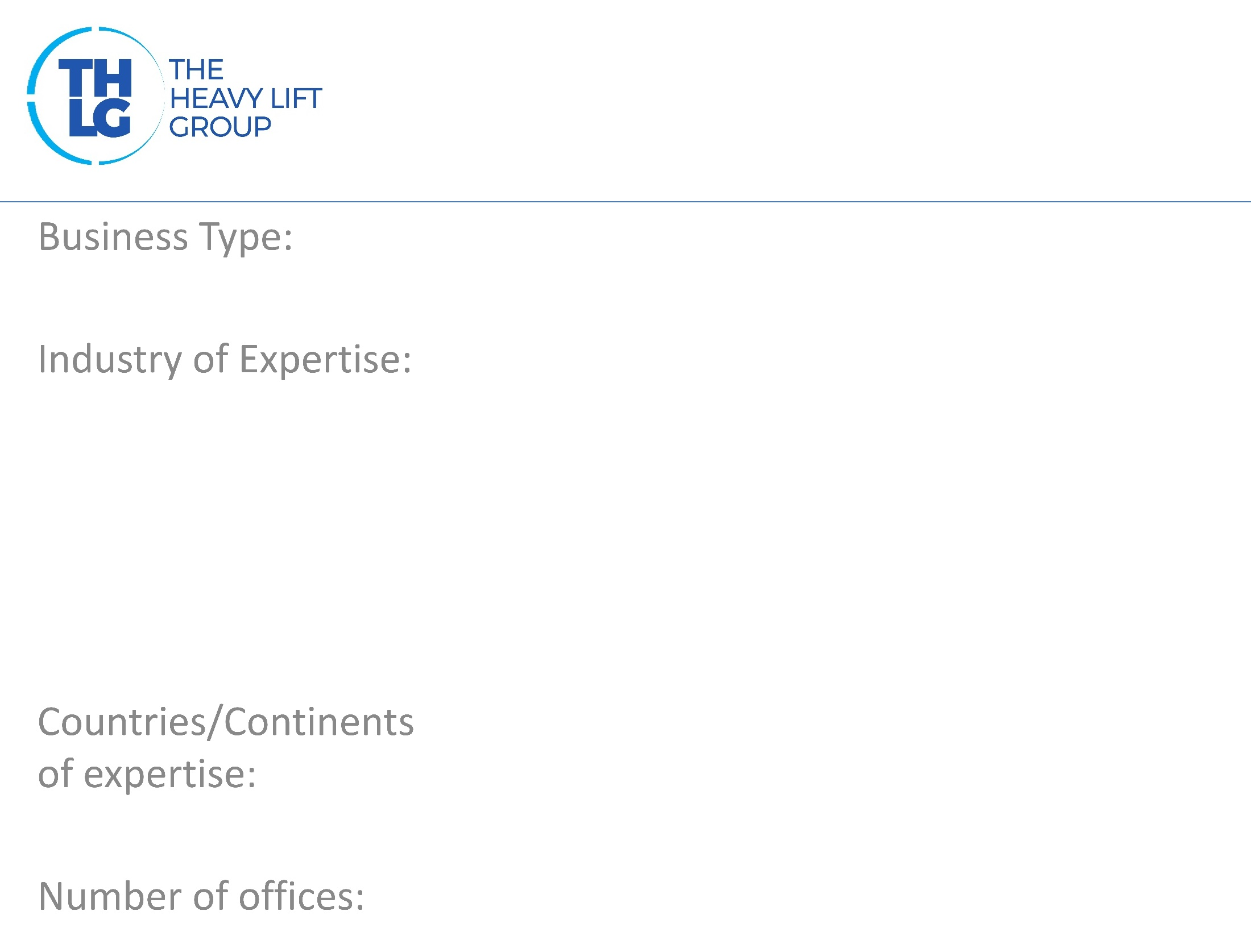
Project Logistics
Oil & Gas,
Petrochemical,
Power & Utility,
Infrastructure,
Renewable energy
Saudi Arabia and other GCC countries
In major cities of Saudi Arabia and in UAE, Oman, Bahrain, Korea

Slide 4
End to End Integrated Logistics Solutions like Transportation, Freight Forwarding, Custom Clearance, Warehousing, Terminal handling and Project Logistics, which includes :
Heavy Transportation
Installation & Engineering and road surveys
Heavy Lifting
Barge Movements
Erections

Slide 5
https://www.linkedin.com/company/almajdouielogistics
https://www.facebook.com/AlmajdouieLogistics/
https://twitter.com/AlmajdouieL
Almajdouie Logistics
Guinness move video :
https://www.youtube.com/watch?v=H3yRGiPyb7A&t=7s
Corporate Video :
https://www.youtube.com/watch?v=zcmedm_czco
Participation in other Groups :
PPG, WCA, WFO,

