Slide 1
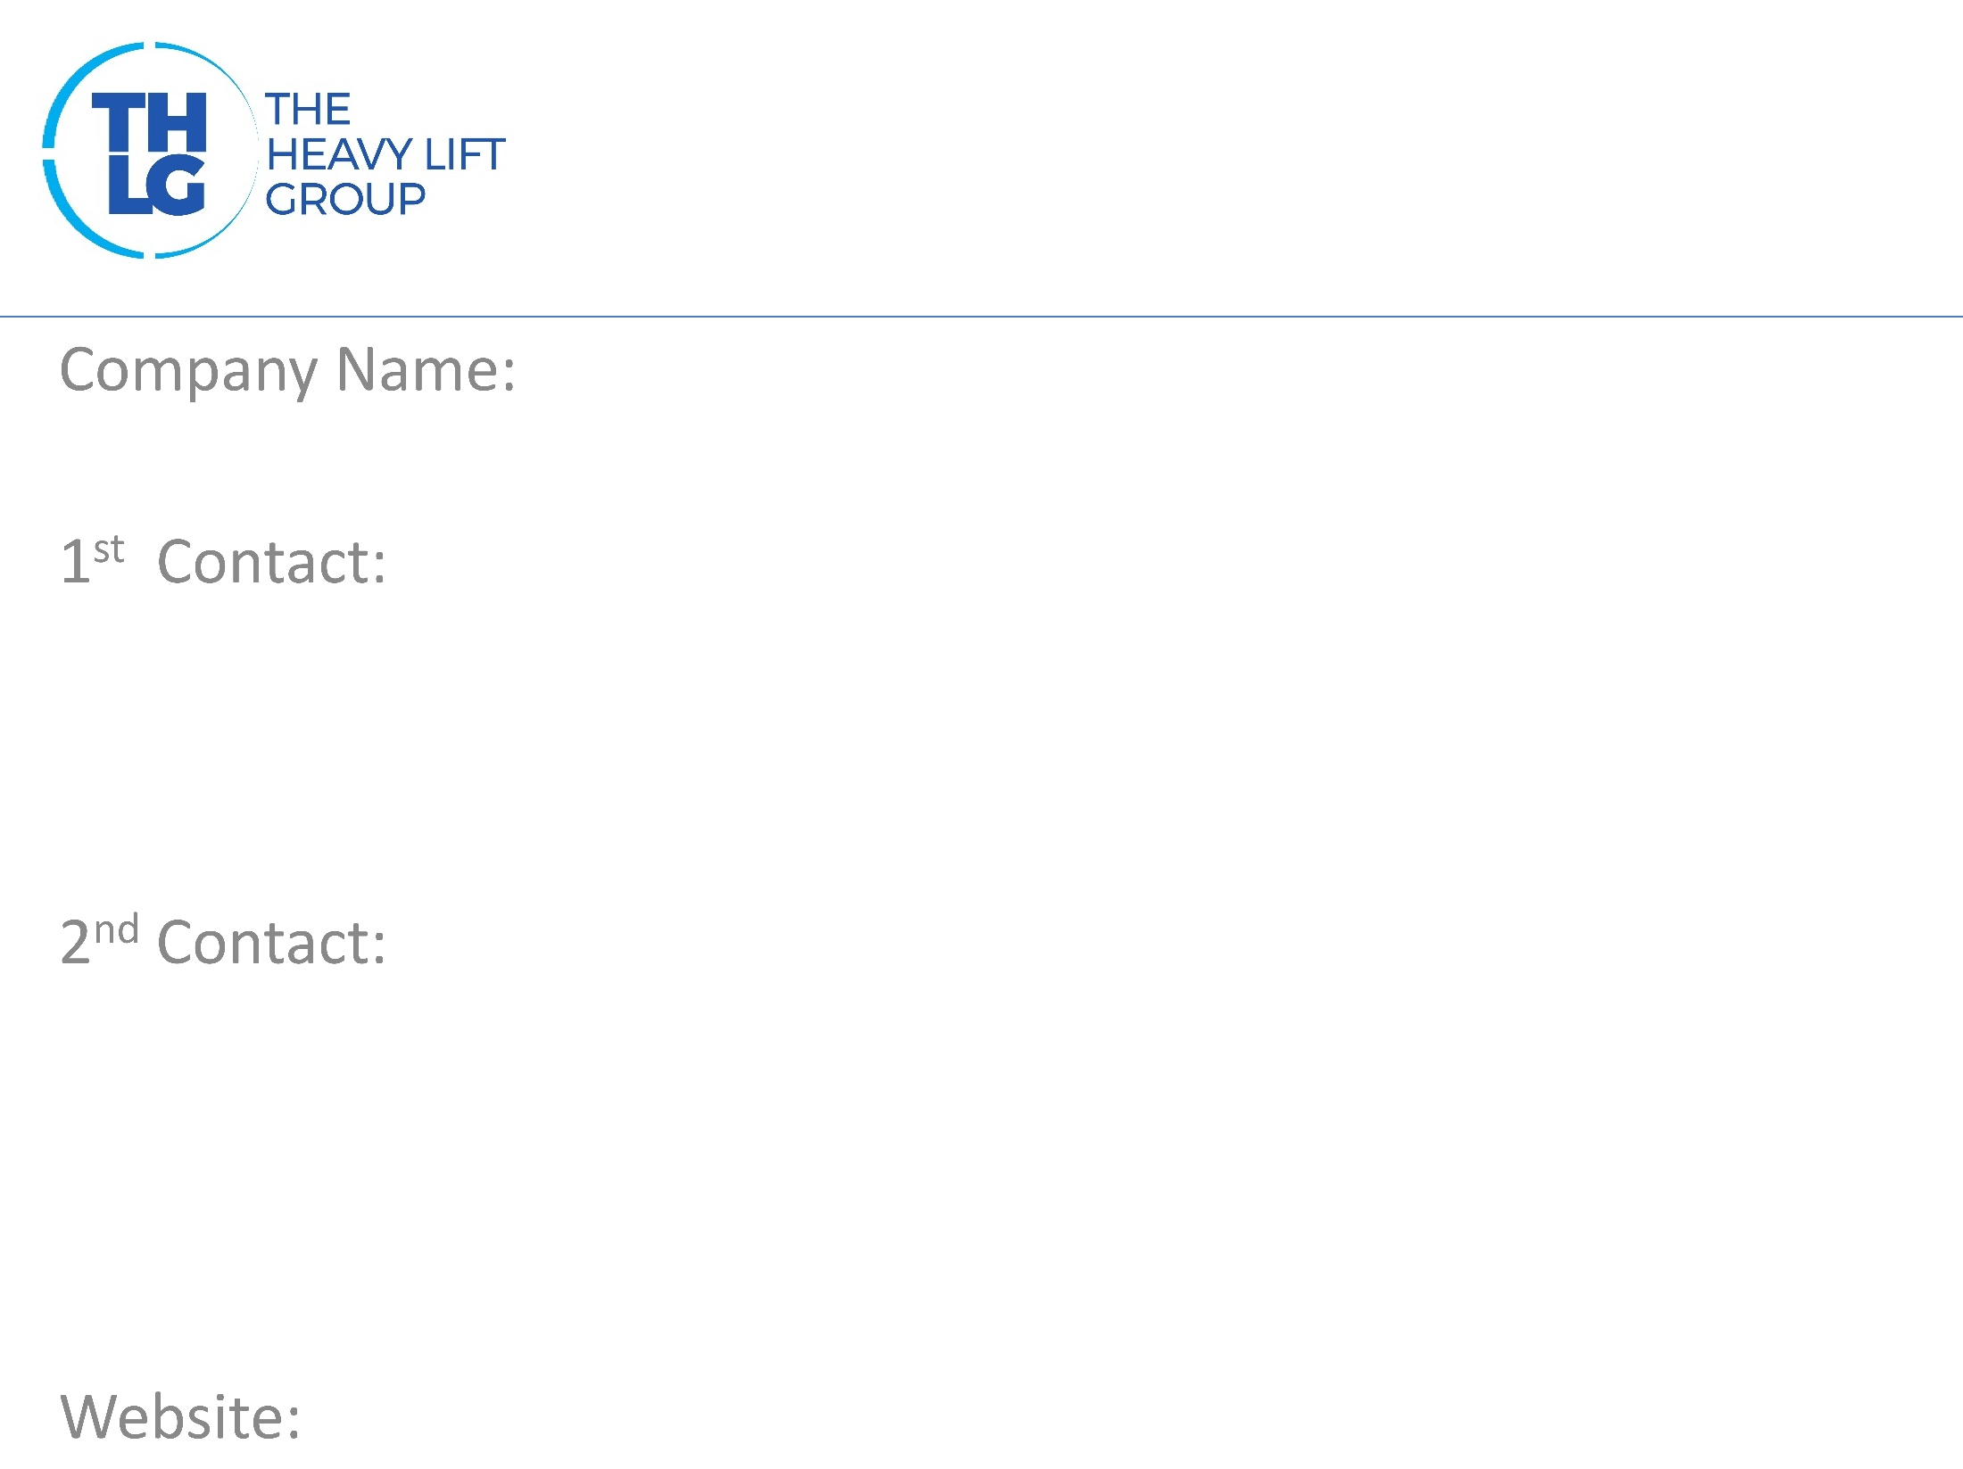
SPAIN THLG member since 1992
DEL CORONA & SCARDIGLI S.L.U.
Mr. Franco Ribechini / Project Director T: +34 932 697 031 M:+34 618 056 940
fribechini@es.dcsfreight.com
www.dcsspain.com

Slide 2
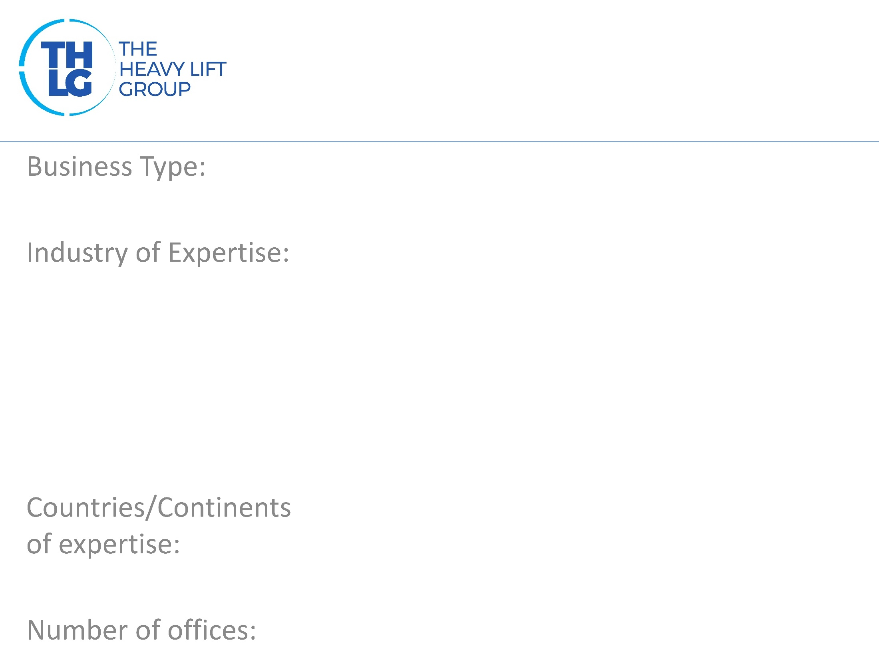
SPAIN THLG member since 1992
Freight Forwarders / Chartering / Ship Agents
Renewable Energies Petrochemical Oil & Gas Infrastructure Mining & Cement Plants Rolling Stock Chemical plants Nuclear Power
Spain, Portugal, Algeria
5 - Spain / 1 – Algeria (commercial office)

Slide 3
SPAIN THLG member since 1992

Slide 4
SPAIN THLG member since 1992
Turnkey: Project logistic concept analysis Technical route and infrastructure survey Vessel and Aircraft Chartering Shipbrokers Port handling operations Abnormal road transport Warehousing Special packaging L/S/D services Operations survey reports Sea, Air and Rail Freight Customs clearance service, AEO Fiscal customs consultancy Domestic and Worldwide insurance coverage

Slide 5
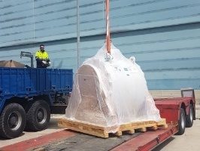
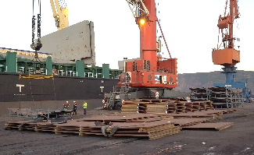
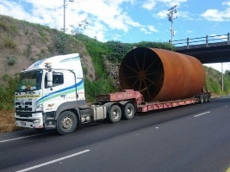
SPAIN THLG member since 1992
Join us on social media
Oil & Gas
Project Cargo Expertise
Petrochemical
Cement Plant
Read all about our projects:
Participation in other Groups:

