Slide 1
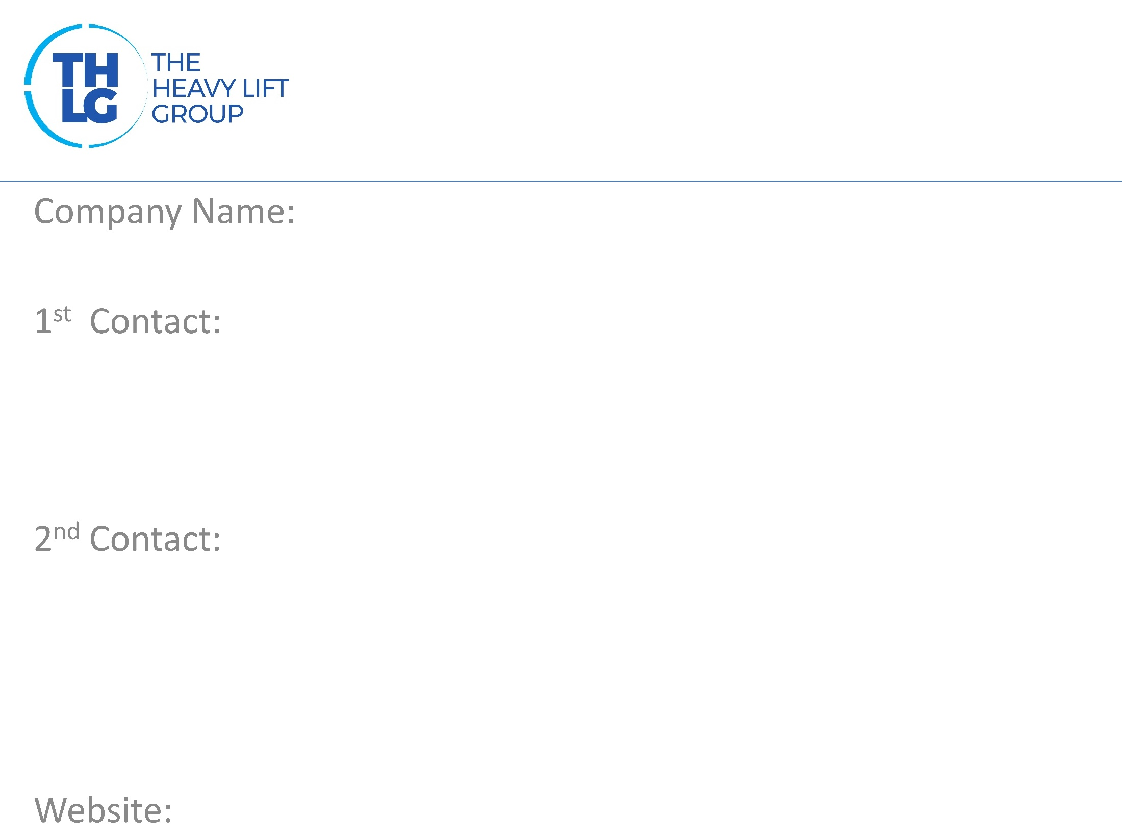
UK THLG member since 1997
Allelys Heavy Haulage Ltd
Mr. David Allely / Managing Director T: +44 (0) 1527 852408 / Option 3 david.allely@allelys.co.uk
Mr. Charlie Latham / Head of Tendering & Business Development T: +44 (0) 1527 852408 / Option 2 projects@allelys.co.uk
www.allelys.co.uk

Slide 2
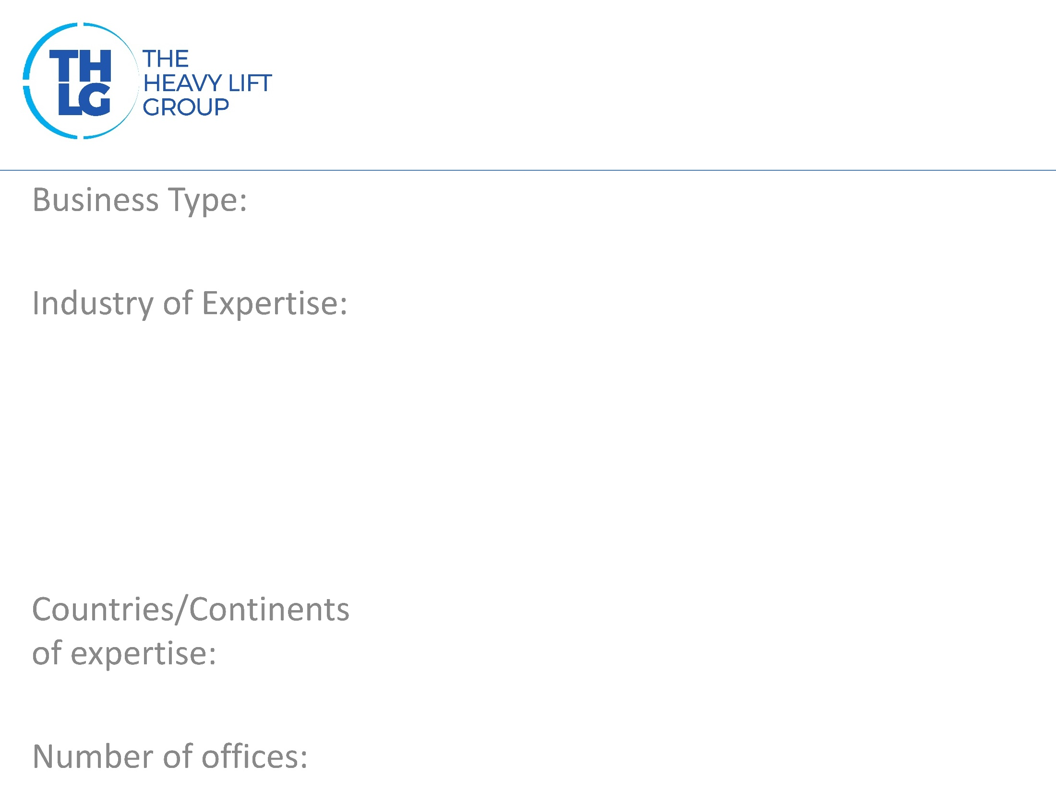
UK THLG member since 1997
Heavy and Specialist Transport & Lifting
Factory to Foundation Project Cargo Power Industries Oil & Gas Machinery Movements & Factory Relocations Rail Movements Port
UK & Ireland
1 - UK

Slide 3
UK THLG member since 1997

Slide 4
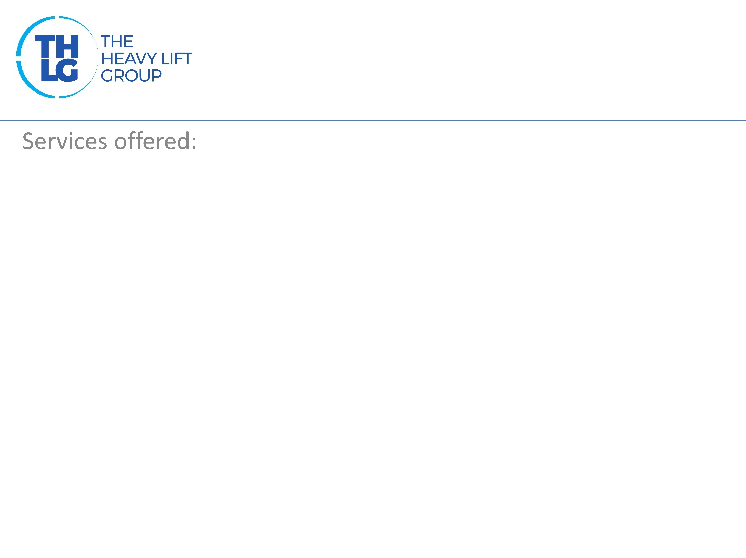
UK THLG member since 1997
Factory to Foundation Project Cargo. Specialist UK Road Transport up to 500t. Heavylift cranes up to 1000t. SPMT specialist movements. Port load outs. Full project planning, management and execution. Route surveys and swept path engineering. Machinery movements and factory relocations. Rail movements.

Slide 5
UK THLG member since 1997
Join us on social media
Participation in other Groups:

